Slide 1
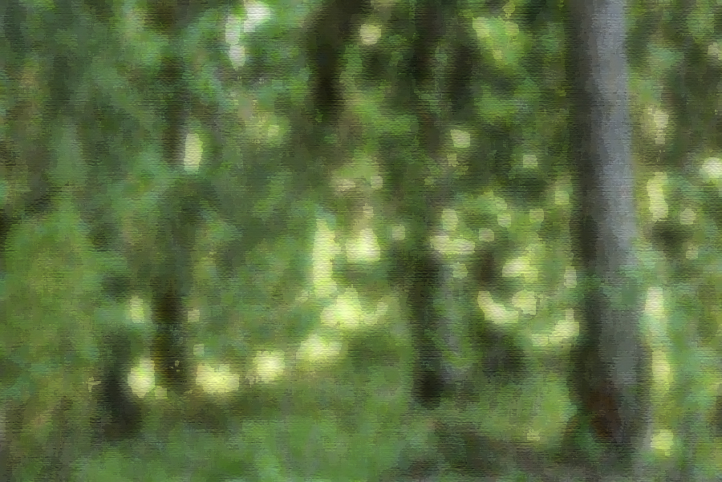
Finnish plant microbiome
Let’s go hunt microbes!

Slide 2
Choosing the sampling site
An easily accessible site (forest) near the school
Pine, spruce, bilberry, lingonberry
Choose the sampling site(s) withing the forest to avoid the influence of neighborging biotopes

Slide 3
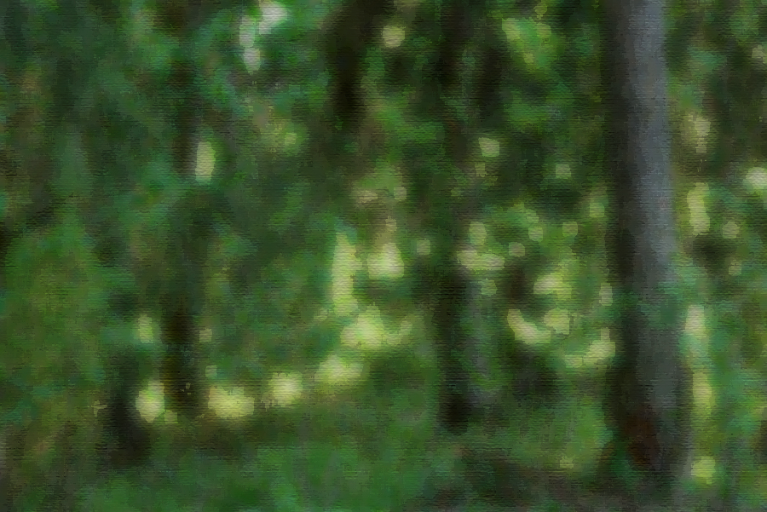
The project investigates MICROBIOMES of four plant species: pine, spruce, bilberry and lingonberry. We will chart the microbial inhabitants of our familiar forest species in different seasons. Currently these microbiomes are unknown - you will be the pioneers in this research front ☺

Slide 4
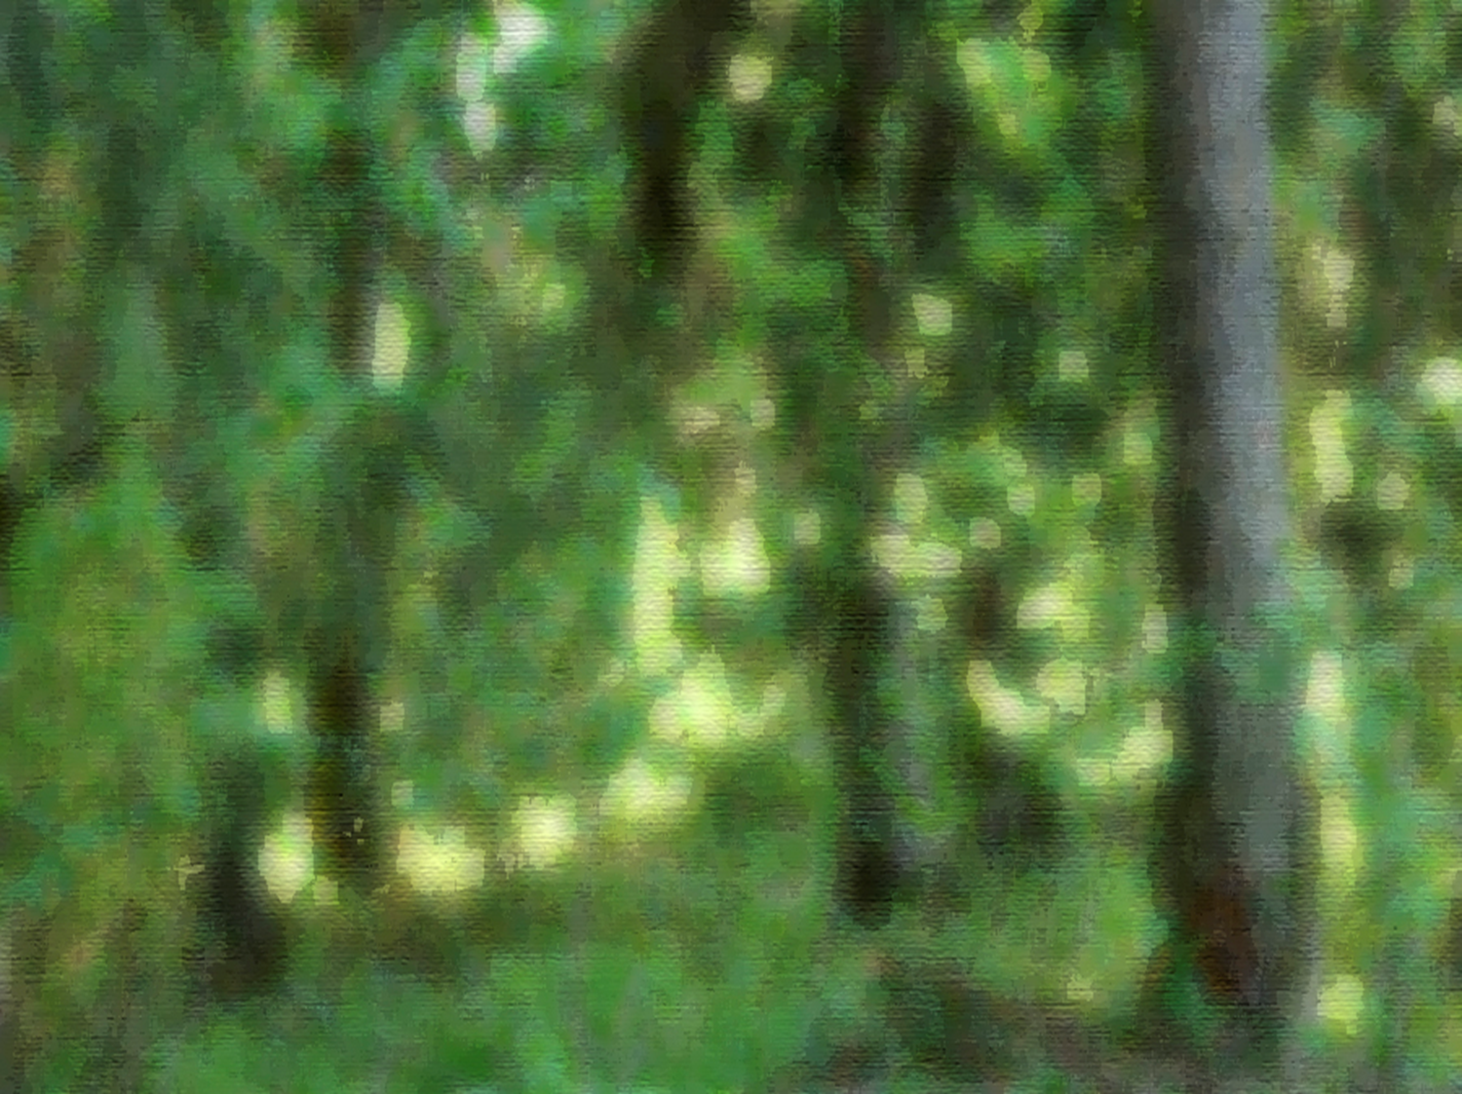
PINE Pinus sylvestris

Slide 5
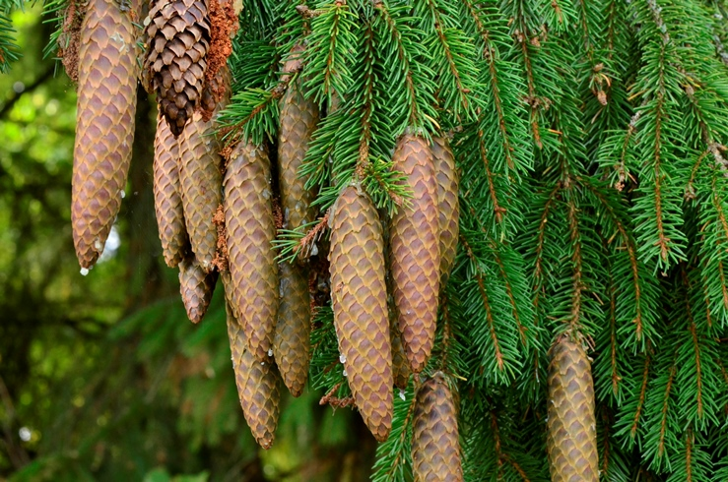
SPRUCE Picea abies

Slide 6
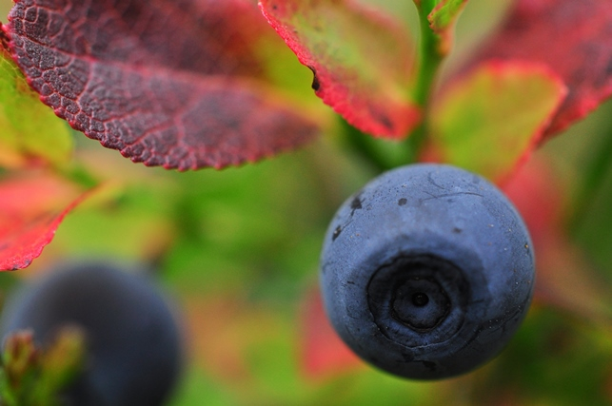
BILBERRY Vaccinium myrtillus

Slide 7
LINGONBERRY Vaccinium vitis-idea

Slide 8
Sampling equipment (1/2)
1 L sampling bags for samples, 16x (4 bags per plant species)
Optional: 16 sample bags for plant samples for leaf tissue print samles and microscope samples (plus microsope)
Markers for bags
Clean gloves and scissors (4 x) for sampling
Alcohol wipes for scissors
compass
Temperature meter
Temperature logger (to be buried at 10 cm depth in August)
Light meter

Slide 9
Sampling equipment (1/2)
Samling instructions for different tasks
Data forms, pencils
cooler
Cold blocks, frozen
Ice cube bags, filled and frozen, August: red marking ribbon
Marking poles (esim. aurauskeppi) for bilberry and lingonberry
Garden shovel and four sample bags for soil sample
February: snow shovel and measuring tape for measuring snow depth
Camera(s)/phone(s) with camera
NOTE: the underlined equipment are NOT included in the sampling kit, but must be provided by the schools.
Remember to freeze the cold b locks beforehand

Slide 10
Sampling: in total 8 tasks 4 plant samplings 1 soil sampling 3 other tasks plus optional microbial cultures from plant surfaces, microscopy !

Slide 11
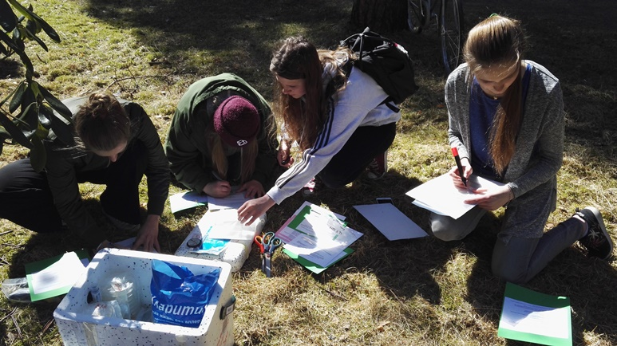
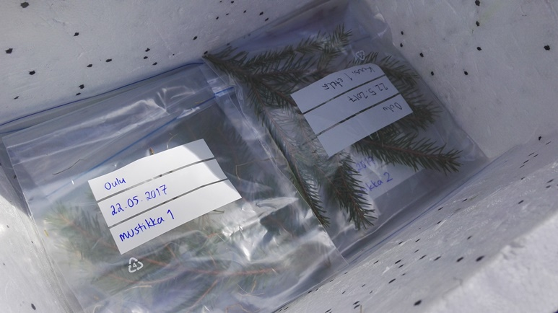
Plant sampling Leaf samples from pine, spruce, bilberry, lingonberry for microbiome analysis – detailed instructions in the instruction cards!

Slide 12
Other tasks - detailed instructions in the task instruction cards!
1. Soil sampling (for pH and nutrient levels)

Slide 13
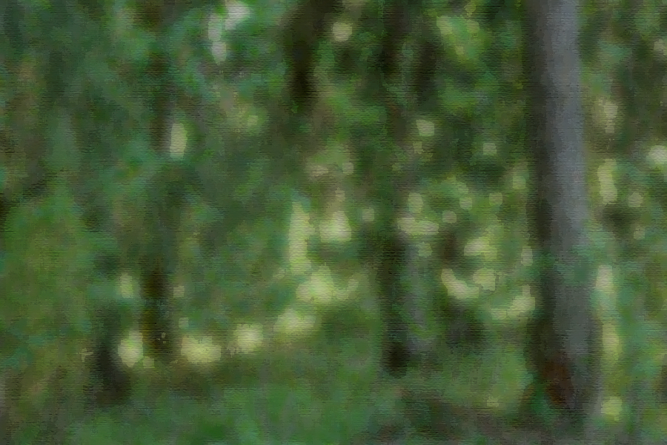
Other tasks - detailed instructions in the task instruction cards!
2. Sampling site metadata
3. Temperature measurements,
data loggers in the site(s)
4. Light measurements
+ Optional:
Microscopic observations of leaf surface structures,
leaf tissue prints for microbial cultures

Slide 14
Leaf tissue prints = bacterial culture plates
If you have time, you can prepare leaf tissue prints at school (or at site) to culture leaf surface microbes on agar plates
Agar plates (R2A bacterial culture media, solidified with agar agar), 16 pcs plus some extra ones for mishaps
Clean paper for sample preparation prior to culture
Tape for securing the plate lids

Slide 15
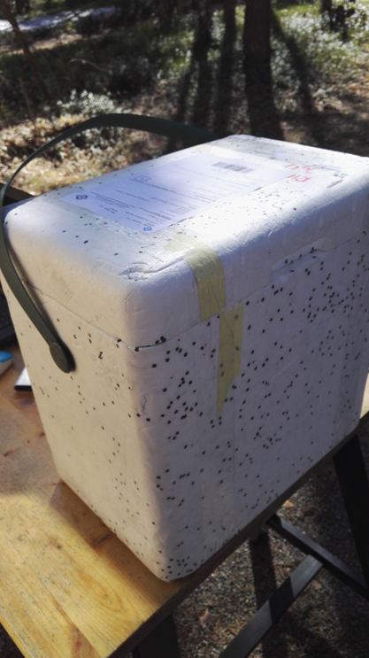
What happens to the samples?

Slide 16
At the Jyväskylä University…
…Next slide set: studying microbes….

