Slide 1
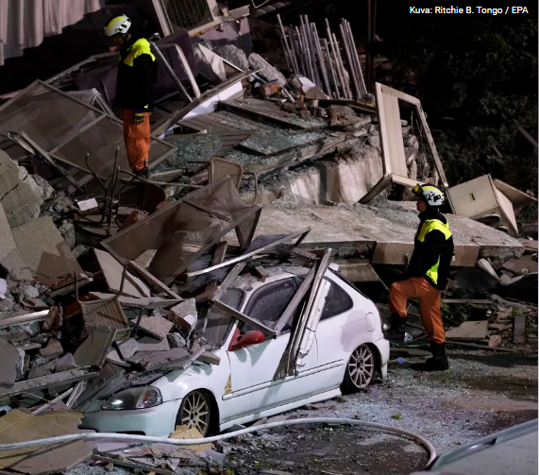

.
.

Slide 2
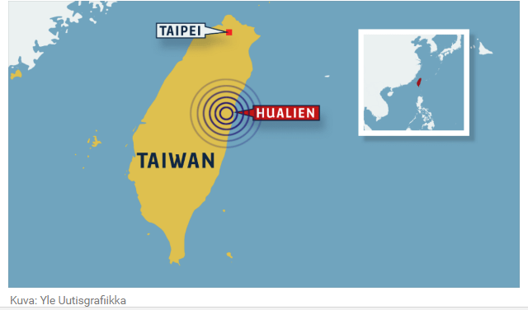
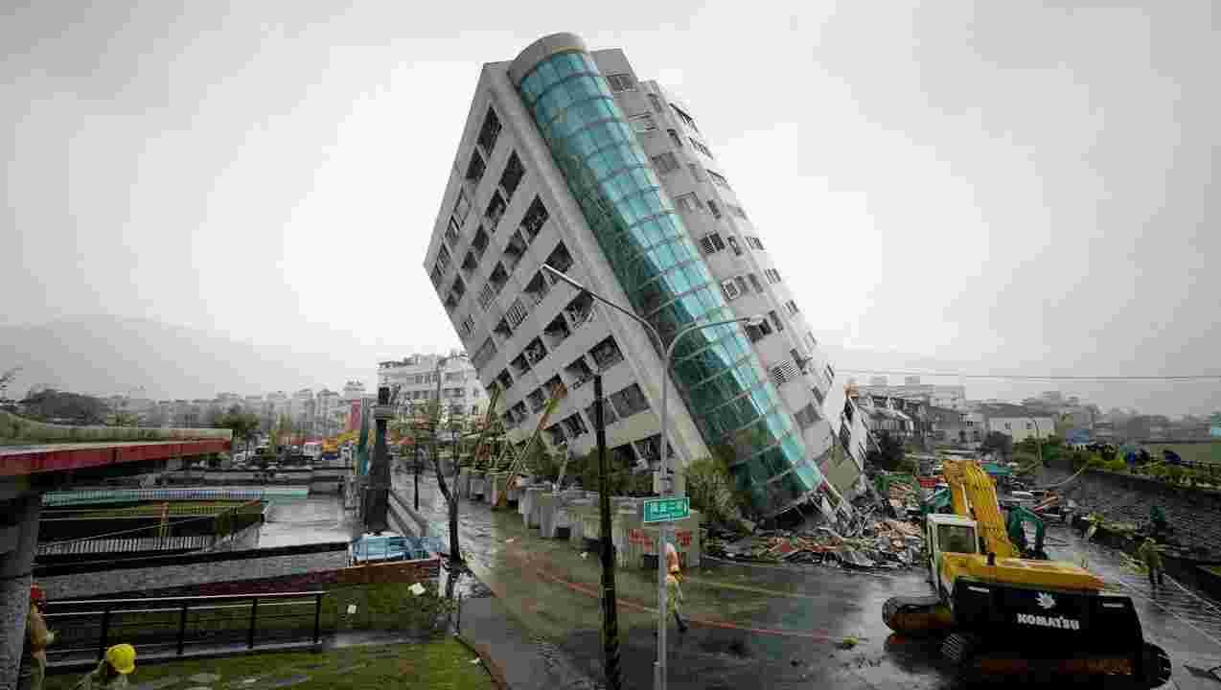
_
Taiwan earthquake occured seventh day of February this year in the early morning (1AM) Rumors tell that four died and over 200 injuries. There are still 145 individuals missing.
There was also 10 waves of earthquakes.

Slide 3
Websites used:
https://yle.fi/uutiset/3-10062457

