Slide 1
Language, media and communication

Slide 2
Within the frames available, we
are focusing extra attention on:
Language - Swedish, English, German, French and Spanish
Mathematics and science
Art, music and movement

Slide 3
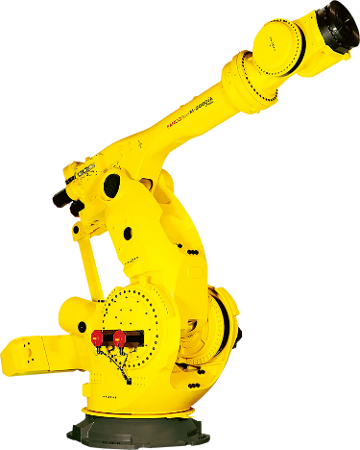
Our profile languages

Slide 4
Our profile languages
English from pre-school class
Grade 1-3 Spanish, French, German
Grade 4-9 immersion in one language
Grade 7-9 student’s choice: Mandarin, conversational English, robot programming or media communication

Slide 5
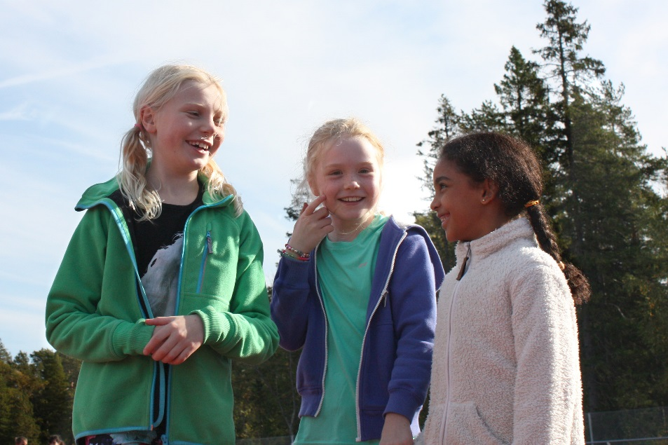
Communication
The students practice oral and written communication
Converse
Explains
Argues
Presents
Debates
Express themselves

Slide 6
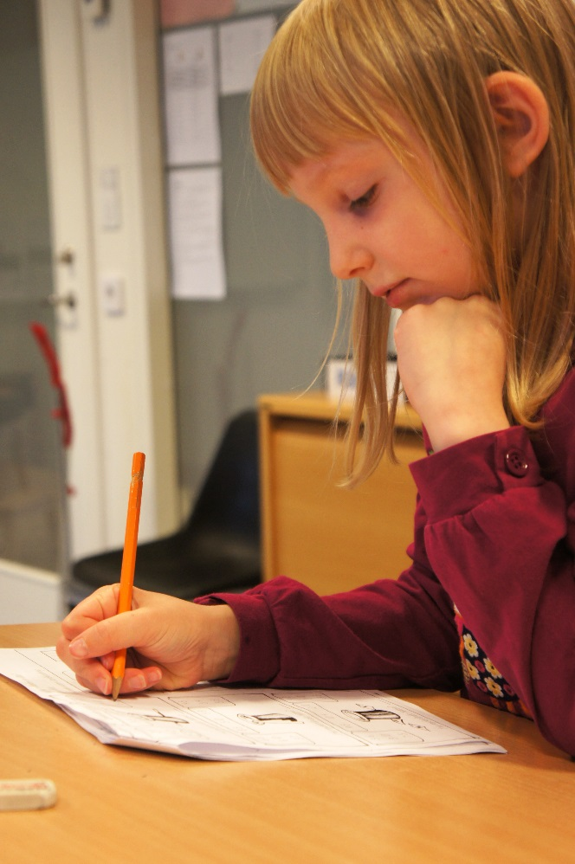
Individualization
The teaching is adapted to each student, their knowledge, experience, background and needs.

Slide 7
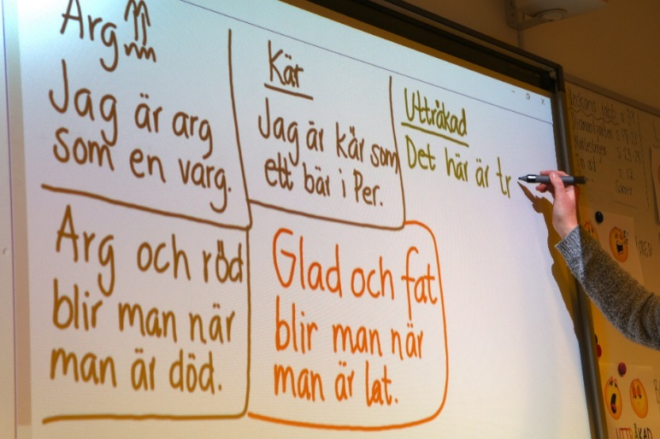
Various ways of learning
Practically
Theoretically
Art
Music
Movement
Drama

Slide 8
Comparison Språkskolan’s timetable with guaranteed hours

Slide 9
Economic Association
Språkskolan is run as an economic association without profit interests, any surplus is returned directly to the association.

Slide 10
Our students thrive!
 | Grade F-2 | Grade 3-9
1. Teaching | 100 % | 98 %
2. Lessons | 100 % | 95 %
3. Teaching material | 100 % | 89 %
4. Study results | 100 % | 98 %
5. Influence | 100% | 93 %
6. Treatment | 100 % | 98 %
7. Forms of study | 100% | 97 %
8. Homework | 100% | 96 %
Overall assessment | 100 % | 96 %
Comment: The response alternatives refers to positive results as satisfied/quite satisfied and good/pretty good. The numbers are rounded to the nearest whole number.

Slide 11
Unique pre-school class
Literacy preparatory activities
Alphabetical/letter exercises
Activities to provide a basic mathematical understanding
A lot of English, in a playful way
Social practice and life skills
Play and movement as a natural part in all subjects

Slide 12
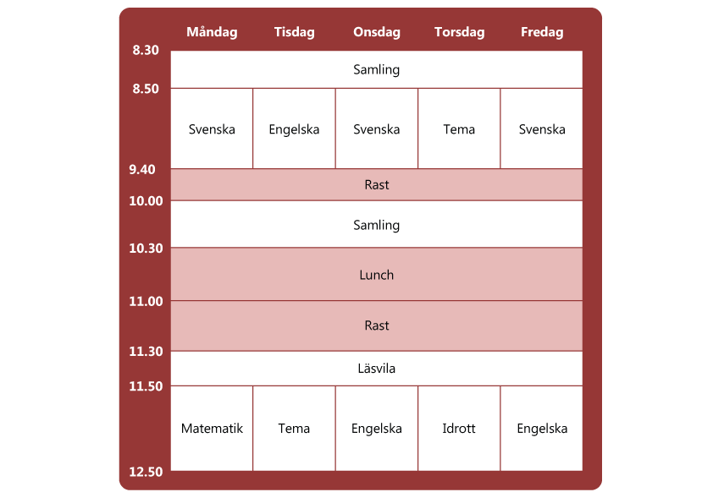
Schedule for the pre-school class

Slide 13
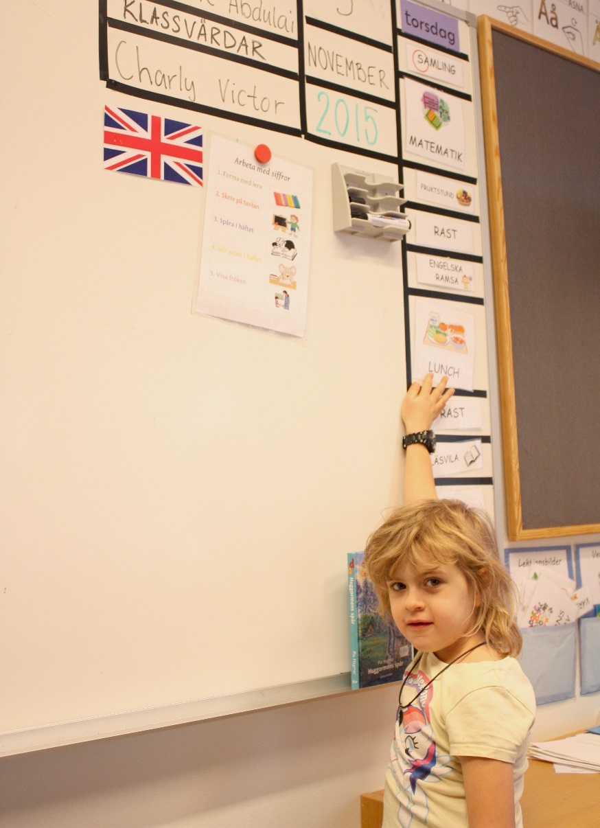
Morning assembly and
a structured day

Slide 14
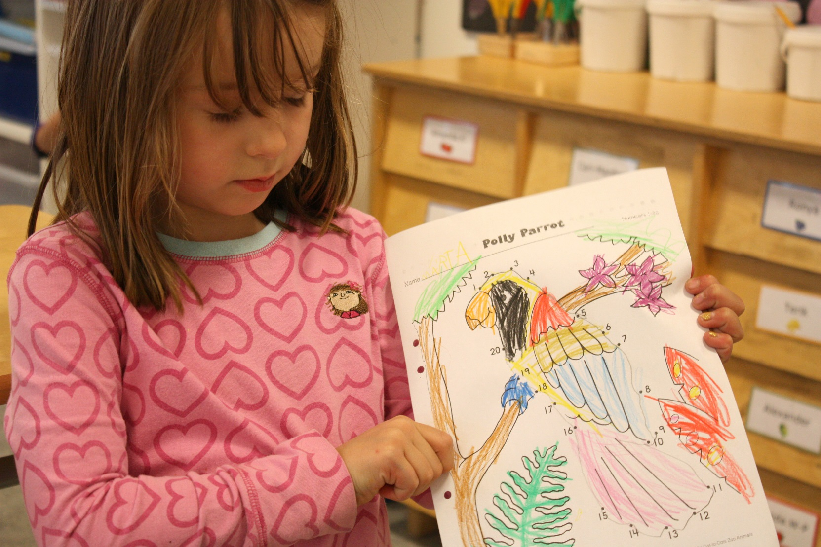
Mathematics

Slide 15
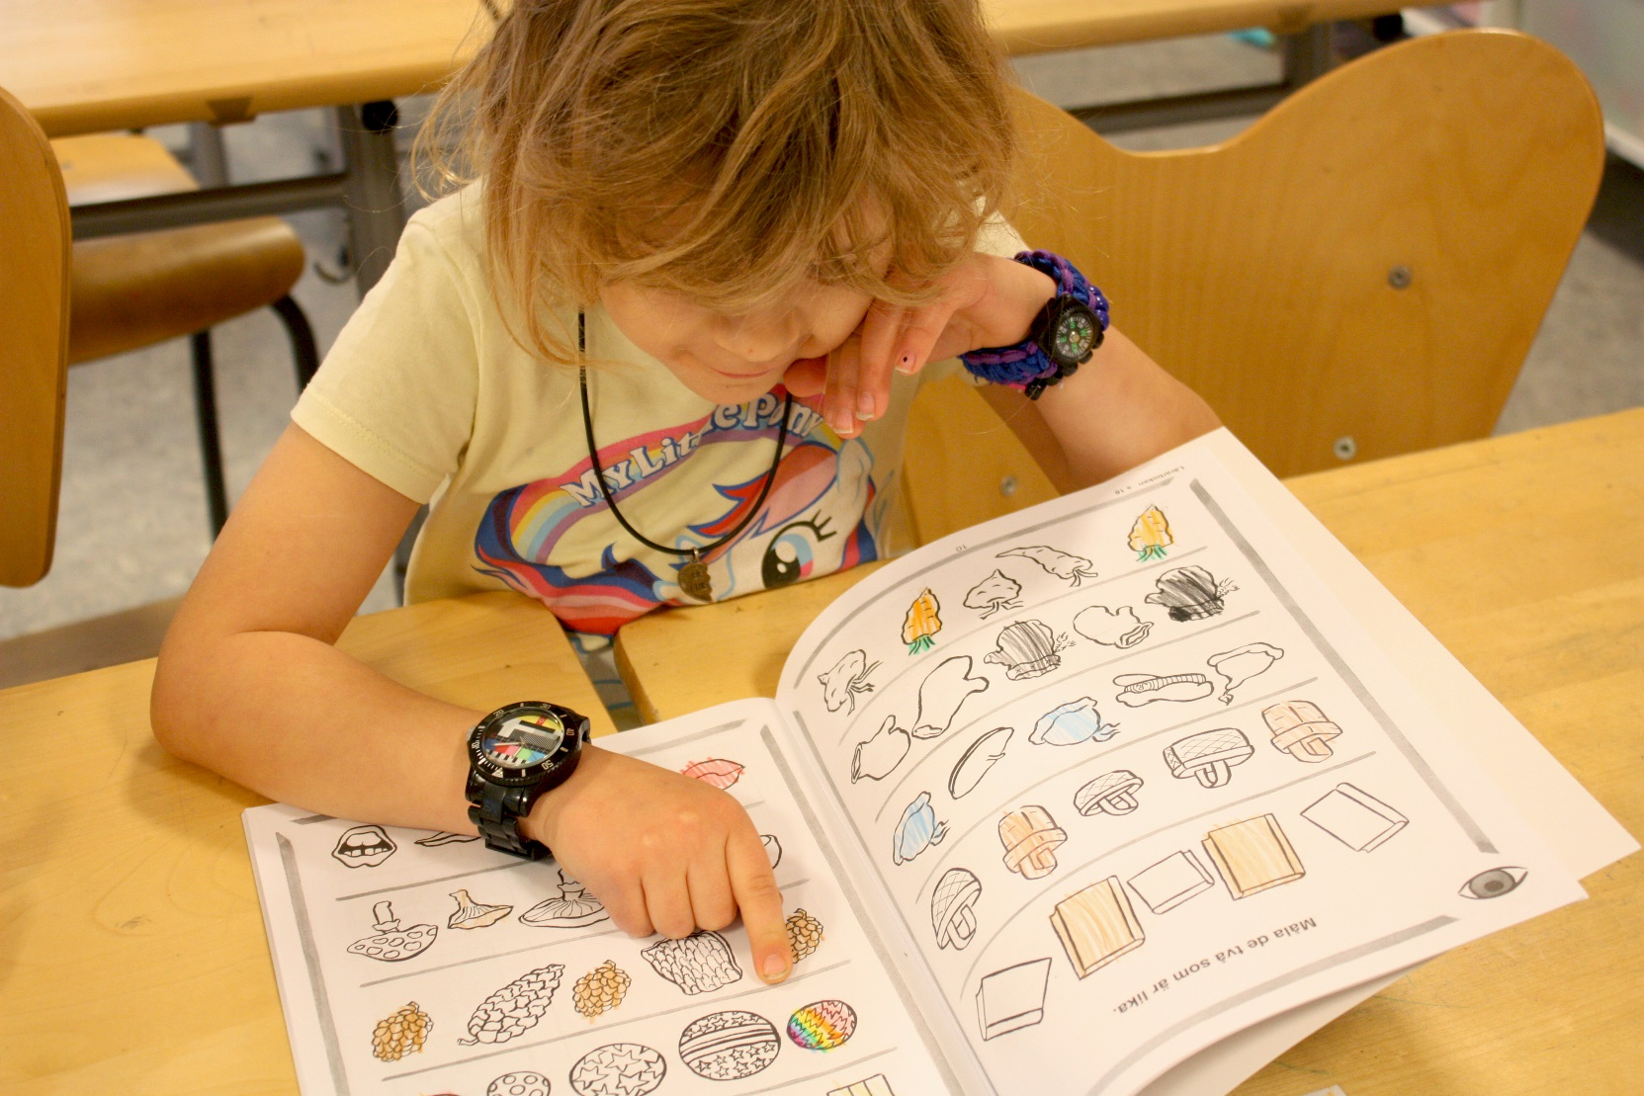
Swedish

Slide 16
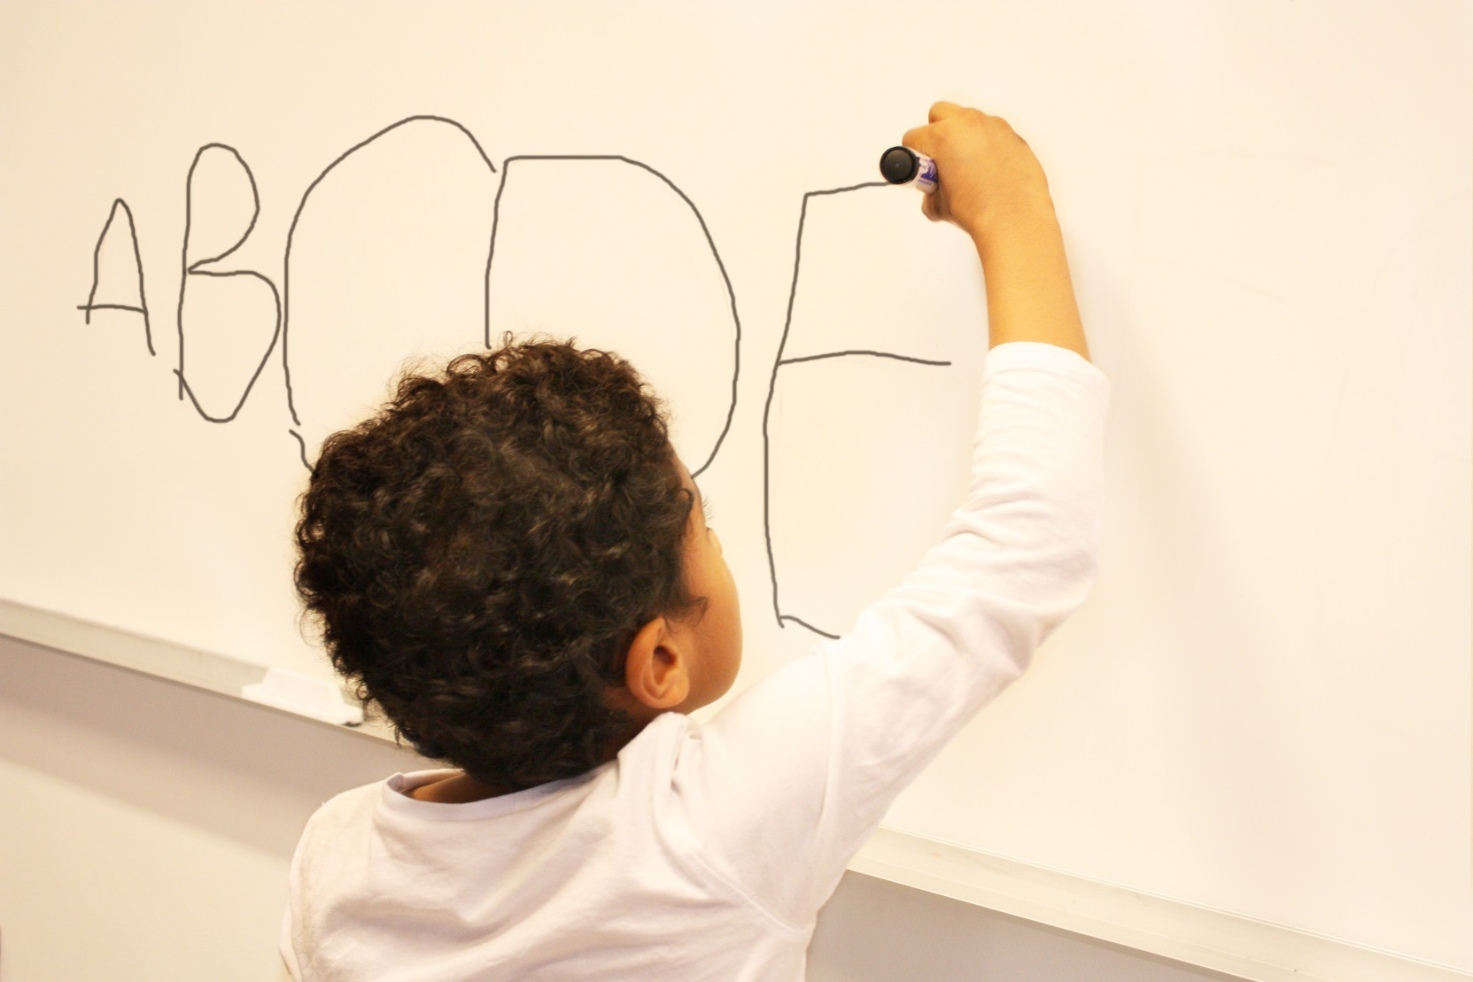
Letter of the week

Slide 17
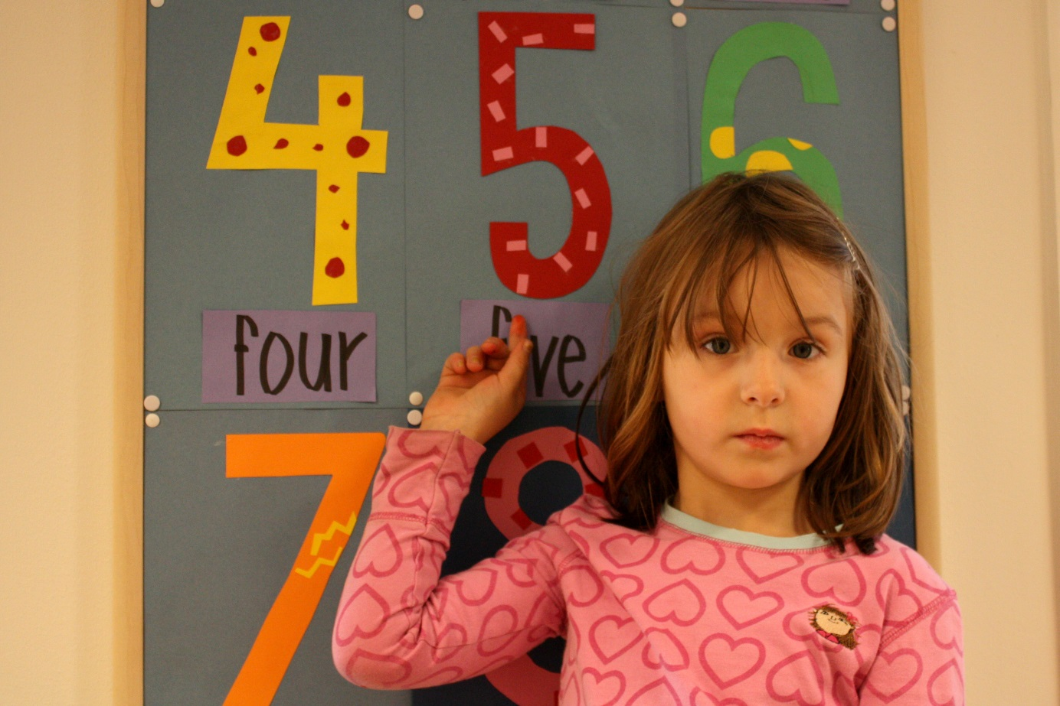
English
We sing, play practice words, learn rhymes and craft.

Slide 18
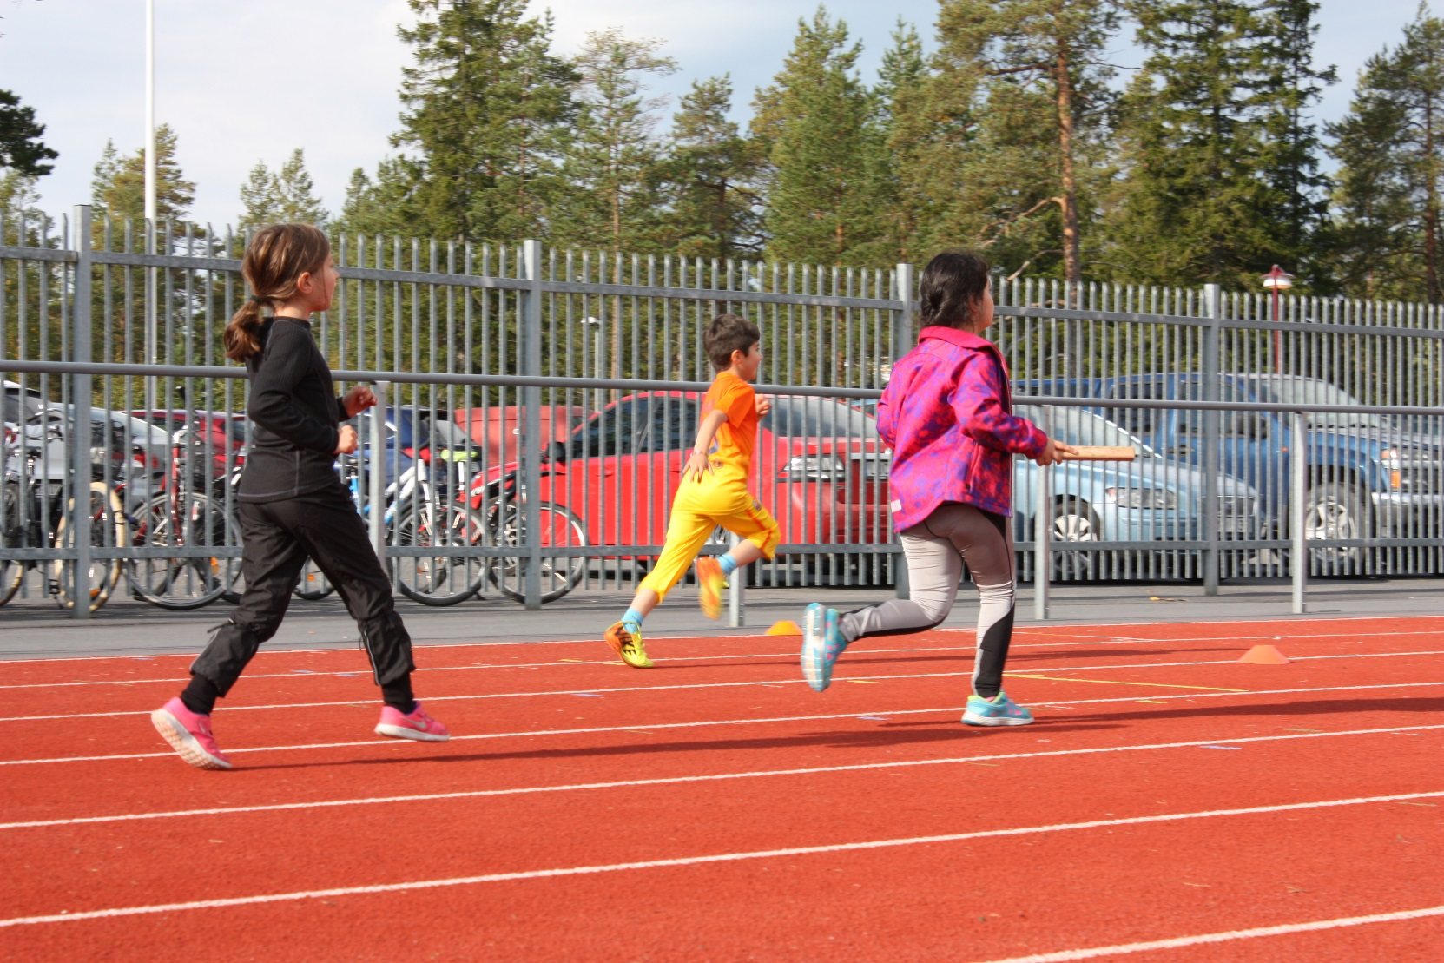
Physical Education

Slide 19
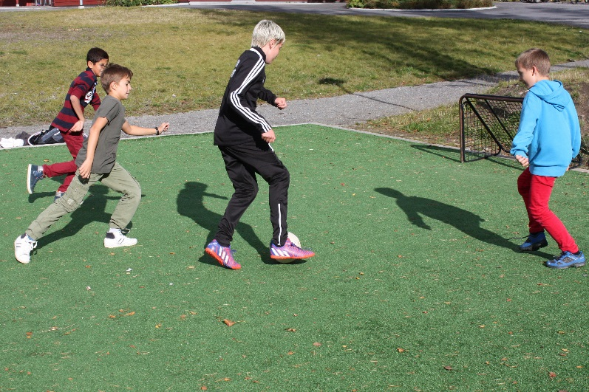
The world’s best after school care
Educational activities
High staff density
Daily outside activities
Planned activities every day
The children practice responsibility
Varied activities with play, sports and calmer activities of a creative nature

Slide 20
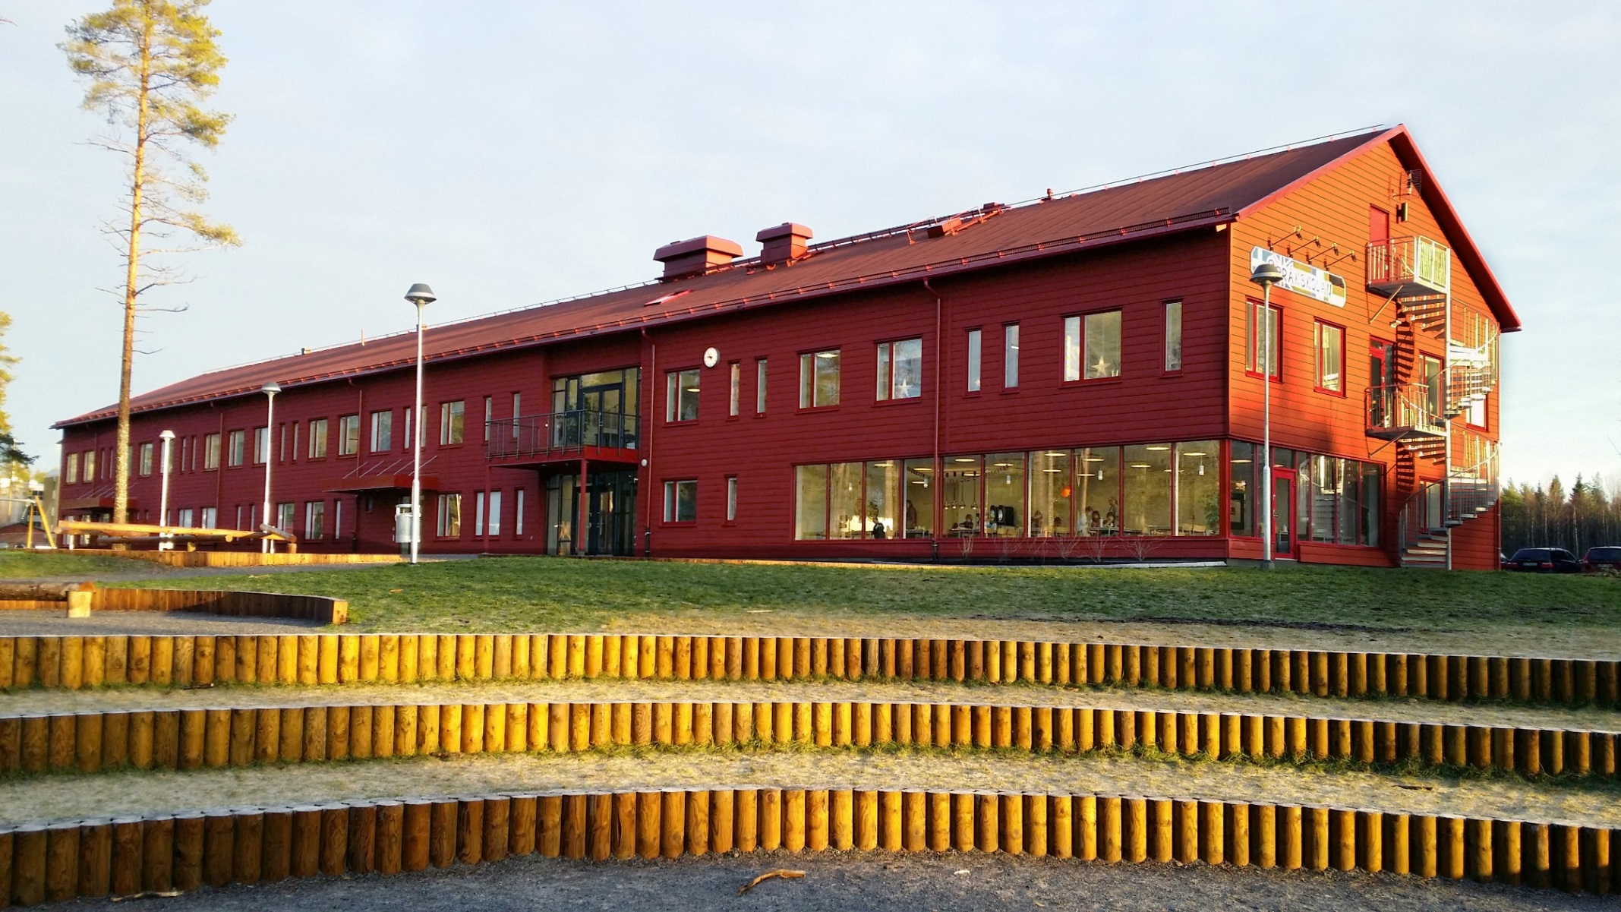
Språkskolan
Complete primary school from pre-school to grade 9
Newly built, modern, bright and fresh
New, bigger school yard

Slide 21
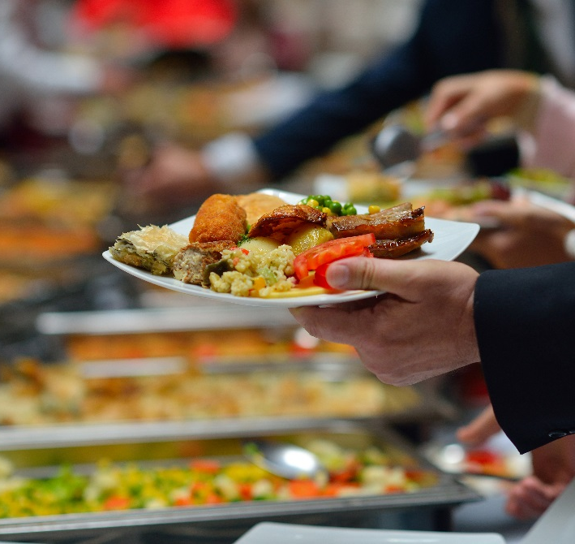
Food from our own kitchen
Good and nutritious food
makes students more alert
A lot of organic and locally
produced ingredients
Bigger possibility for
origin control
Less processed foods
Reduced transports

Slide 22
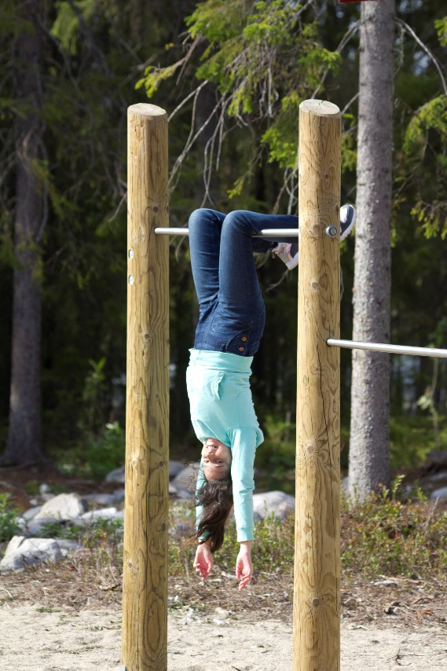
This is why you should
choose Språkskolan!
Early language learning
Proficient in English
Smaller groups – more teachers
Good learning environment
High level of knowledge
Good conflict management – safe children
Individualized
All children are seen!

