Slide 1
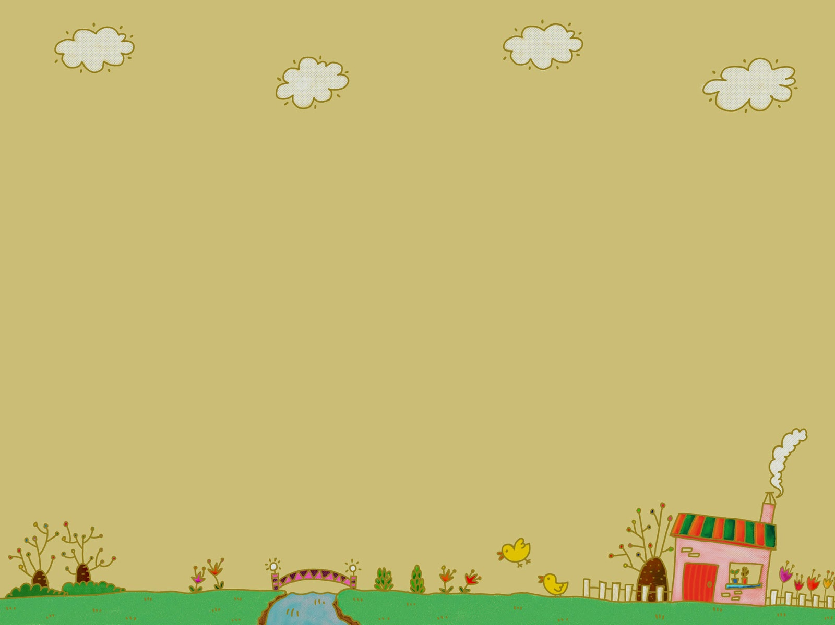



Slide 2
The Centre for the Prevention of addiction and Psychosocial health promotion ’’FAETHON’’, has been founded in 2006.

Slide 3

PRENENTION in GREECE
There are 75 Centers for Prevention of Addictions and Psychosocial Health Promotion, established within the framework of cooperation between the Organisation Against Drugs (OKANA) and local authorities.
Their activities include the prevention of all kinds of addiction and the promotion of psychosocial health.

Slide 4
OKANA:
plans, coordinates and implements a national policy
prevention
treatment and
rehabilitation of addictions.

Slide 5
Primary prevention
The emphasis of all the centers for prevention of addictions is posed on primary prevention addressed to general or ’’healthy population’’.

Slide 6
Primary prevention of addictions focus on the detection of all these causative factors contributing to the formation of psychological and social dysfunction and manifestation of addictive behaviors.

Slide 7
There are three types of prevention which are complementary to one another :
a) universal prevention addressed to general population, focusing on the development of skills and values, norm perception and social interaction

Slide 8
b) selective prevention addressed to vulnerable groups and focuses on improving their opportunities in difficult living and social conditions

Slide 9
c) indicated prevention addressed to vulnerable individuals and helps them in dealing and coping with their individual personality traits that make them more vulnerable for escalating drug use.

Slide 10
In universal prevention it is assumed that all members of the population share the same general risk for substance abuse, although the risk may vary greatly among individuals

Slide 11
Our theoretical approach considers addictions/addictive behaviors as a multi-factorial phenomenon, where many factors (biological, psychological and social) are involved

Slide 12
AIMS of FAETHON
a) Its aim is not solely to prevent substance use and addictive behaviours but also to delay or reduce substance use
b) promotion of a healthy and creative way of lifestyle

Slide 13
Faethon implements a broad range of programs and activities.
These programs are addressed to local community, target groups (children, adolescents, teachers, parents, health professionals) differing with respect to their needs and demands.

Slide 14
The activities of FAETHON include:
information and sensitization of the local community about addictions, addictive behaviors and mental/ psychological health issues.

Slide 15
Teachers and educators (primary and secondary education)
Faethon implements training seminars and supervision sessions to help teachers:
improve their relationship with students
promote students to cooperate
implement programs for the promotion of psychosocial health

Slide 16
Prevention interventions in school setting Prevention interventions in primary education are implemented during the so-called ‘flexible zone’ of the school timetable. In secondary education interventions are implemented outside school hours.

Slide 17
Primary education
a) Skills for the Primary School Child:Promoting the Protection of Children (ALYSOON MOON, 1998)
b) The Garden of 11 Cats (Luciano Morati, 2000)
c) Children's activities (ISPA/SFA, 2000)

Slide 18
PARENTS
Faethon coordinates parents’ groups in order to:
support them in their parental role
identify their emotional needs, their difficulties
improve communication skills and consequently to strengthen the relation with their children
enchance their personal and social skills

Slide 19
Children and Adolescents
These groups aiming at:
helping children become aware of their emotional needs, desires, difficulties, abilities (self-awareness)
’’build’’ their self-esteem
recognize and express their feelings
develop and improve their personal and interpersonal skills (empathy, communication, management of conflicts, respect and acceptance of diversity, ecc)

Slide 20
All these multi-session programs include experiential groups and creative activities.
The experiential approach encourage each member of the group to participate through activities and learn through experience (personal /vicarious)

Slide 21
The common feature and the aim of these programs is the enhancement of protective factors (personal and social skills) and the elimination or the reduction of risk factors

Slide 22
Counseling Sessions
We provide counseling or psychotherapy to individuals or families
Counseling to adolescents with aggressive and psychopatic behavior.

Slide 23
Scientific staff of FAETHON:
ELENI FILIOU (Social Worker)
MARINA THETEKOUS (Sociologist)
MARINA PAPADIOTI (Psychologist)
SPYROS SASSANIS (Sociologist)
MARIOS KATSOUROS (Psychologist)

Slide 24
THANK YOU!

Slide 25
Η ΠΟΡΕΙΑ ΜΑΣ ΑΥΤΑ ΤΑ 10 ΧΡΟΝΙΑ, ΓΕΜΑΤΗ ΟΜΟΡΦΕΣ ΚΑΙ ΔΗΜΙΟΥΡΓΙΚΕΣ ΣΥΝΑΝΤΗΣΕΙΣ…

Slide 26
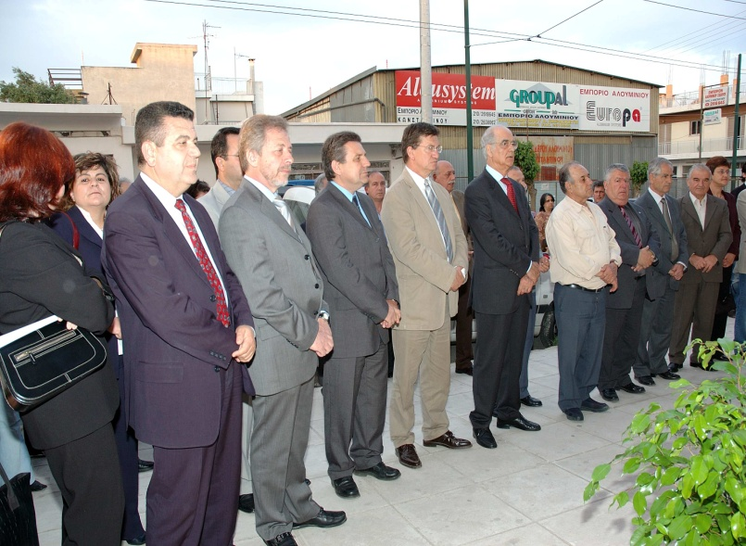
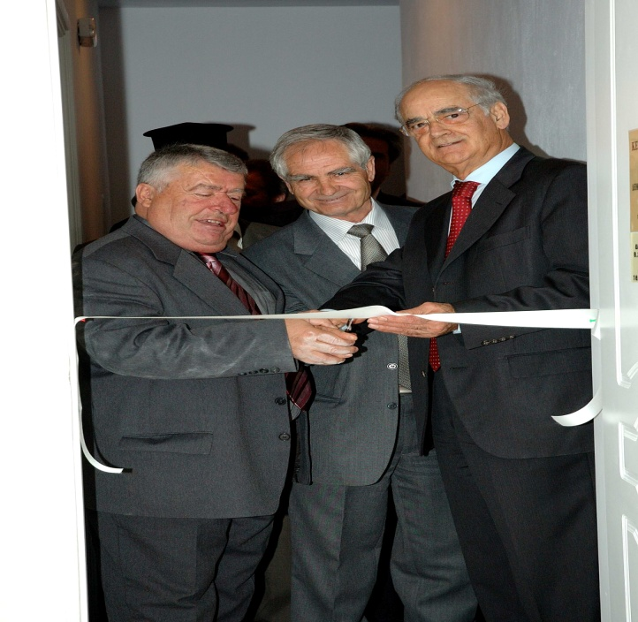
ΚΑΠΩΣ ΕΤΣΙ ΛΟΙΠΟΝ ΑΡΧΙΣΑΜΕ…

Slide 27
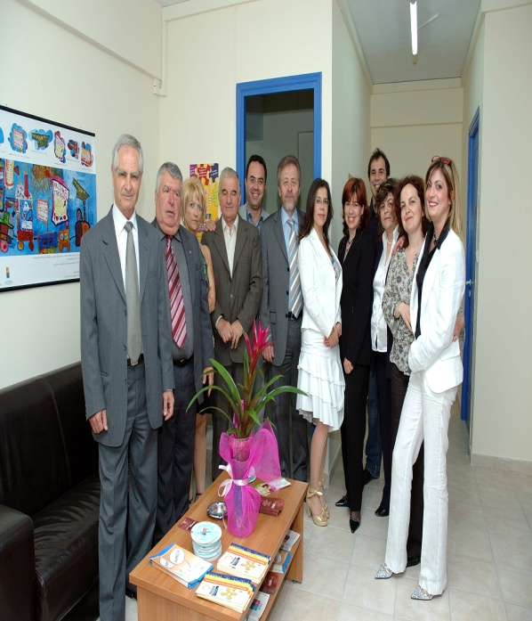
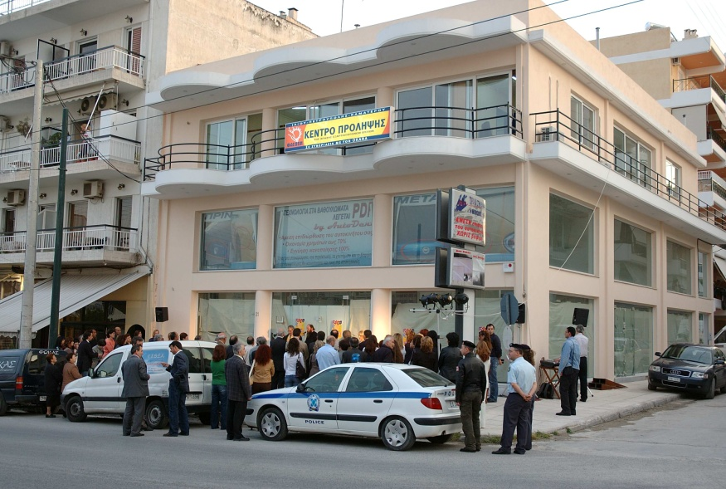

Slide 28
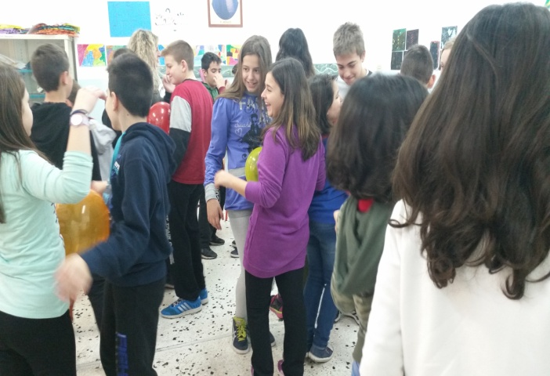
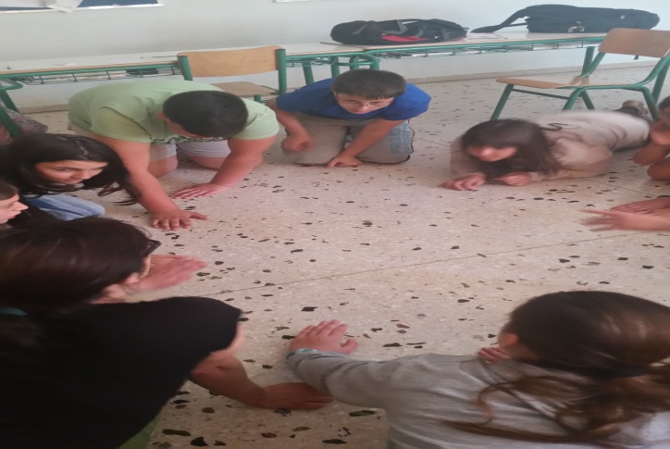
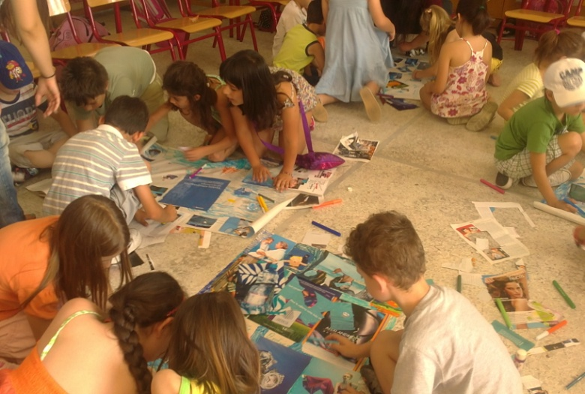
Με τους μαθητές…

Slide 29
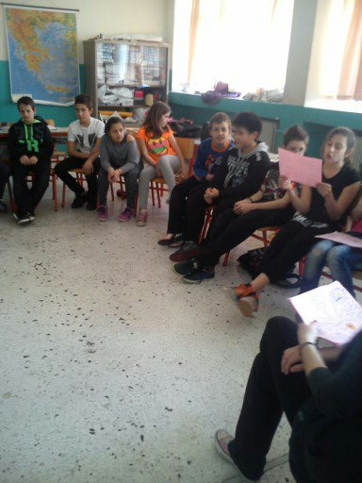
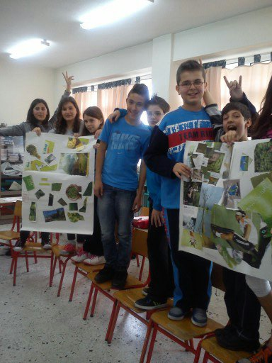
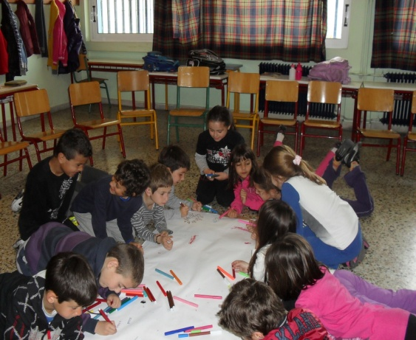

Slide 30
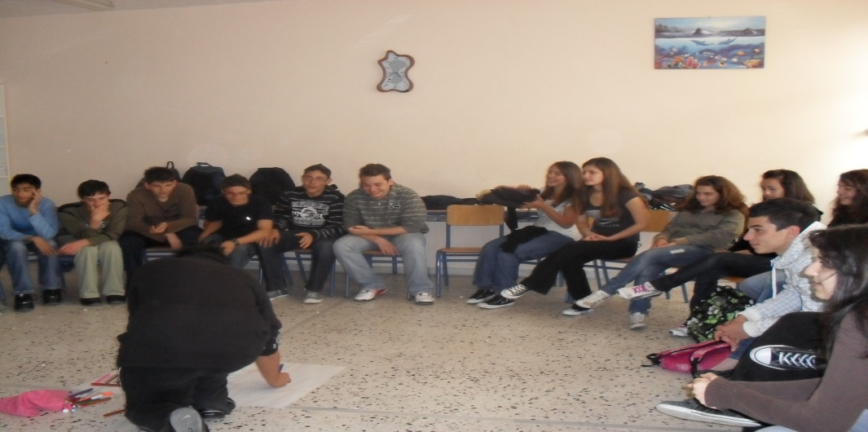
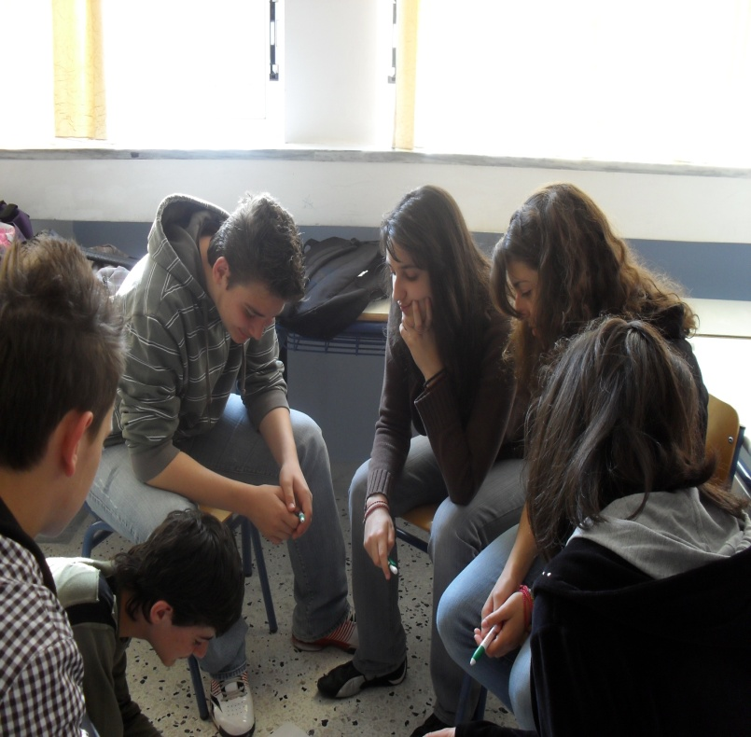
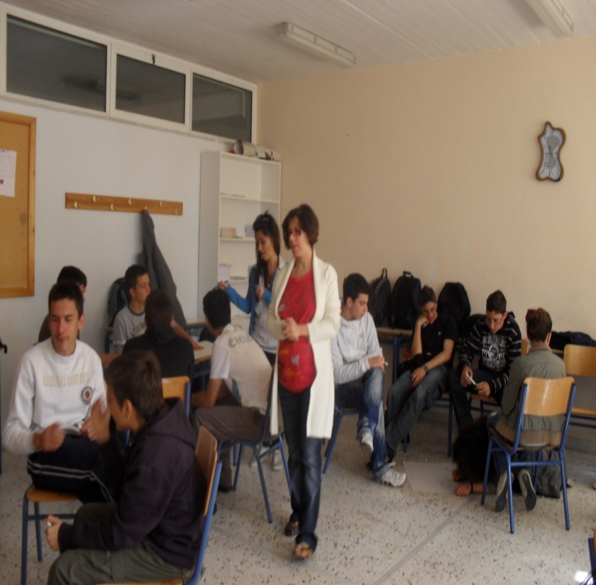

Slide 31
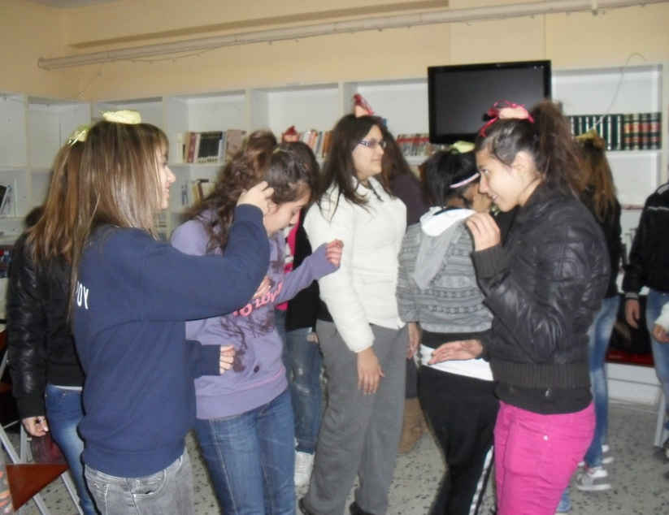
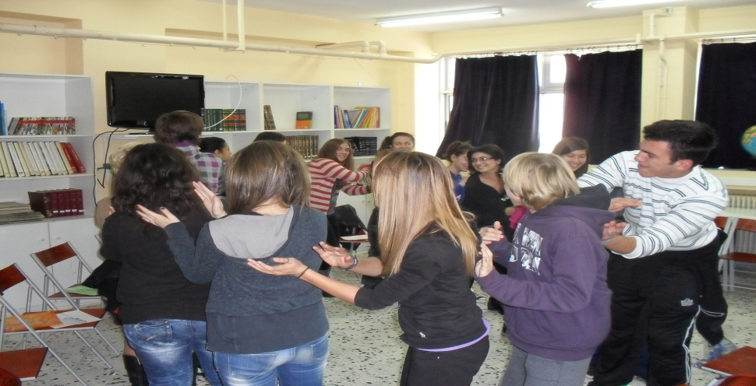
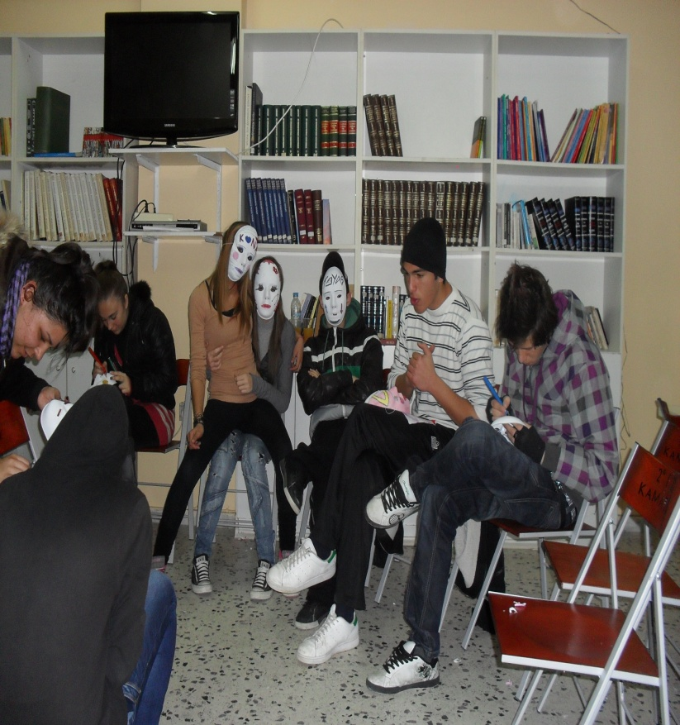

Slide 32
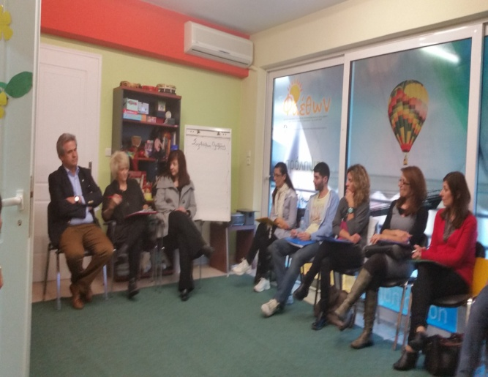
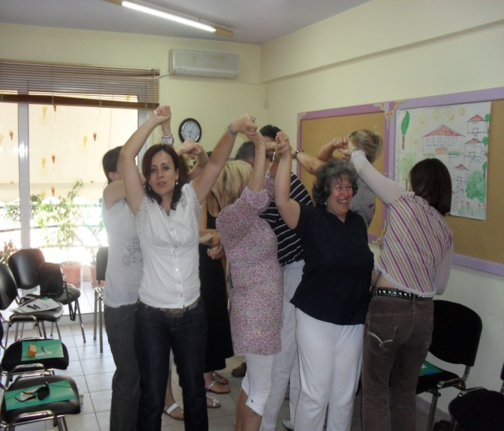
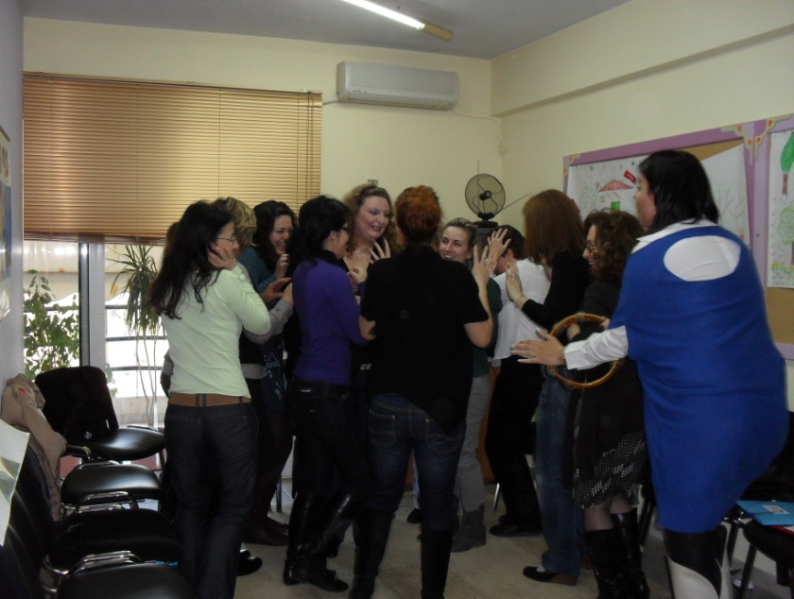
ΜΕ ΤΟΥΣ ΕΚΠΑΙΔΕΥΤΙΚΟΥΣ

Slide 33
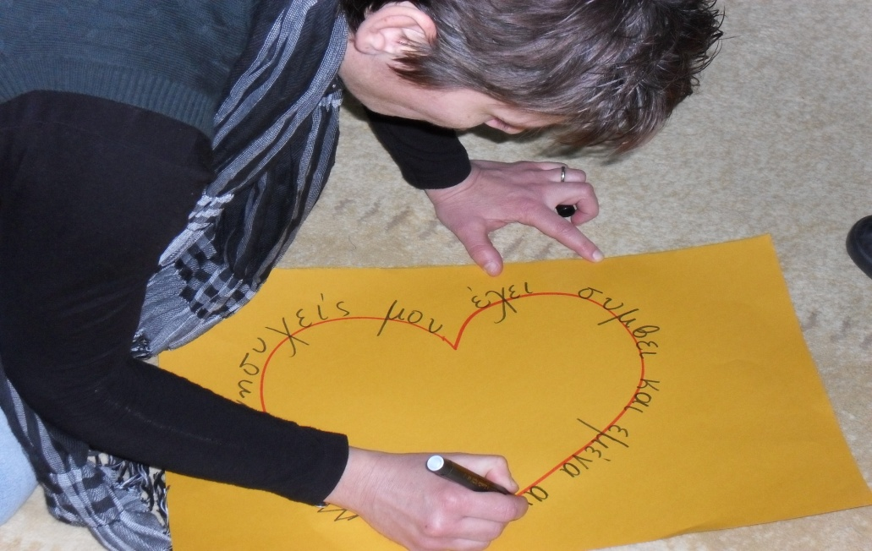
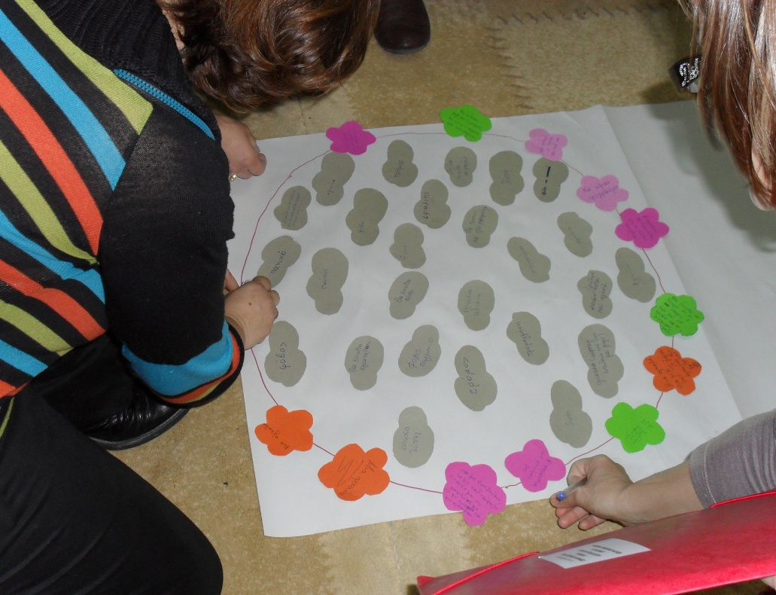
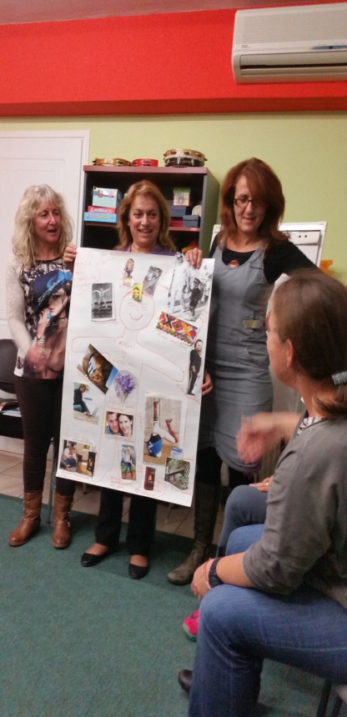

Slide 34
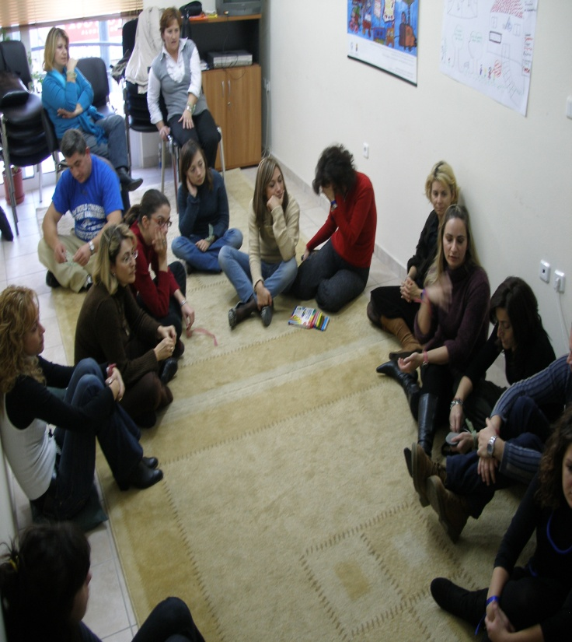
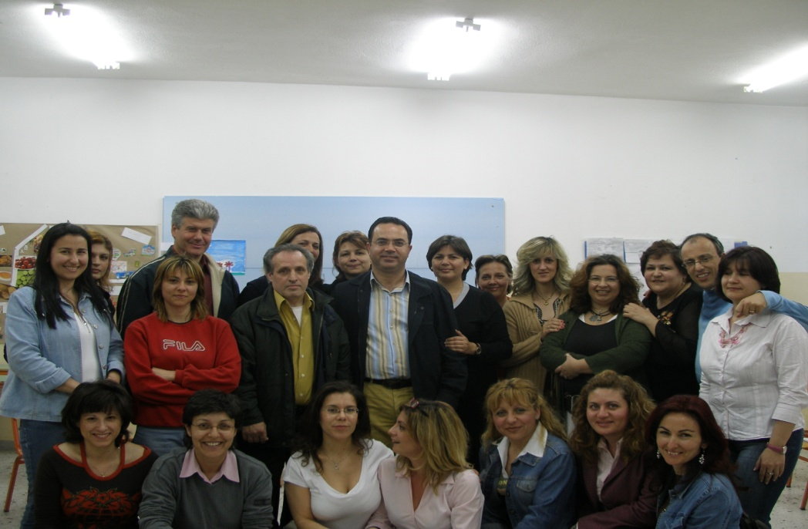
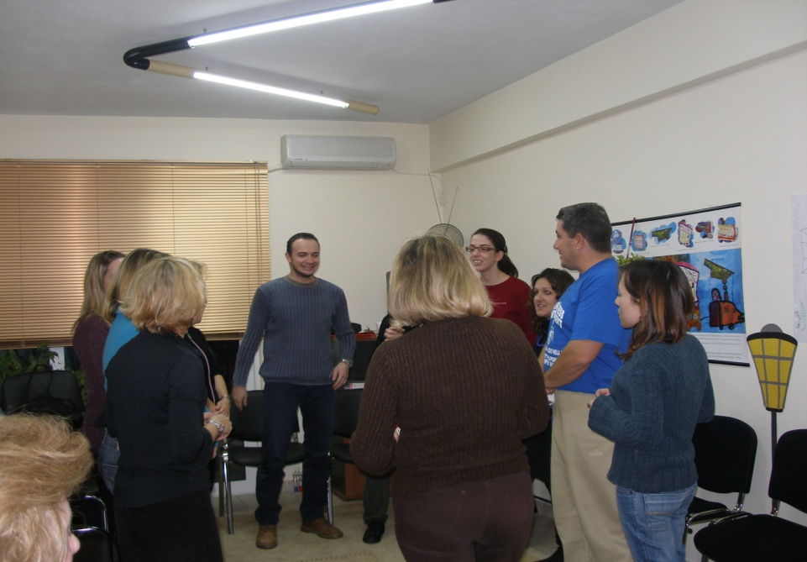
ΜΕ ΤΟΥΣ ΓΟΝΕΙΣ

Slide 35
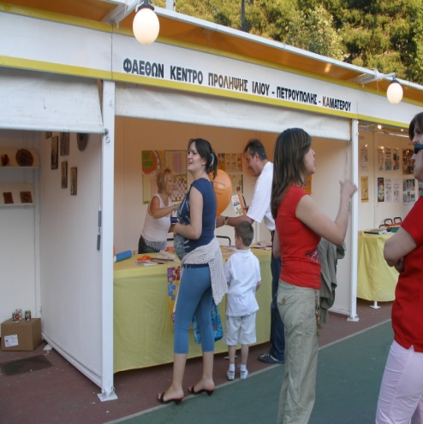
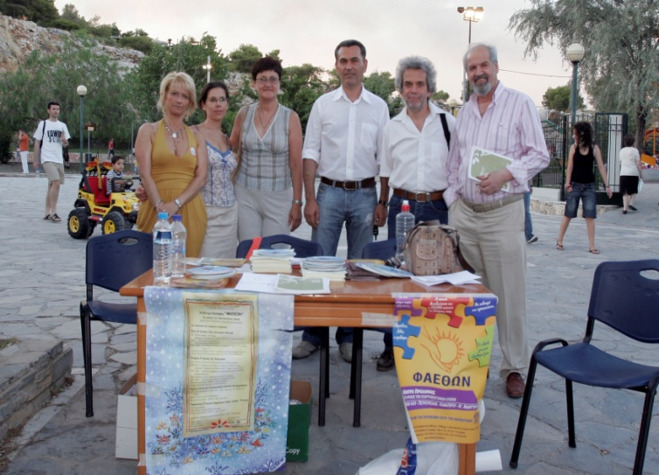
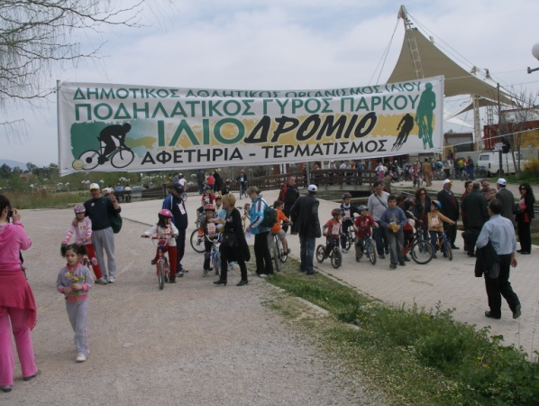
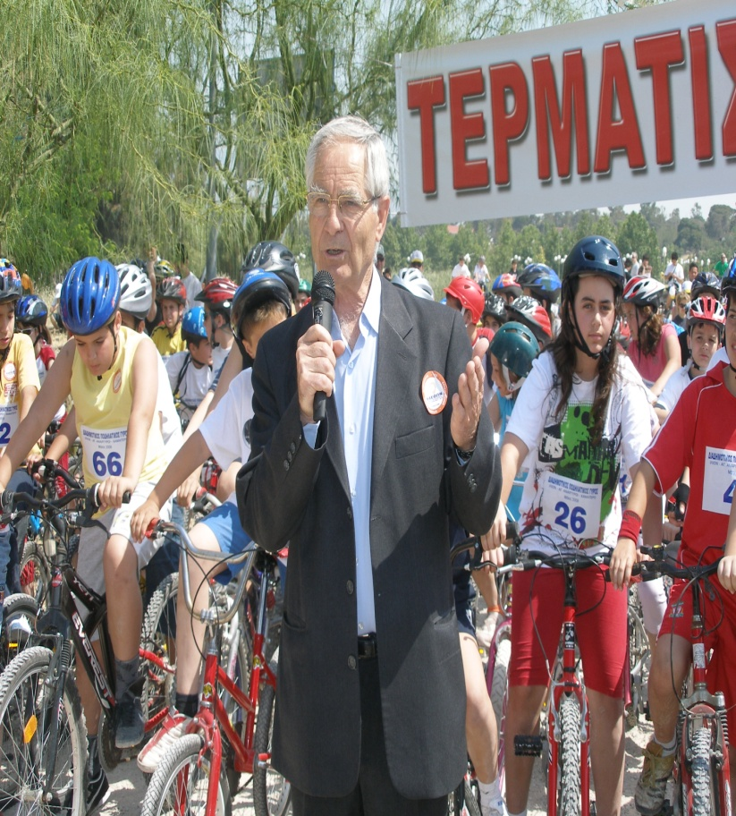
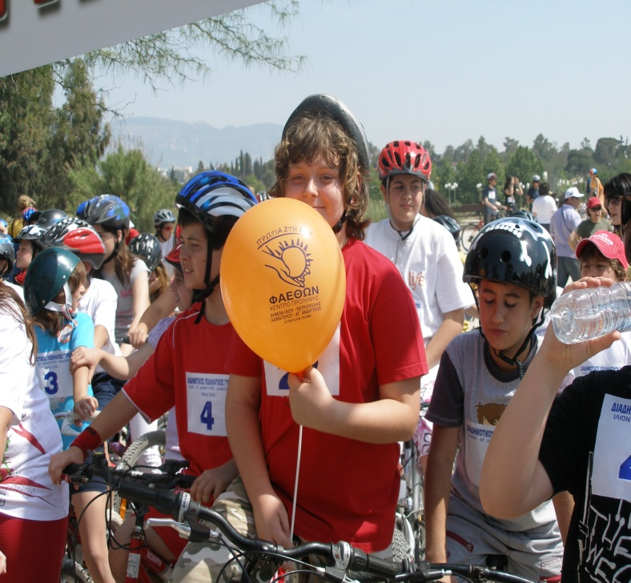
ΜΕ ΤΗΝ ΚΟΙΝΟΤΗΤΑ

Slide 36
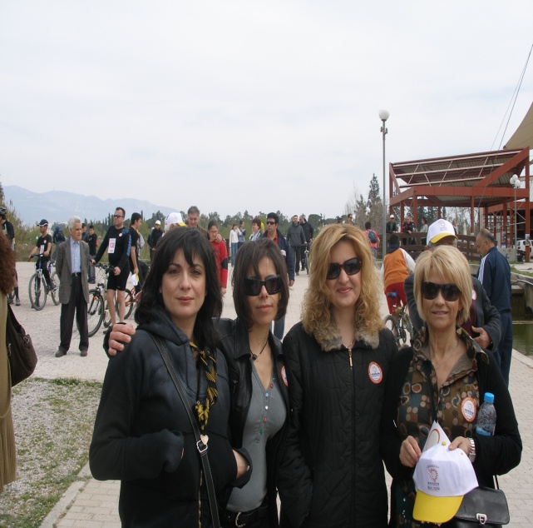
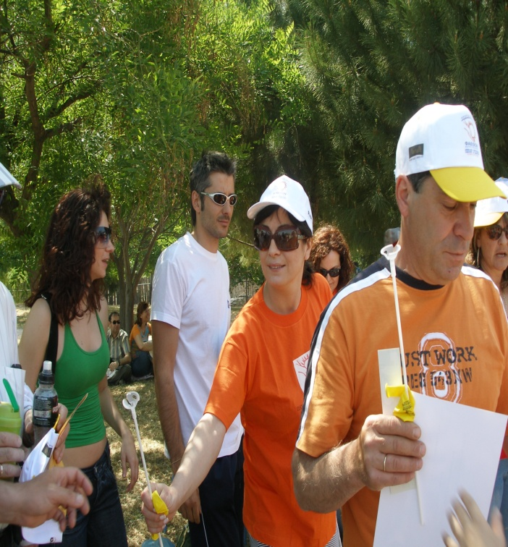
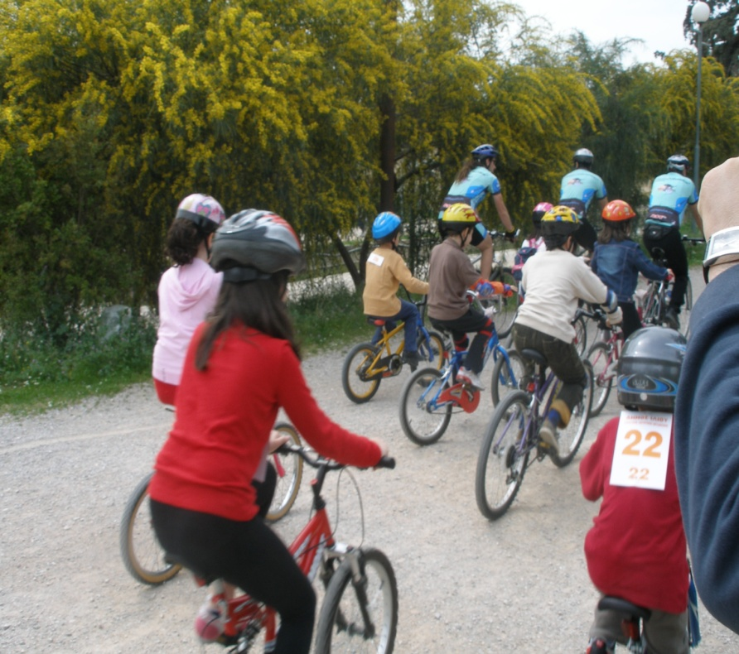

Slide 37
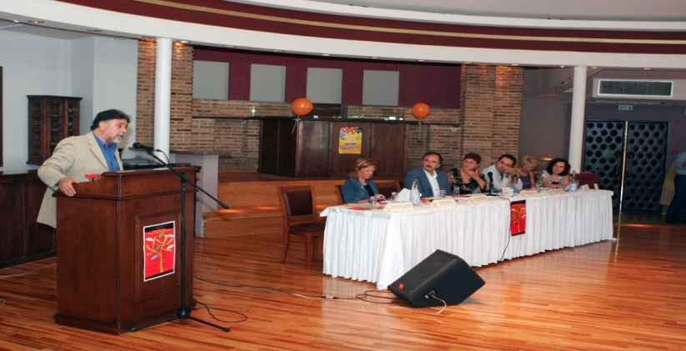
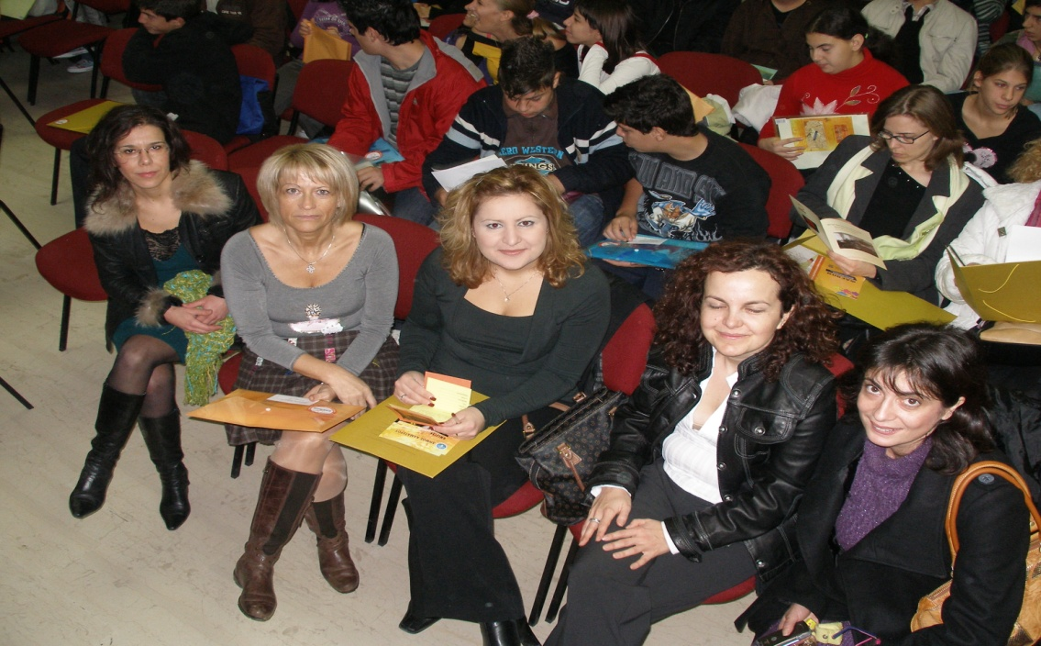
ΜΕ ΗΜΕΡΙΔΕΣ

Slide 38
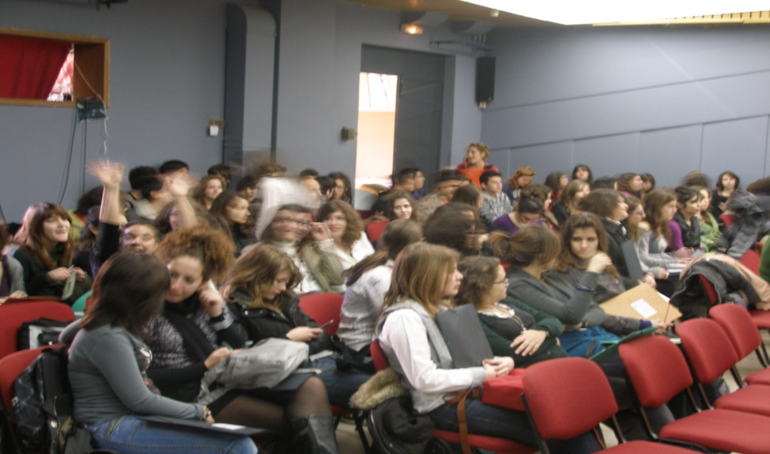
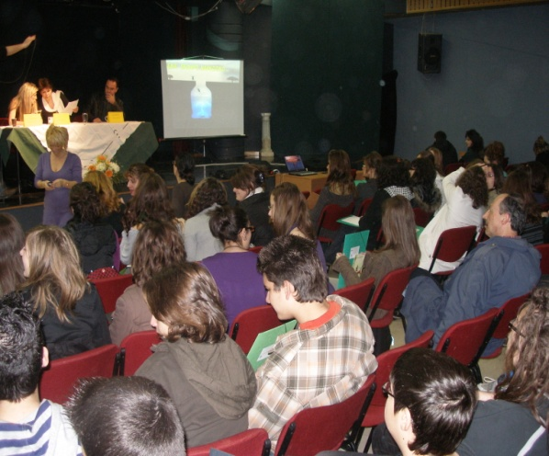

Slide 39
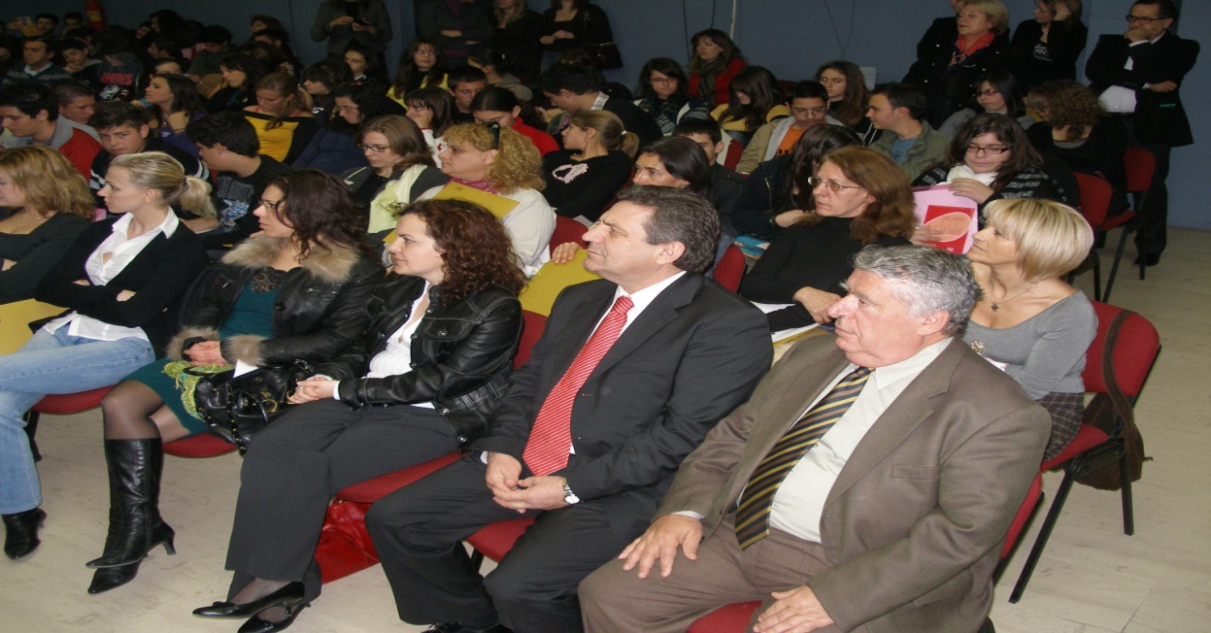
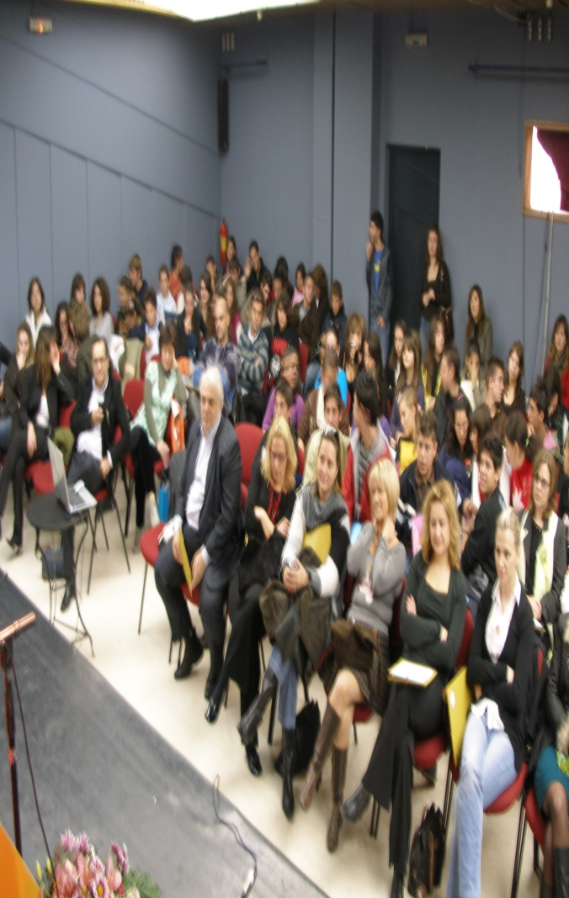

Slide 40
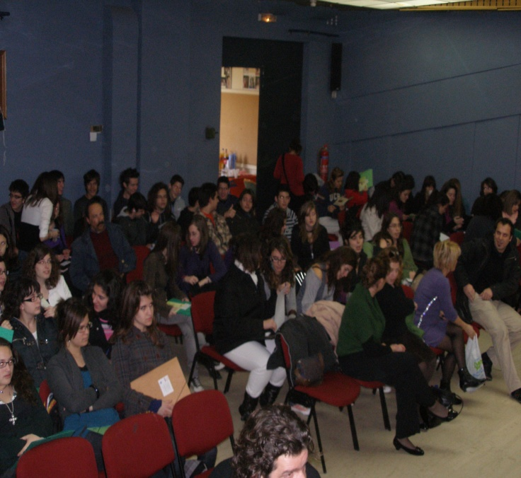
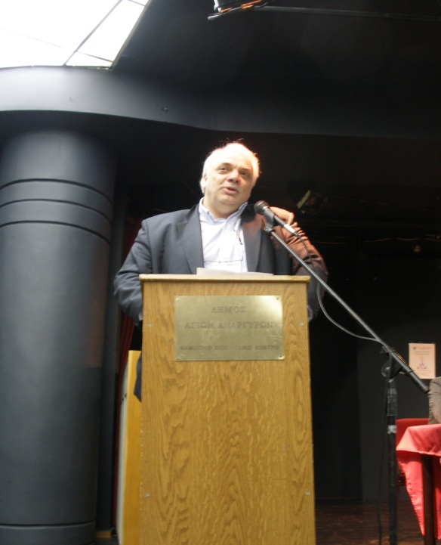

Slide 41
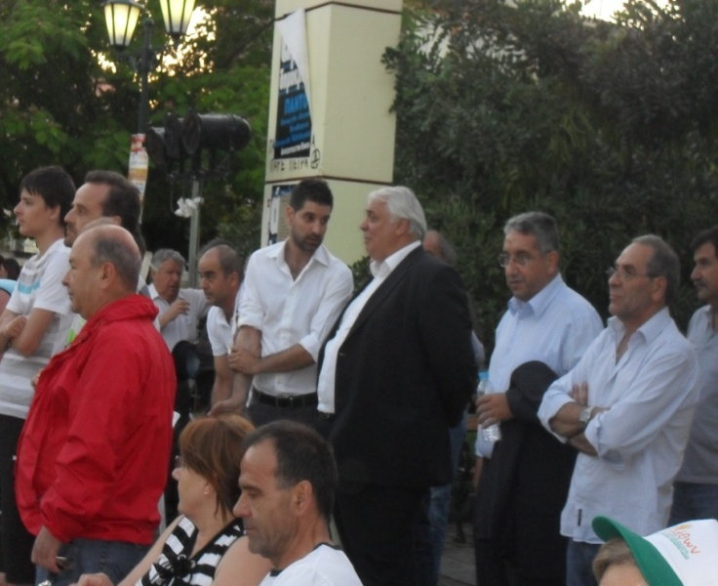
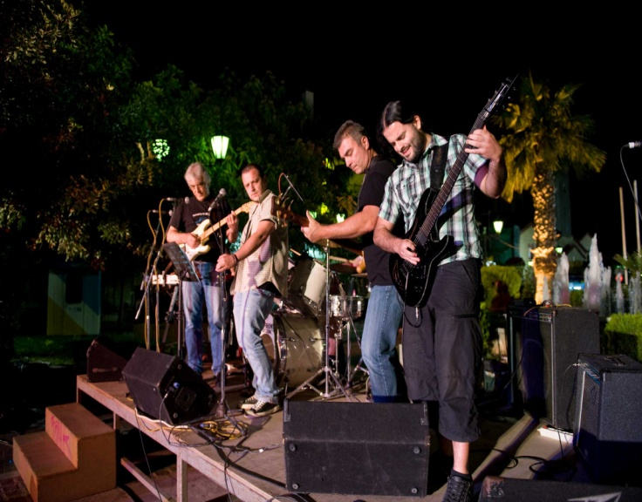
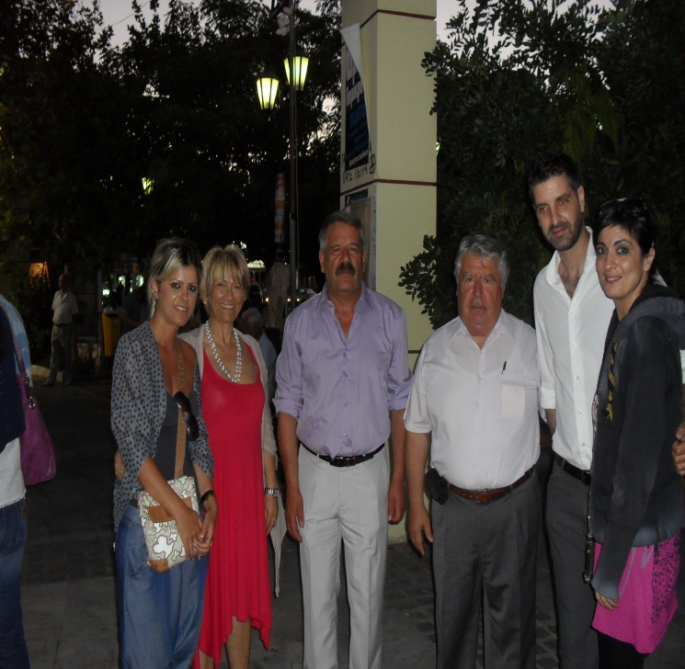
ΜΕ ΠΑΓΚΟΣΜΙΕΣ ΗΜΕΡΕΣ ΚΑΤΑ ΤΩΝ ΝΑΡΚΩΤΙΚΩΝ

Slide 42
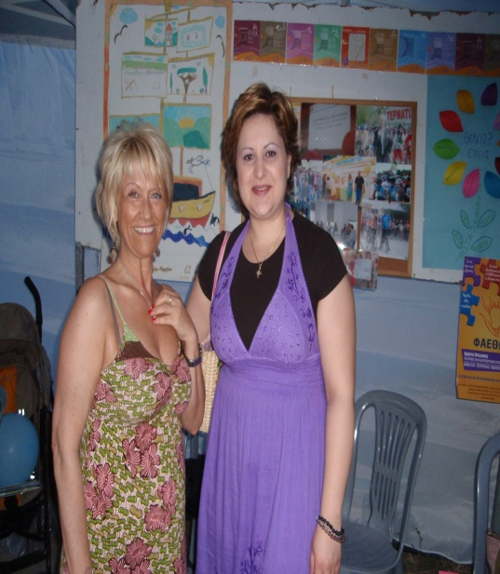
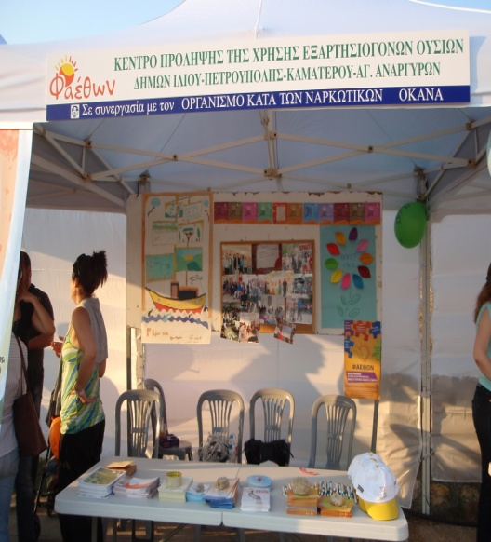
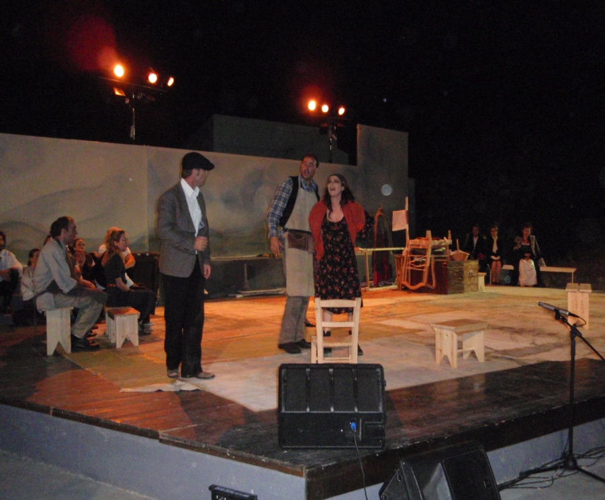

Slide 43
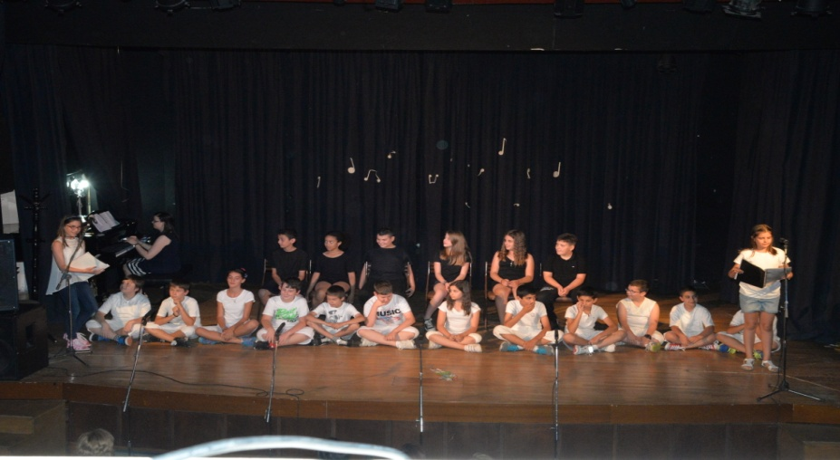
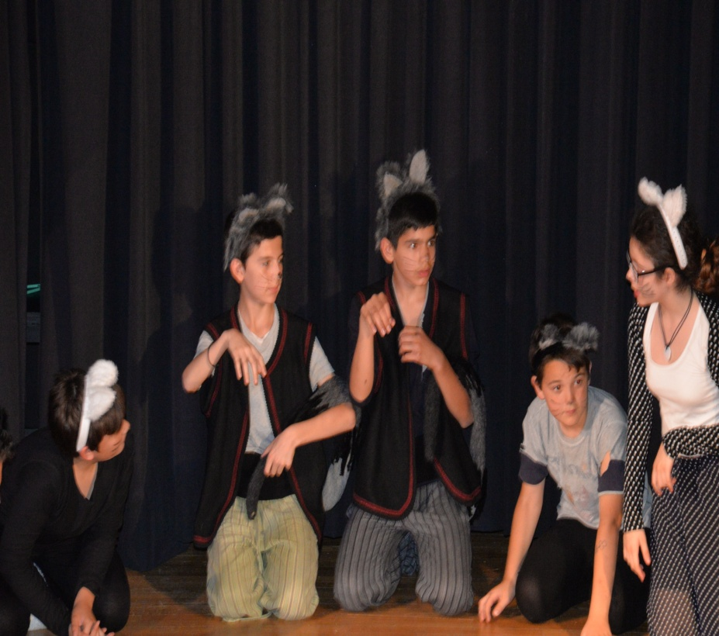

Slide 44



Slide 45




Slide 46




Slide 47


ΕΠΙΣΚΕΦΤΗΚΑΝ ΤΟ ΚΕΝΤΡΟ ΜΑΣ

Slide 48




Slide 49


ΌΤΑΝ ΟΙ ΟΜΑΔΕΣ ΜΑΣ ΔΗΜΙΟΥΡΓΟΥΝ…

Slide 50



Slide 51




Slide 52

ΟΤΑΝ ΕΜΕΙΣ ΔΗΜΙΟΥΡΓΟΥΜΕ…

Slide 53



Slide 54
ΕΊΠΑΝ ΓΙΑ ΕΜΑΣ…
Ομολογώ ότι περίμενα κάτι βαρετό και αδιάφορο. Όμως η ζωντάνια, η συλλογικότητα και η συμμετοχή με διέψευσαν. Σίγουρα θα το συνιστούσα ανεπιφύλακτα!!!»
Λόγια πατέρα...

Slide 55
Η ηρεμία, η εναλλαγή και η λειτουργικότητα είναι αυτά που μου ενέπνευσαν οι εμψυχωτές του Σεμιναρίου.
Η ανατροφοδότηση με ΙΔΕΕΣ και η επιμονή στις έννοιες ΒΙΩΜΑΤΙΚΟΤΗΤΑ, ΜΑΖΙ, ΟΜΑΔΑ, η προσπάθεια να συνειδητοποιήσουμε ότι ο δάσκαλος είναι ΜΕΣΑ στη τάξη».
Λόγια Εκπαιδευτικού...

Slide 56


ΛΌΓΙΑ ΜΑΘΗΤΩΝ…

Slide 57
Διασύνδεση με Φορείς
Κοινωνική υπηρεσία Δήμου Ιλίου
Κοινωνική υπηρεσία Αγίων Αναργύρων Καματερού
Συμβουλευτικός Σταθμός Δήμου Πετρούπολης
Κέντρο Γυναικών Ιλίου
Ψυχοπαιδαγωγικό Κέντρο Δήμου Ιλίου
Τμήμα ΑμΕΑ Πετρούπολης
ΚΕΘΕΑ
ΟΚΑΝΑ
18 ΆΝΩ
Σωματείο Εργαζομένων Κέντρων Πρόληψης

Slide 58


Σήμερα…

Slide 59




Slide 60

Στοιχεία Επικοινωνίας
Διεύθυνση: Αγίου Νικολάου 21 & Εφύρας
Ίλιον 13123 Τηλέφωνο: 210-2690011 fax: 210-2693337 email: faethon2@otenet.gr website: www.faethon.org
Σε συνεργασία με τον ΟΡΓΑΝΙΣΜΟ
ΚΑΤΑ ΤΩΝ ΝΑΡΚΩΤΙΚΩΝ (ΟΚΑΝΑ)

