Slide 1
Η ΕΚΠΑΙΔΕΥΣΗ ΣΤΗΝ ΕΛΛΑΔΑ
The Educational System of Greece

Slide 2
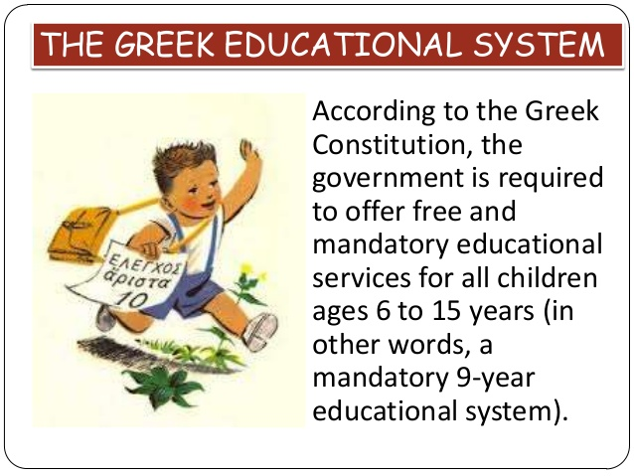

Slide 3
The Greek Educational System
The educational system in Greece is mainly characterized by its versatile character, which is ordained by the numerous laws and decrees of the Greek Ministry of Culture, Education and Religious Affairs. Over the years, the Ministry in question has made significant changes to the education system, most of which were mandated by the wish of each government to adopt recent scientific findings and acclaimed education models of other countries in the world.

Slide 4
Adapting state-of-the-art research in the field of education, as well as foreign education practices to meet the needs of the Greek society and labor market, has resulted in a multilayered education system, which caters for all students in the country.
Most students in Greece attend public schools of all levels, for which there are no tuition fees, while less than 10% of the student population enrolls in private schools.

Slide 5
Based on a recent EU research on the leadership and autonomy of schools, Greece has the most centralized educational system in the EU.
In European Union countries’ education systems there is a relatively high autonomy of schools in matters of teaching methods, the selection of the textbooks or their student’s choice with the “notable exception of Greece, where these issues are determined by the educational authorities”.

Slide 6
Education in Greece is centralized and governed by the Ministry of Education and Religious Affairs (Υ.ΠΑΙ.Θ.) at all levels.
The Ministry exercises control over public schools, formulates and implements legislation, administers the budget, coordinates national level university entrance examinations, sets up the national curriculum, appoints public school teaching staff, and coordinates other services.
The national supervisory role of the Ministry is exercised through Regional Unit Public Education Offices, which are named Regional Directorates of Primary and Secondary School Education Public schools and their supply of textbooks are funded by the government. Public school students attend free, tuition-free, and they are provided free with textbooks from the state approved list.
About 25% of postgraduate programs have free tuition, while about 30% of students are eligible to attend programs tuition-free based on individual criteria.

Slide 7
LITERACY in Greece 2014
Total 98%
Male 99%
Female 97%

Slide 8
School Holidays
School holidays in Greece include Christmas, Greek Independence Day, Easter, National Anniversary Day, a three-month summer holiday, National Public Holidays, and local holidays, which vary by region such as the local patron saint's day.
In addition to schooling, the majority of students attend extracurricular private classes at private centers called "frontistiria" (φροντιστήρια, frontistirio), or one-to-one tuition. These centers prepare students for higher education admissions, like the Pan-Hellenic Examinations, and provide foreign language education.
It is forbidden by law the mobile phone use on school by students while in the school premises either take or make mobile phone calls, texting, or the use of other camera, video or other recording devices or medium that have image and audio processing like smart watches. Students must switch off their mobile phones or set to silent mode and keep them in their bags

Slide 9
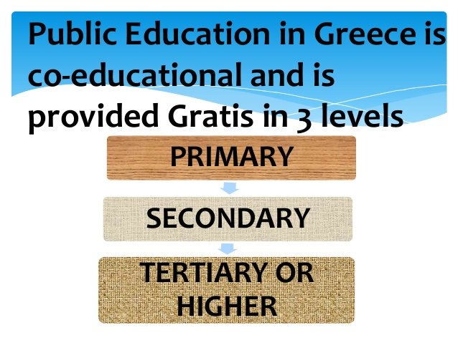

Slide 10
Greece Framework
Compulsory School Education PK9
Year in Schooling |  | Age | Designation | Educational Stage
Pre-kindergarten | Year 1 | 4–5 | Pre-kindergarten | Preschool
Kindergarten | Year 2 | 5–6 | Kindergarten
First grade | Year 1 | 6–7 | 1st Grade | Primary School
Second grade | Year 2 | 7–8 | 2nd Grade
Third grade | Year 3 | 8–9 | 3rd Grade
Fourth grade | Year 4 | 9–10 | 4th Grade
Fifth grade | Year 5 | 10–11 | 5th Grade
Sixth grade | Year 6 | 11–12 | 6th Grade
Seventh grade | Year 7 | 12–13 | 1st Grade | Lower Secondary School (It is called Gymnasium)
Eighth grade | Year 8 | 13–14 | 2nd Grade
Ninth grade | Year 9 | 14–15 | 3rd Grade
Non-Compulsory School Education
Tenth grade | Year 10 | 15–16 | 1st Grade | Upper Secondary School (It is called Lyceum) (US equivalent: High School)
Eleventh grade | Year 11 | 16–17 | 2nd Grade
Twelfth grade | Year 12 | 17–18 | 3rd Grade

Slide 11
Early childhood education / care
AGE 0-4
Daycare center Vrefonypiakos stathmos
AGE 5-6
Kindergarten school Nypiagogio ΝΗΠΙΑΓΩΓΕΙΟ
Experimental Kindegarten School
Piramatiko Nipiagogio

Slide 12
Primary education lasts 6 years AGE 6-12 COMPULSORY
Primary school Dimotiko scholio
ΔΗΜΟΤΙΚΟ ΣΧΟΛΕΙΟ
Experimental Primary School Piramatiko Dimotiko Scholio
SPECIAL EDUCATION
Primary School for students with Special Needs
Ediko Dimotiko Scholio

Slide 13
Secondary education Γυμνάσιο AGE 12-15 COMPULSORY
Junior High school Gymnasium
Evening Junior High School Esperino Gymnasium
Experimental Junior High School
Piramatiko Gymnasium
Music Junior High School Mousiko Gymnasium
Ecclesiastical Gymnasium

Slide 14
Arts Junior High School
Kallitechniko Gymnasium
Multicultural Junior High School
Gymnasium Diapolitismikis Ekpedefsis
SPECIAL EDUCATION
Junior High School for students with Special Needs Ediko Gymnasium

Slide 15
Secondary Education lasts 3 years AGE 15-18
General High school Lykeum ΛΥΚΕΙΟ
General Evening High School
Esperino Geniko Lykeum
Experimental High School Piramatiko Lykeum
Music High School Mousiko Lykeum
Arts High School Kallitechniko Lykeum
Multicultural High School Lykio Diapolitismikis Ekpedefsis

Slide 16
Special Education
Special Vocational Education & Training Institutes
VOCATIONAL EDUCATION
Vocational High School Epagelmatiko Gymnasium
Vocational Evening High School
Esperino Epagelmatiko Lykeum
Vocational Training Schools Scholi Epagelmatikis Katartisis

Slide 17
Higher Education FROM THE AGE OF 18
University Panepistimio ΠΑΝΕΠΙΣΤΗΜΙΟ
Technological Educational Institute
School of Pedagogical and Technological education
School of Fine Arts Scholi Kalon Technon
Hellenic Open University Elliniko Anichto Panepistimio

Slide 18
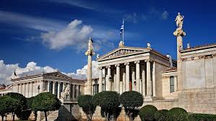
Athens Trilogy, National Library~ University~ Academy

Slide 19
Lifelong Learning
Lifelong Learning Centers Kentra Dia Viou Mathisis
Second Chance Adult Education School
VOCATIONAL EDUCATION
Vocational Training Schools
Vocational Training Institutes

Slide 20
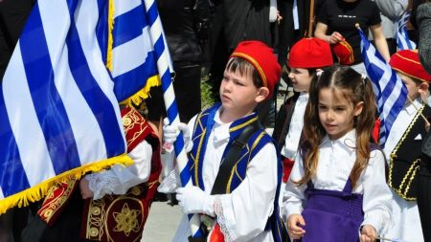
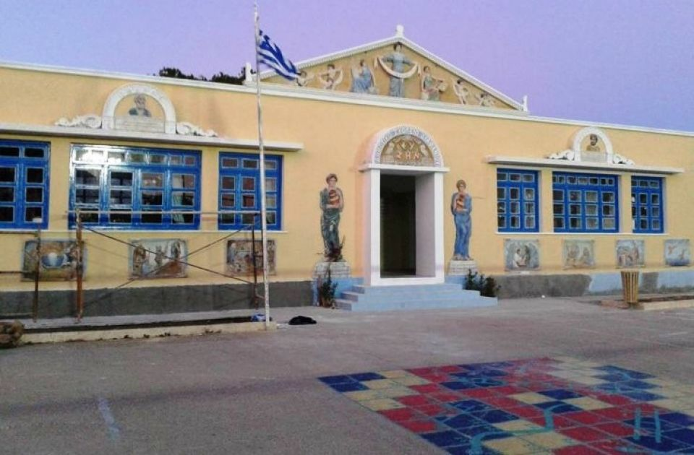
Structure of the Greek Education System
Education in Greece is compulsory for all children between the ages of 6 and 15.
The education system is divided into Early Education and Care for children up to the age of 6
Primary Education for schoolchildren between the ages of 6 and 12
Secondary Education for teenagers between the ages of 12 and 18
Higher Education for those wishing to attend university courses and finally
Lifelong Learning, which caters for adult students of all ages.
Primary school on the island of Karpathos, Dodecanese

Slide 21
Early Education and Care
In Greece there are Daycare Centers which provide children up to the age of 5 with pre-school education.
The last stage of pre-school education is carried out in Kindergarten Schools, where young students take preparatory courses just before enrolling in primary/elementary schools.

Slide 22
Primary Education Δημοτικό Σχολείο Age 6-12
Primary Schools welcome children of the age of 6 to the age of 12.
Some of these schools are termed “Experimental”, as they carry out experimental education practices, and are supervised by university departments specializing in pedagogics and primary education.
There are also primary schools which cater for students with physical or mental impairment, or special needs. In all three types of primary schools, students learn basic skills in a number of subjects, like Language Reading and Writing, Environmental Studies, Mathematics History, Geography, Religion, Physical, Education. English, German or French.
Primary Schools in Greece operate between 8.15 am and 13.15 pm, while the majority of those offer extra classes on Physical Education, Art and Music until 4pm. ALL DAY SCHOOL-OLOEMERO SCHOLIO

Slide 23
Junior High School Gymnasio -Γυμνάσιο Age 12-15
All students graduating from primary education must attend courses in a Junior High School. There are several types of Junior High Schools. A student may attend the Junior High School which is located in his neighborhood, or he/she may be admitted to an Experimental Junior High School through a lottery system.
Students who have a special interest in painting, drama, dancing or music may attend a Junior High School that specializes in the field. There are also Junior High Schools which address students from a multicultural background, as well as students with special needs.

Slide 24
Most Junior High Schools operate from 8am to 2pm, but there are also evening schools that operate from 7pm till 10pm for students – mainly adults – who work during daytime.
A variety of subjects are taught in Junior High Schools, including Modern and Ancient Greek Language, Maths, Physics, Chemistry, Geography, History, Physical Education, Religious Studies, Music and Art, while special emphasis is given to Foreign language learning, as students are taught both English and another European language of their choice (students tend to choose between French and German).
Students take exams in all subjects at the end of each school year.

Slide 25
Upper Level Secondary Education LYKEUM - ΛΥΚΕΙΟ
Although upper level Secondary Education is not compulsory in Greece, most students attend High School. At this level, students may choose to attend a General High School or an Experimental High School (mainly for graduates of Experimental Junior High Schools) or any High School specializing in music or the arts.
Students from foreign countries may attend a Multicultural High School, while there are Special Vocational Education & Training Institutes for students with special needs.

Slide 26
Vocational Training
Students may also pursue vocational training in Vocational High Schools, or, once they are 16, they may enroll in a Vocational Evening High School and graduate after 4 years of study.
In addition, there are Vocational Training Schools; in these schools, as well as in all Vocational High Schools students attend general education courses combined with workplace courses. At the final stage of his/her studies, a student may work as an apprentice and gain valuable work experience.

Slide 27
Higher level education is ensured by Panhellenic exams
High Schools offer a combination of General Education courses and Advanced Placement courses. Students who wish to pursue studies in Higher Education take Panhellenic exams in a specific number of Advanced Placement courses which fall into one of the following categories: Humanities, Law and Social Sciences, Sciences, Health Sciences and Economic & Computer Studies.
This is considered to be a tough and highly competitive exam process that students go through in order to ensure education at a higher level.

Slide 28
Higher Education
Greece has a high number of university graduates. Most of them attend four-year studies in University departments and in Technological University departments, as well as in the various departments of the School of Pedagogical and Technological Education, while those attending Technical University departments – specializing in fields like architecture and engineering – graduate after five years of studies.
Students who wish to enroll in the School of Fine Arts take special exams, and graduate after five years of studies.

Slide 29
Courses in Higher Education institutes in Greece take the form of either lectures or workshops, and most of the courses spread over one semester. Most university departments in Greece offer one-year or two-year postgraduate courses, as well as the opportunity to pursue a doctoral degree.
Students may also enroll in the Hellenic Open University for graduate or postgraduate studies, where they pay tuition fees and where they are admitted through an annual lottery system.

Slide 30
Lifelong Learning
Lifelong Learning in Greece takes place in Lifelong Learning centers which are usually supervised by Municipality services. These centers offer a variety of courses, aiming at both formal and informal education. On the other hand, Vocational Training Institutes and Vocational Training Schools often adapt their curriculum to suit the needs of their adult students and of the labor market.
Finally, Second Chance Adult Education Schools cater for those students who have dropped out of school at some point in their life, but wish to continue with their studies at a later date.

Slide 31
Teachers in Greece
Teachers with University Degrees and Post graduate titles, Bachelor and Master degrees are hired in public education but according to the Teachers’ and School Heads’ Salaries and Allowances in Europe 2011/12 published by the European Commission to coincide with World Teachers’ Day, teachers’ salaries in Greece are among the lowest in the 17 countries of the Eurozone, and 15 others in Europe because of punishing pay cuts under harsh austerity measures.
An annual average salary for teachers in Greece is 9.000 -14.000 euros.

Slide 32
Flashback to History EDUCATION in ANCIENT GREECE
Athenian state
The harmonious development of body and spirit is the ultimate educational goal of the Athenian state.
The development of good taste, decency, sociability and insightful political thought are also complementary objectives of educational aspirations. The music is dominant in this learning process. The tutor, usually an educated slave, helps the male member of the family learn his lesson but one of his duties is to take him to and from school. There are also the grammarians teaching writing, reading and understanding of the Homeric epics.

Slide 33
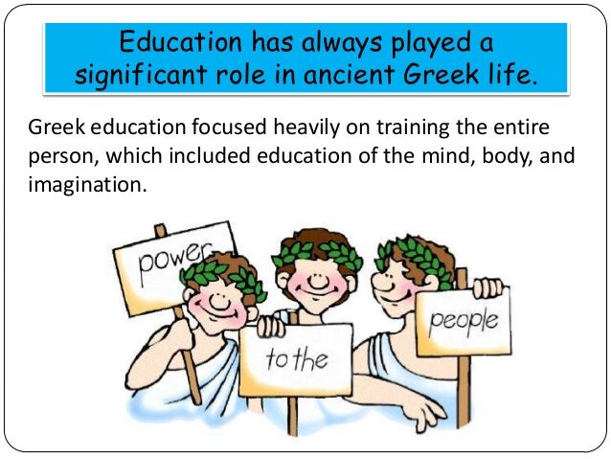
«Νους υγιής εν σώματι υγιει» A Healthy mind in a healthy body

Slide 34
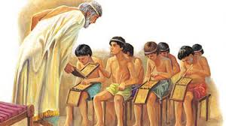
Παιδαγωγός- pedagogue~tutor teaching in ancient Greek classroom

Slide 35
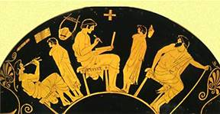
Red-figure 5th century BC vase, depicting students with the grammarian, guitarist and tutor(παιδαγωγό-pedagogue) (Archaeological Museum of Berlin)

Slide 36
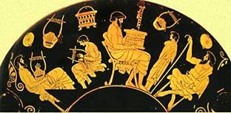
Red-figure vase of the 5th century BC depicting students reading and playing the lyre (Archaeological Museum of Berlin)

Slide 37
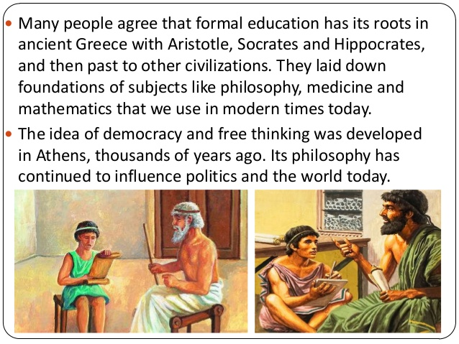

Slide 38
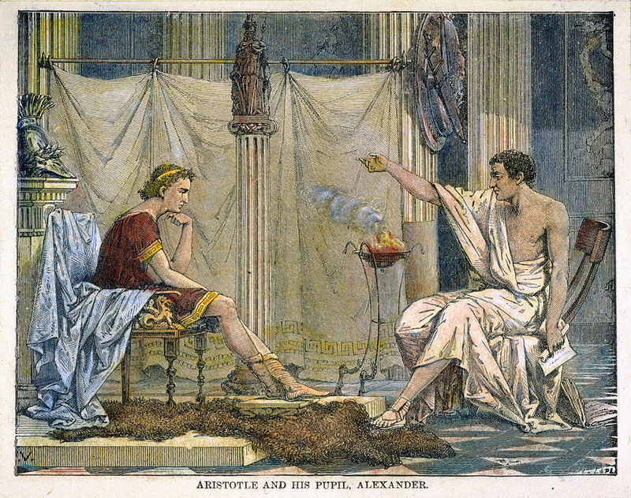

Slide 39
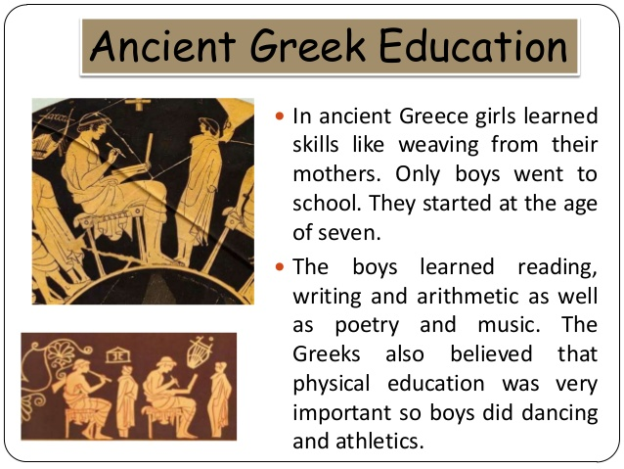

Slide 40
In all the Greek city-states except for Sparta, the purpose of education was to produce good citizens. Children were trained in music, art, literature, science, math, and politics.
In Athens, for example, boys were taught at home until they were about six years old. Then boys went to school, where they learned to read and write. They learned to play a musical instrument, usually the flute or the lyre. They learned the poetry of Homer. They learned how to debate and how to give a persuasive speech. They studied science and math. After high school, they attended military school, where they learned to be good warriors. Boys did not graduate from all the schooling they were required to take until they were about 20 years old.
Except for the city-state of Sparta, Greek girls did not go to school. They were taught at home by their mothers. If their mother could read and write, they taught their girls how to do the same, as well as teaching them how to cook and sew and run a household.

Slide 41
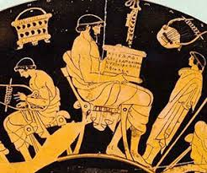
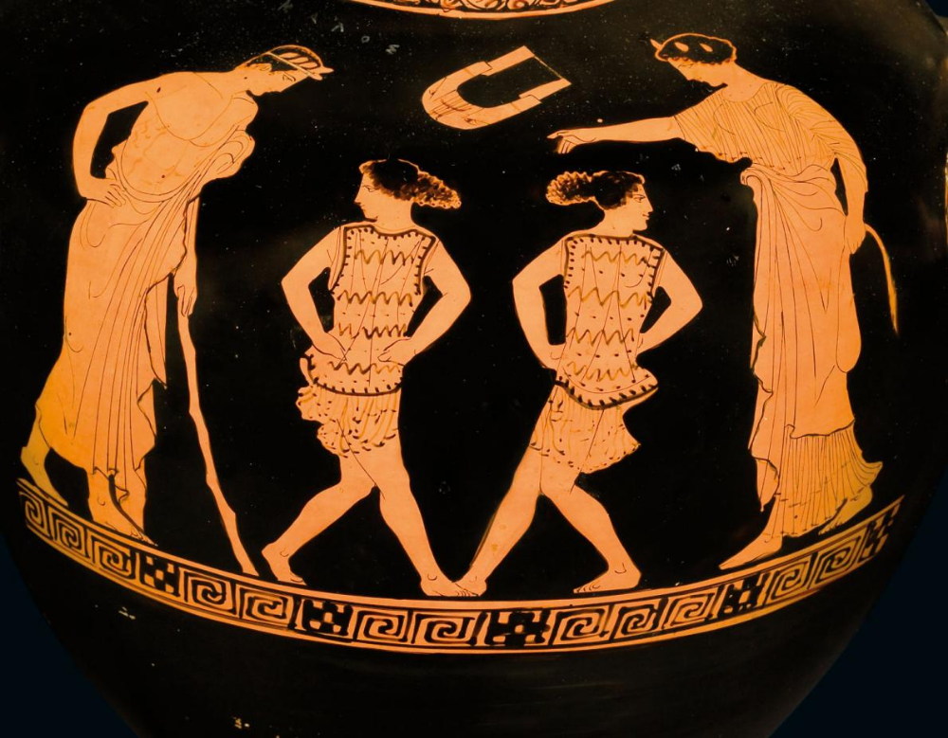

Slide 42
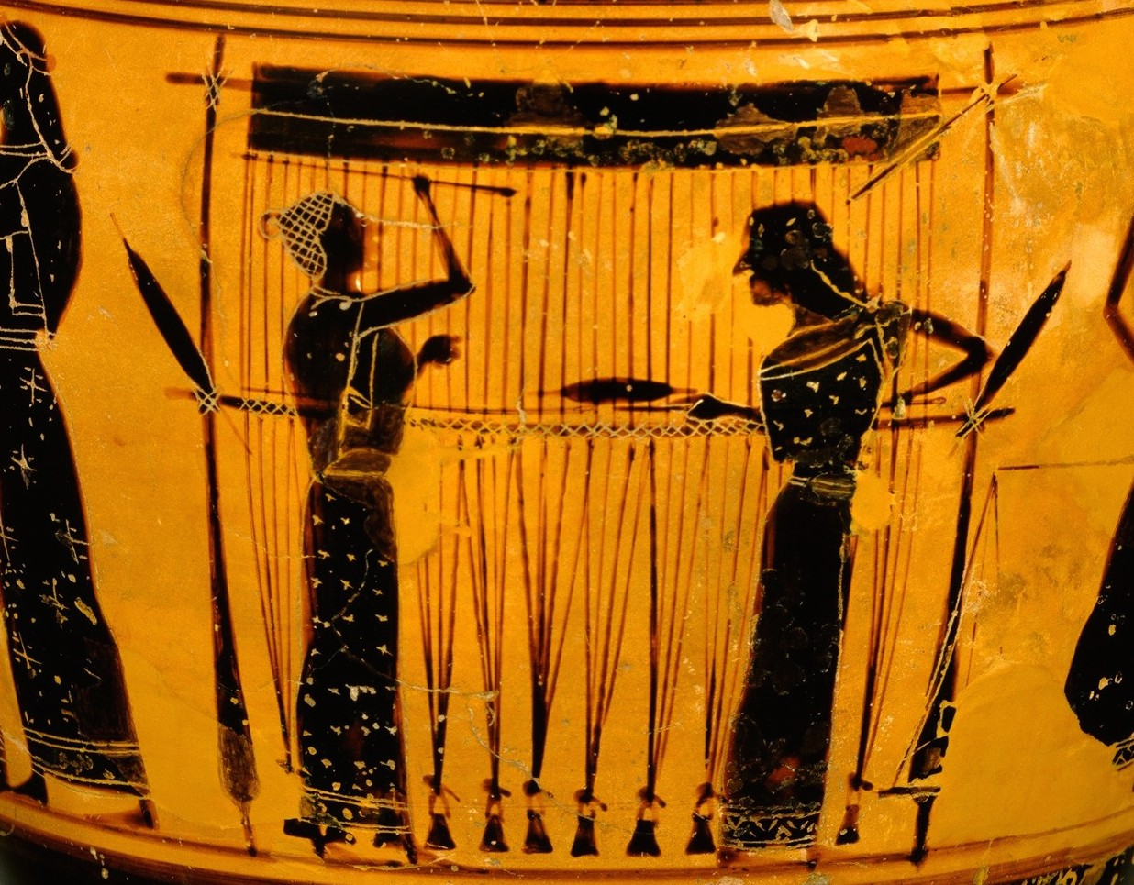
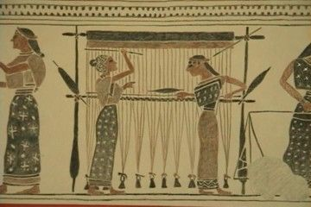
Spinning and weaving in ancient Greece

Slide 43
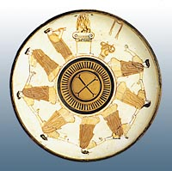
Music played by girls in a religious ceremony, Boston Museum of Fine Arts.

Slide 44
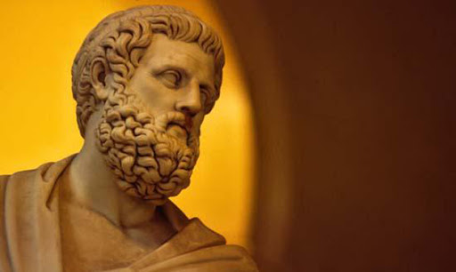
The Theatre in ancient Greece and its educational role
The Greeks loved theatre!
The ancient Greek drama was a theatrical culture that flourished in ancient Greece from 600 BC. The city-state of Athens, which became a significant cultural, political, and military power during this period, was its center, where it was institutionalised as part of a festival called the Dionysia, which honored the god Dionysus.
Tragedy (late 500 BC), Comedy (490 BC), and the Satyr play were the three dramatic genres to emerge there. Athens exported the festival to its numerous colonies. They brought incredible stories to life through drama, music and dance. So, in ancient Greece, theatres were everywhere. Every town had a big bowl-shaped arena, usually on a hillside, where thousands would flock to sit on hard stone seats and watch the latest play.
The most successful Athenian playwright was Sophocles (496-406 B.C), who won so many Greek theatre competitions that he became recognizable to everyone.

Slide 45
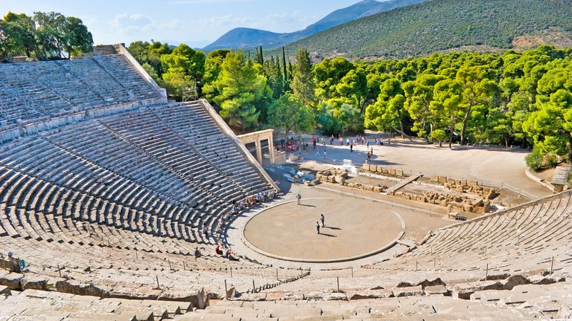
The ancient theatre of Epidaurus

Slide 46
The Greek Language has given continuity and new perspectives to Education
Education in Greece, like many other aspects in Greek life, has been affected by long, turbulent historic periods : from the Ancient and Hellenistic eras to the Byzantine period and Ottoman occupation until Modern times.
A very important and of vital significance element which gave cohesion to our educational system is the Greek Language. Its power has given a new perspective to education and Greek culture.
Greek has been spoken in the Balkan peninsula since the 3rd millennium BC, or possibly earlier. The earliest written evidence is a Linear B clay tablet found in Messenia that dates to between 1450 and 1350 BC, making Greek the world's oldest recorded living language.
The Greek language is also important to the languages and cultures of the world. Every language contains Greek words. The Greek language recorded ancient philosophy and culture and spread Christianity.

Slide 47
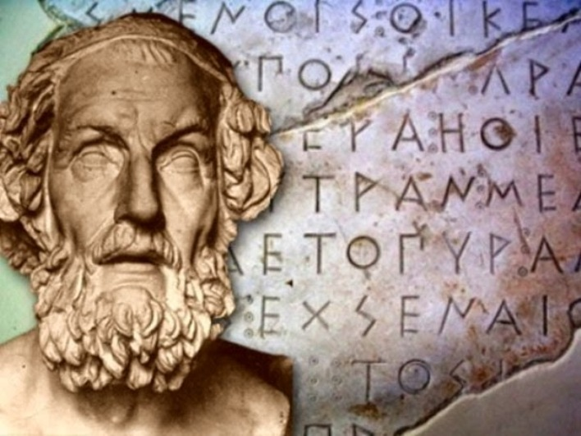
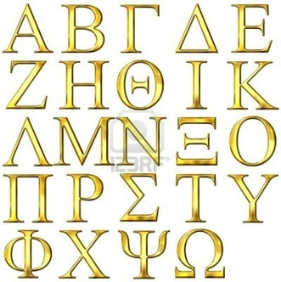
Homer 8th century B.C The Greek alphabet

Slide 48
ΠΑΙΔΑΓΩΓΙΚΗ
PEDAGOGICS
PEDAGOGIA
PEDAGOGIK
PEDAGOGIIKKAA
ΣΧΟΛΕΙΟ
SCHOOL
ESCUELA
SKOLAN
SCOIL
ΜΕΘΟΔΟΣ
METHOD
ΠΡΑΚΤΙΚΗ
PRACTICE
ΜΟΥΣΙΚΗ
MUSIC
ΑΡΜΟΝΙΑ
HARMONY
ΙΣΤΟΡΙΑ
HISTORY
ΜΑΘΗΜΑΤΙΚΑ
MATHEMATICS
ΜΕΛΩΔΙΑ
MELODY
ΡΥΘΜΟΣ
RHYTHM

Slide 49
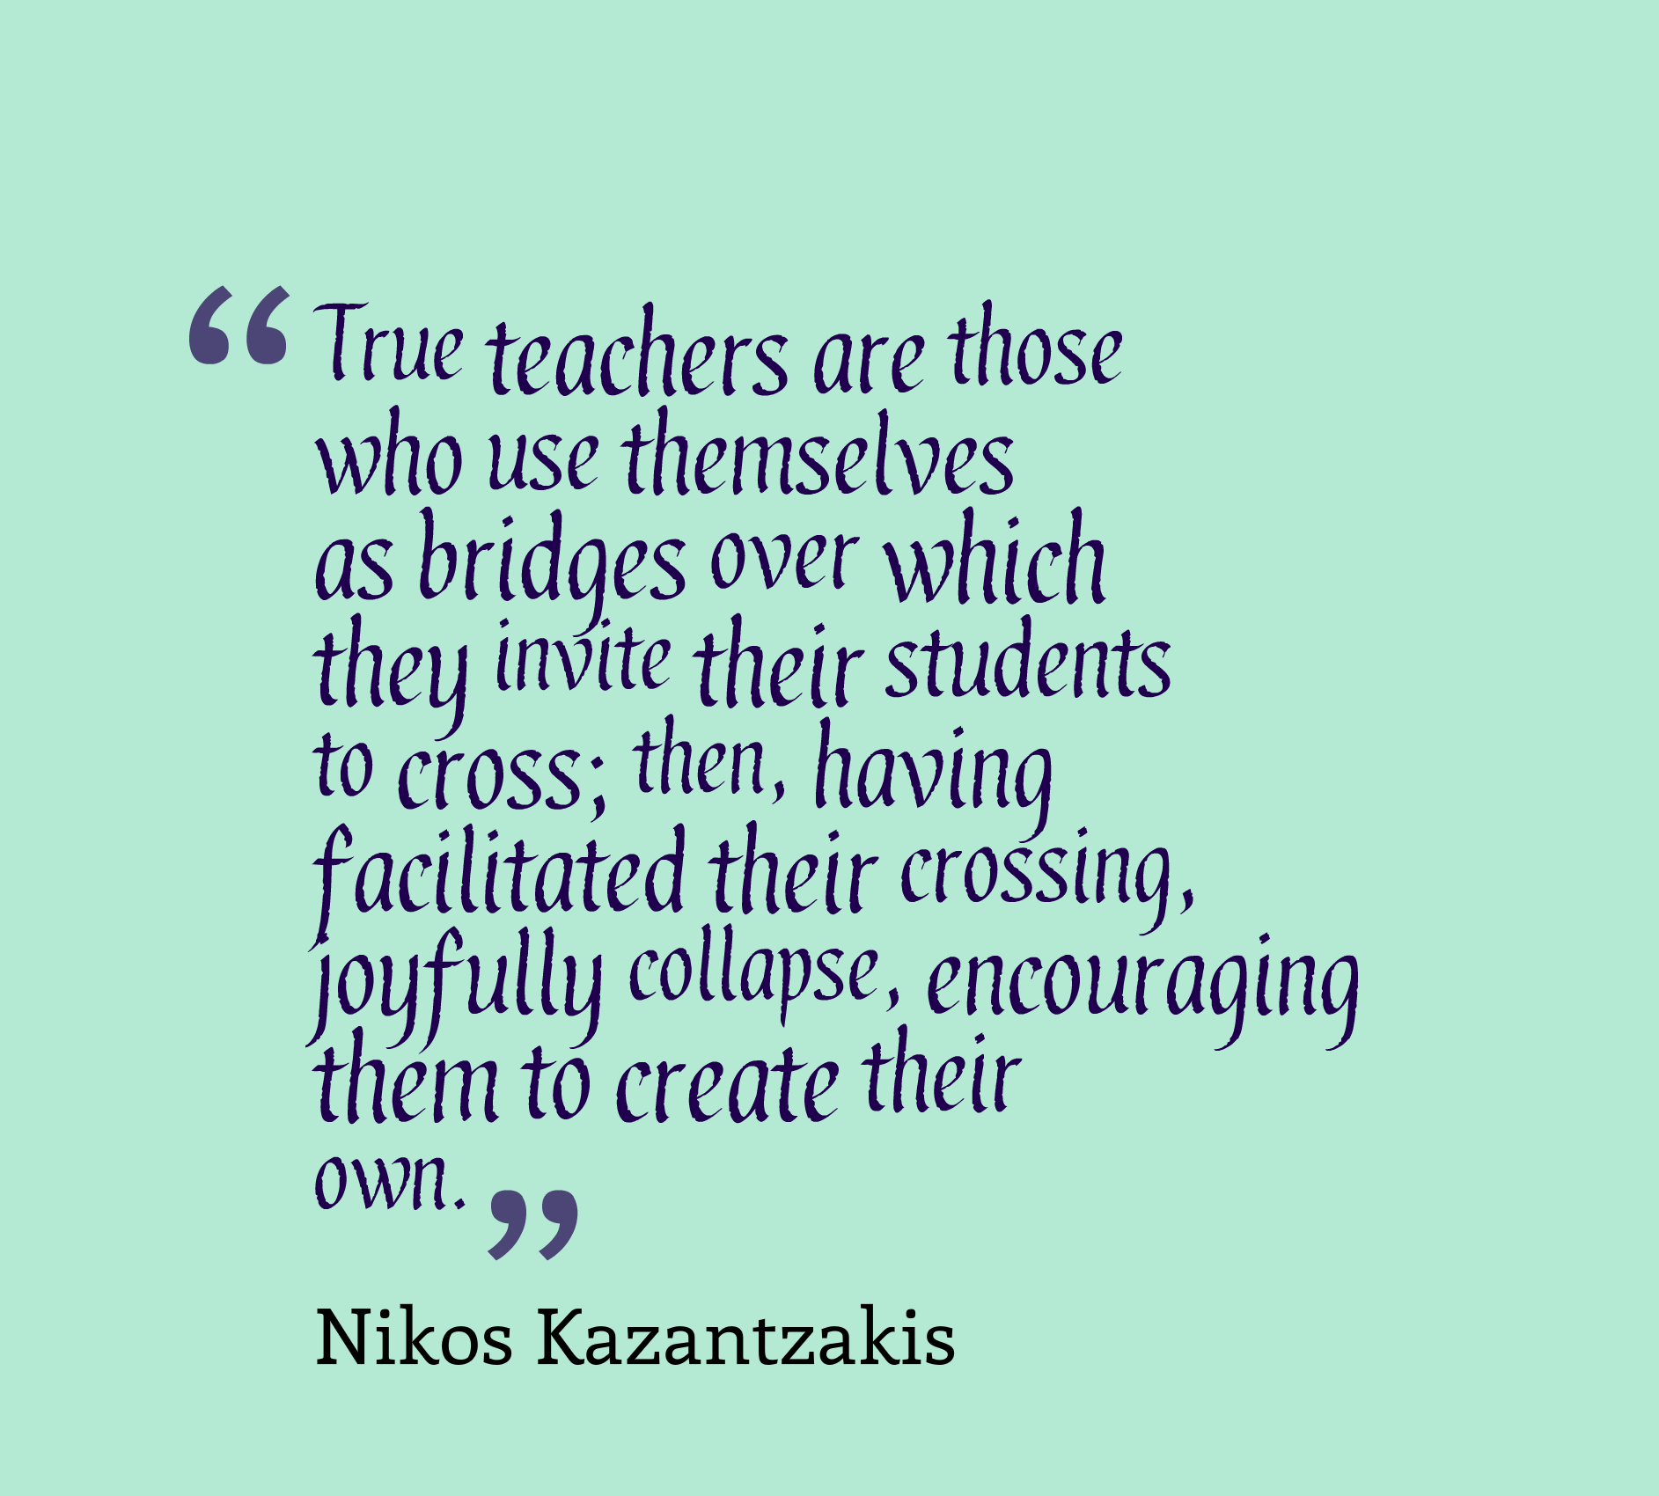
Allow us to finish this presentation with the wise words of a famous Greek writer, Nikos Kazantzakis in relation of our role as true teachers in a child’s intellectual growth.

Slide 50
REFERENCES
Greek Ministry of Education, Culture and Religious Affairs
https://www.minedu.gov.gr/
Myrtis, face to face with the past
http://www.myrtis.gr/index.php?option=com_content&view=article&id=275&Itemid=333&lang=en
Wikipedia
Research, Presentation, Edition
Kalliopi Spanou
English Language teacher
Department of Greek and English Philology
University of Athens

