Slide 1

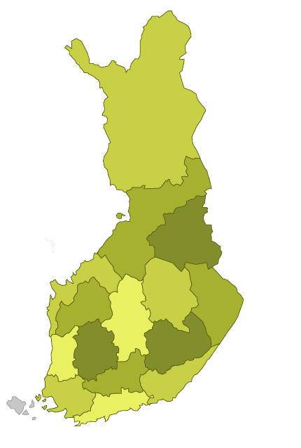
Lifelong Guidance Practice and
Policy Development in Finland
Information, advice and guidance supporting lifelong learning and career management - Lifelong Guidance
Ongoing changes in the labour market, its sectors and professions are pushing individuals to construct their personal career and flexible learning paths through a series of choices they make throughout their lives
Lifelong Guidance - connected with lifelong learning - refers to a range of activities that enable citizens of any age, and at any point in their lives, to:
  Identify their capacities, competences and interests
  Make meaningful educational, training and occupational decisions
  Manage their individual life paths in learning, work and other settings in which these capacities and competences are learned and/or used.
Lifelong Guidance is provided in a range of settings: education, training, employment, community, and private (European Council 2004).
In Finland coherent and well-functioning Information, Advice and Guidance services are based on co-operation with career education and guidance services in schools, career counselling within employment and economic services, workshops and outreached guidance services for youth, work-place guidance and career services provided by employer organisations, trade unions and voluntary/community associations.
Information, Advice and Guidance services support individuals in different points of their lives in
  Acquisition of lifelong career management skills;
  Meaningful educational choises;
  Different transition phases in their career;
  Retention in education and completion of studies and
  Employability
Key outcomes include sustainable solutions meeting the needs of both individuals and the labour market

Slide 2
Co-operation and co-ordination in lifelong guidance
For decades Finland has had a strong tradition of co-operation between different government sectors and service providers.
In 2011 the Ministry of Employment and the Economy and the Ministry of Education and Culture established a National Lifelong Guidance Working Group with representatives from relevant ministries, social security institution, municipalities, education providers, employment and the economy services, regional administration, social partners and voluntary/community organisations. The Working Group has prepared a national lifelong guidance strategy with reference to 2008 Council Resolution policy priorities and ELGPN Work Programmes. During its second term (2015-20), the task of the Working Group is to enhance the systems and policy development of lifelong guidance in national, regional and local levels. The aim is also to strengthen multi-administrative and multi-professional co-operation, avoid overlapping service provision and promote the implementation of the national cross-sectoral ESF-funded Youth Guarantee programme.
In 2012-13 the regional Centres for Economic Development, Transport and the Environment (ELY-centres) were given a task to co-ordinate the development work as well as to promote quality and access to lifelong guidance services in their own region. The co-ordination task is supported by regional Lifelong Guidance Working groups with representatives from regional administration, employment and economic services, educational institutes, municipalities, social partners and voluntary/community organisations.
In 2015-16 the main task of the regional Lifelong Guidance Working Groups is to contribute to:
    the establishment and development of low-threshold cross-sectoral guidance services and
    the use of Information and Communication Technology in guidance and the development of integrated online career services
In 2007-2015 Finland has participated actively in the work of the European Lifelong Guidance Policy Network (ELGPN) as well as hosted the ELGPN Co-ordination Unit in Finland. The Network has developed the European Guidelines for Lifelong Guidance Practice and Systems Development, to promote the acquisition of lifelong career management skills and quality of the services. The Information, Advice and Guidance services in Finland meet these jointly-agreed Guidelines well. The PISA 2012 Study results on career education provide evidence that the Finnish adolescents report to have acquired competence in many dimensions of career management skills (CMS). The integration of career education and career guidance as a compulsory element in the national core curricula provides a strong basis for CMS development as a lifelong continuum.

