Slide 1
TURKEY
ISTANBUL
SIYAVUSPASA

Slide 2
Located in Bahcelievler, Europen Side
ABOUT OUR SCHOOL
There are a total of 103 and a total of 1519 students in our school.
Siyavuşpaşa Vocational and Technical Anatolian High School.
There are 8 departments:

Slide 3
The departments in our school are:
Food and Beverage Services
Information technologies
Shoes and Saddlery
Fashion design
Graphics and Photography
Handicrafts
Child Development and Education
Marketing and Retail

Slide 4
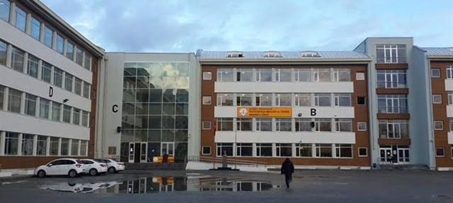
In every department in our school, lessons are taught with detail and meticulousness so that we can have a profession in the future.

Slide 5
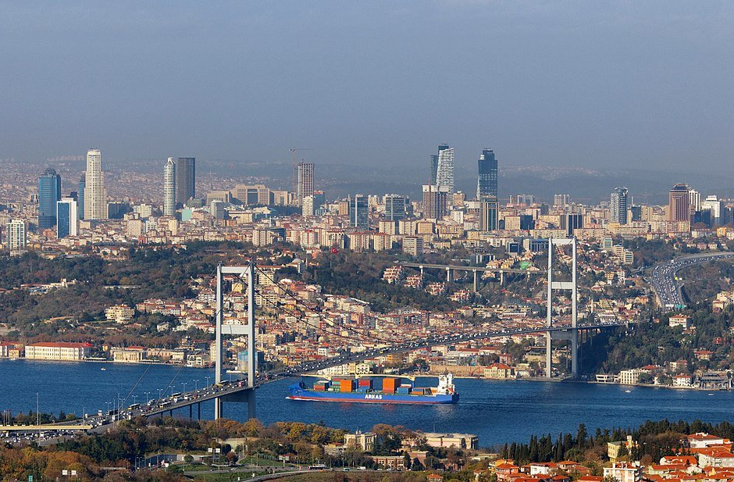
ISTANBUL
Istanbul, is one of the most active places in our country.
Although this city is overcrowded, it has a great historical past.
It is one of our leading cities economically, historically and socio-culturally.

Slide 6
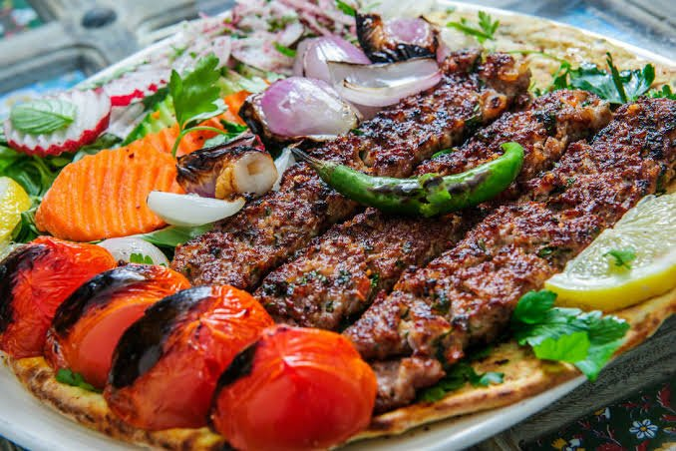
OUR
DISHES:
KEBAP
There are various kinds of food in our food culture and these are the most well-known ones.

Slide 7
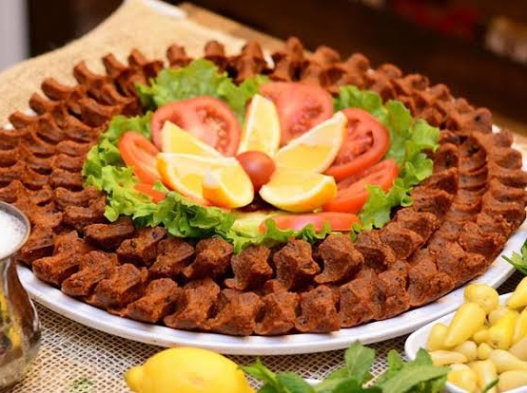
ÇİĞ KÖFTE
You should definitely try our delicious dishes. Since spice is very popular in some of our cities, our meals are divided into two as spicy and non-spicy

Slide 8
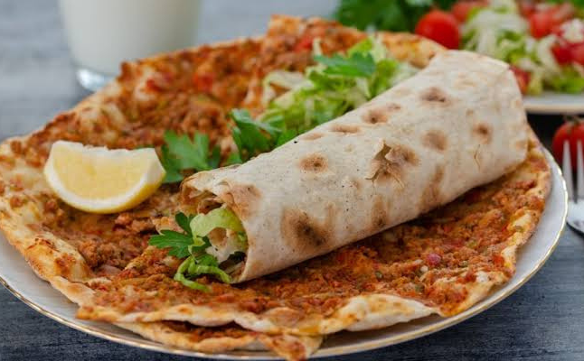
LAHMACUN
Especially this dish is very famous. It is one of the first 4 things that come to mind when you say Turkey.

Slide 9
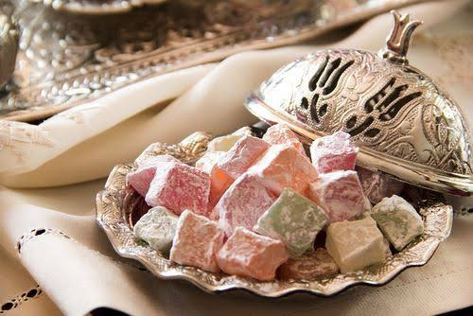
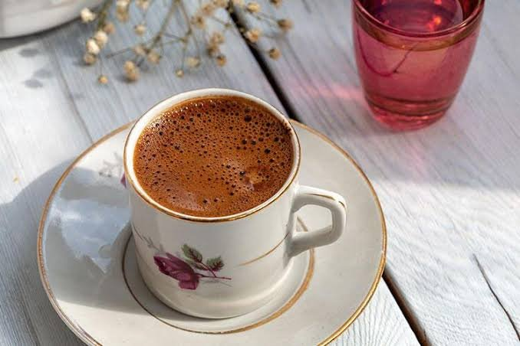
turkısh delight and coffee
Turkish coffee and Turkish delight are an inseparable duo, they are more delicious when they are combined. Since Turkish coffee is a bit strong, it is recommended to drink it with sugar if you are not used to strong coffees.

Slide 10
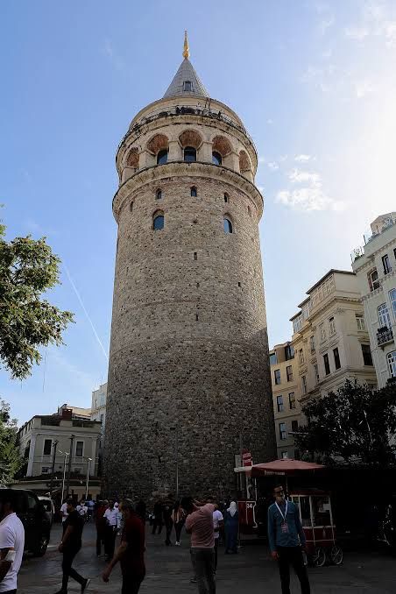
PLACES TO VISIT IN TURKEY
galata tower:
There are many historical and ethnic structures to visit in our country. We got the most popular ones.
Many stories are told about the Galata tower and I think one of the most beautiful ones is this: it is thought that you will marry the person you go up to the tower with. That's so romantic.

Slide 11
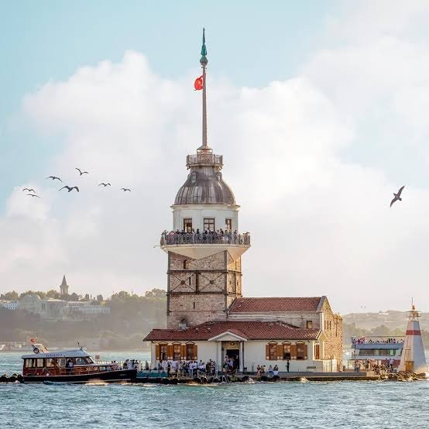
MAIDEN'S TOWER
Is that an emperor's daughter is told that when she turns 18 she will be bitten by a snake and die. Impressed by this information, the king built the Maiden's Tower on a small island and thought that his daughter would be safe there.

Slide 12
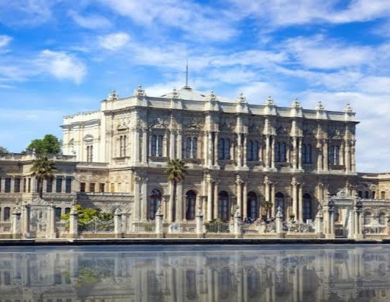
Dolmabahçe Palace
Dolmabahçe Palace was built by Garabet Amira Balyan and her son Nikogos Balyan. It doesn't have a story, but its majestic appearance will impress you greatly.

Slide 13
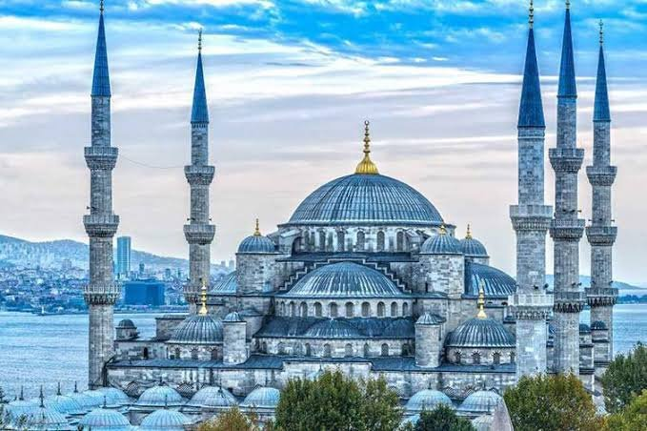
SULTANAHMET MOSQUE blue mosque
The mosque, which was built in the 17th century by the students of Mimar Sinan, Sedefkar Mehmet Ağa and Sultan Ahmet I, is right across the Hagia Sophia.

Slide 14
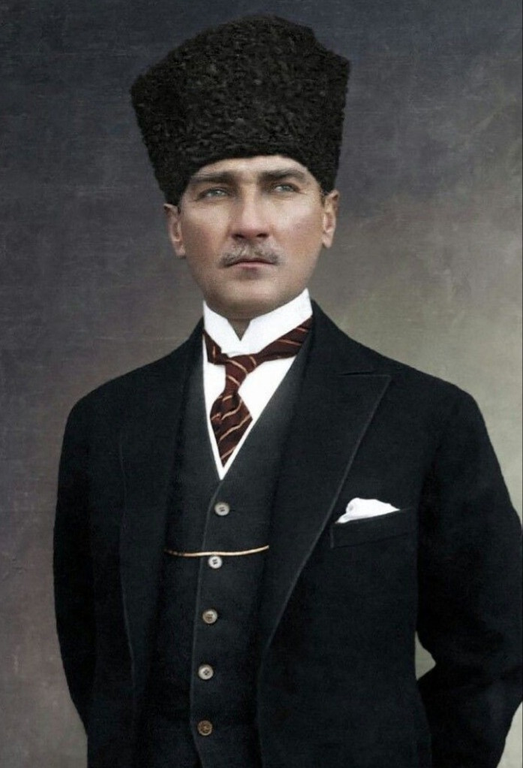
MUSTAFA KEMAL ATATÜRK
1881 - 1938
The founder of the Turkish Republic and its first President, stands as a towering figure of the 20th Century.
His achievements in Turkey are an enduring monument to Atatürk. Emerging nations admire him as a pioneer of national liberation.

Slide 15
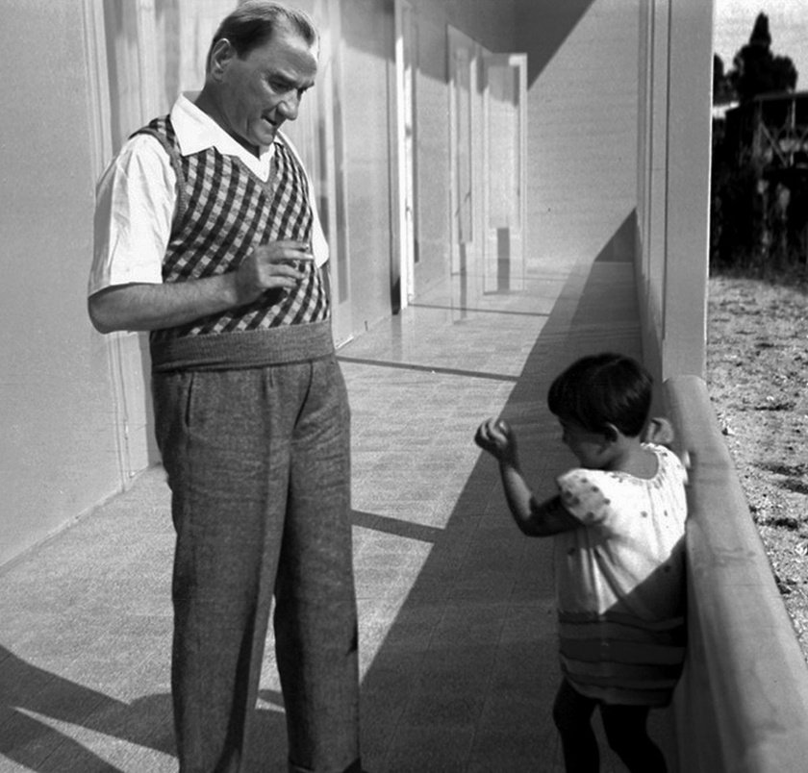
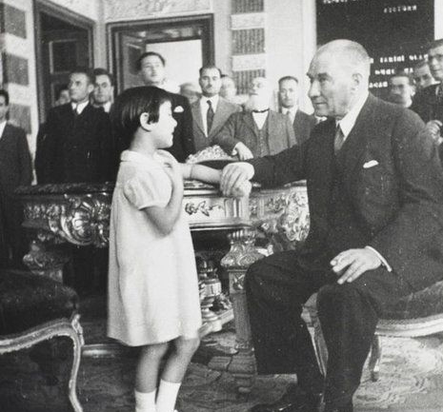
Atatürk valued young people and children very much. Because he thought they were the light of our country's future.

Slide 16
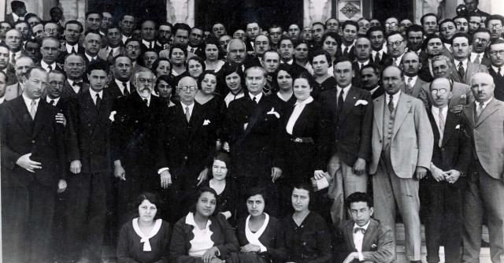
He was always respectful of women, did many things that represented freedom, such as the right to vote, the right to divorce.

Slide 17
SOME IMPORTANT WORDS OF ATATÜRK:
Following the military triumph we accomplished by bayonets, weapons and blood, we shall strive to win victories in such fields as culture, scholarship, science and economics.
To see me does not necessarily mean to see my face. To understand my thoughts is to have seen me.
Teachers: the new generation will be your devotion.

Slide 18
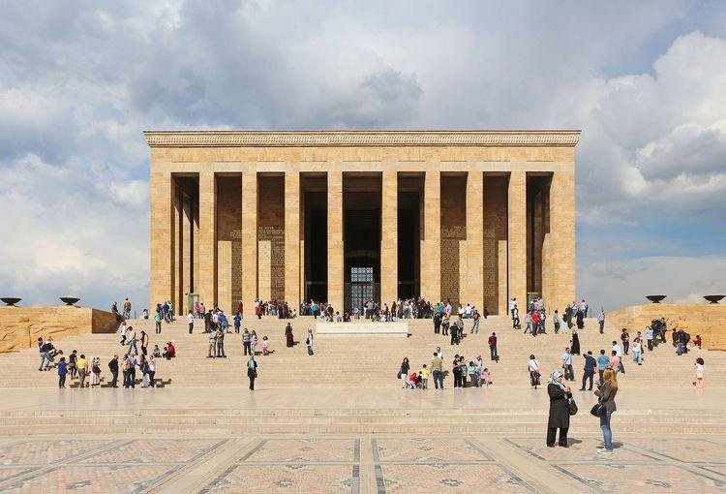
ANITKABIR:
Anıtkabir is a complex containing the mausoleum of Mustafa Kemal Ataturk in the Cankaya district of Ankara, Turkey.

Slide 19
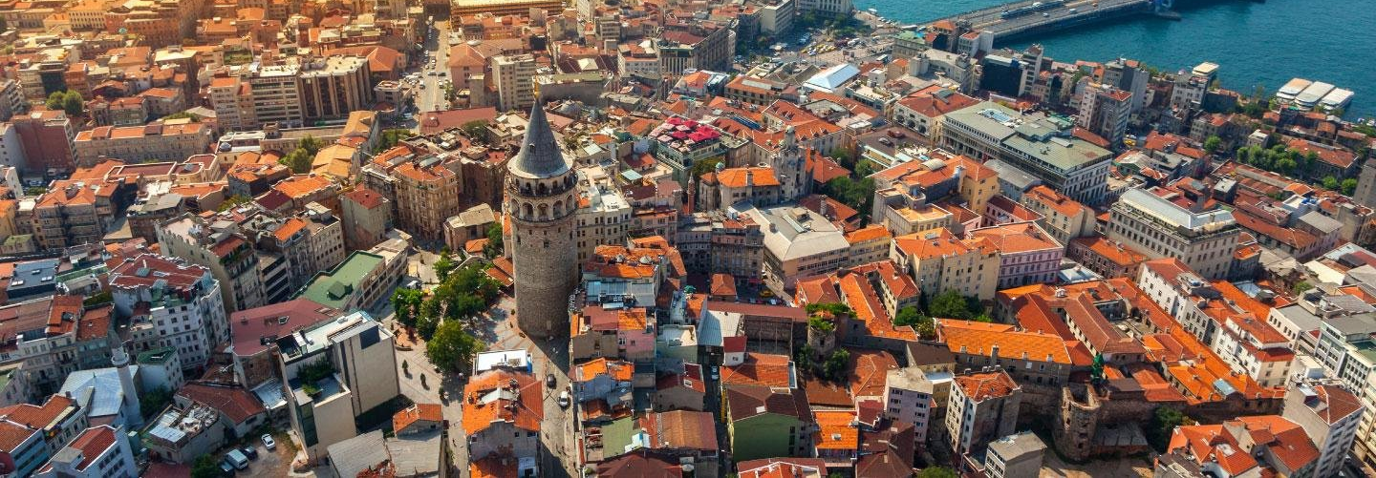
TURKEY:
Turkey, country that occupies a unique geographic position, lying partly in Asia and partly in Europe. Throughout its history it has acted as both a barrier and a bridge between the two continents. Also, our capital city is Ankara, where Anıtkabir is located.

Slide 20
Today, in this presentation, we introduced our country to you. I hope you enjoyed our presentation, thank you for listening to us :)

