Slide 1
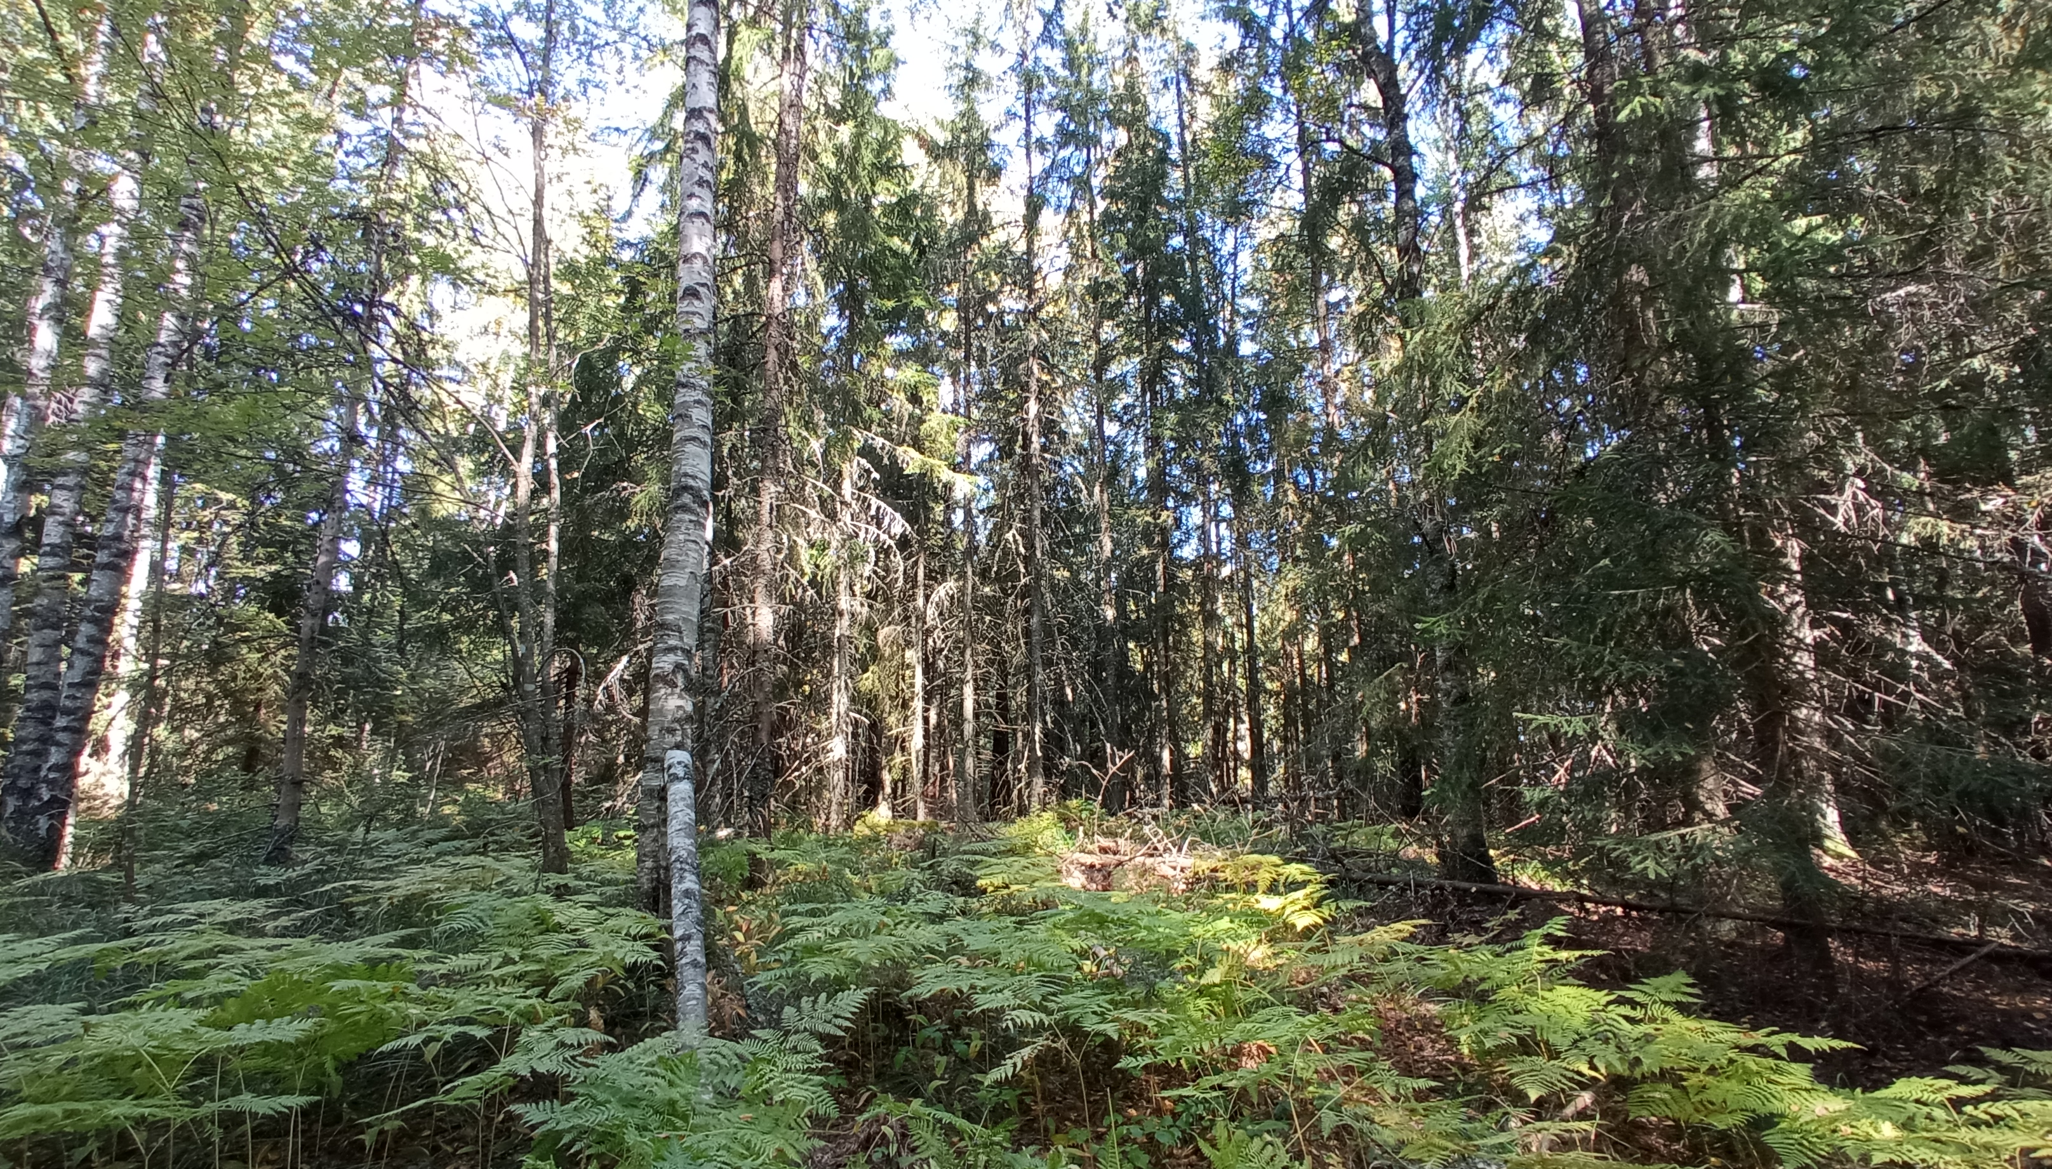
Group 5: Torronsuo: experiences from the day
TORRONSUO NATIONAL PARK

Slide 2
INDEX
How to get to Torronsuo? What is Torronsuo? History and creation of Torronsuo The routes of Torronsuo The flora in Torronsuo Final experience (Reception and snack)

Slide 3
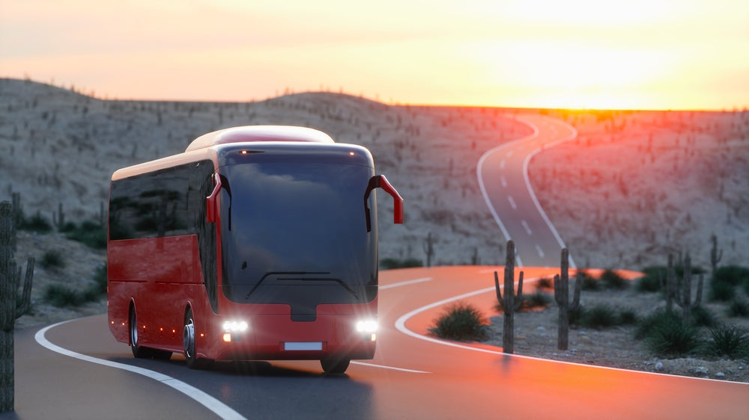
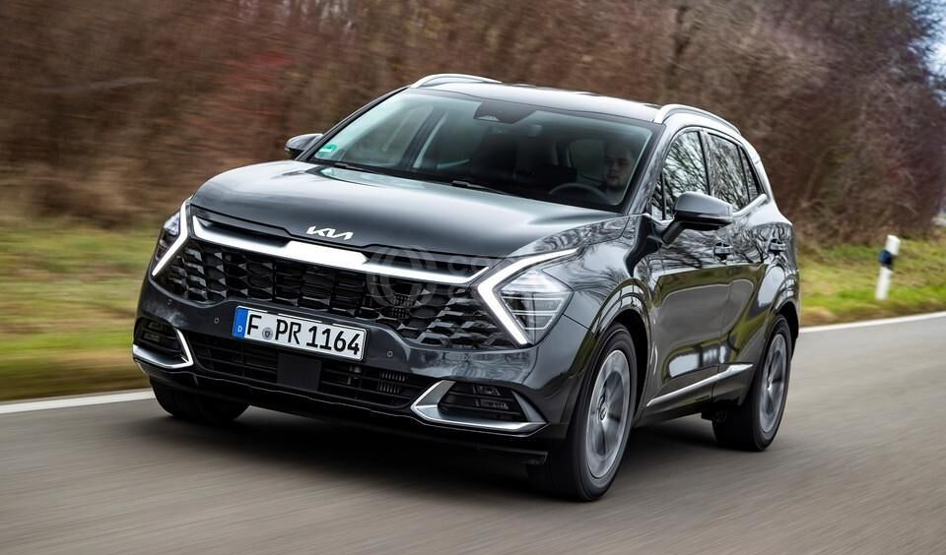
How to get to Torronsuo

Slide 4
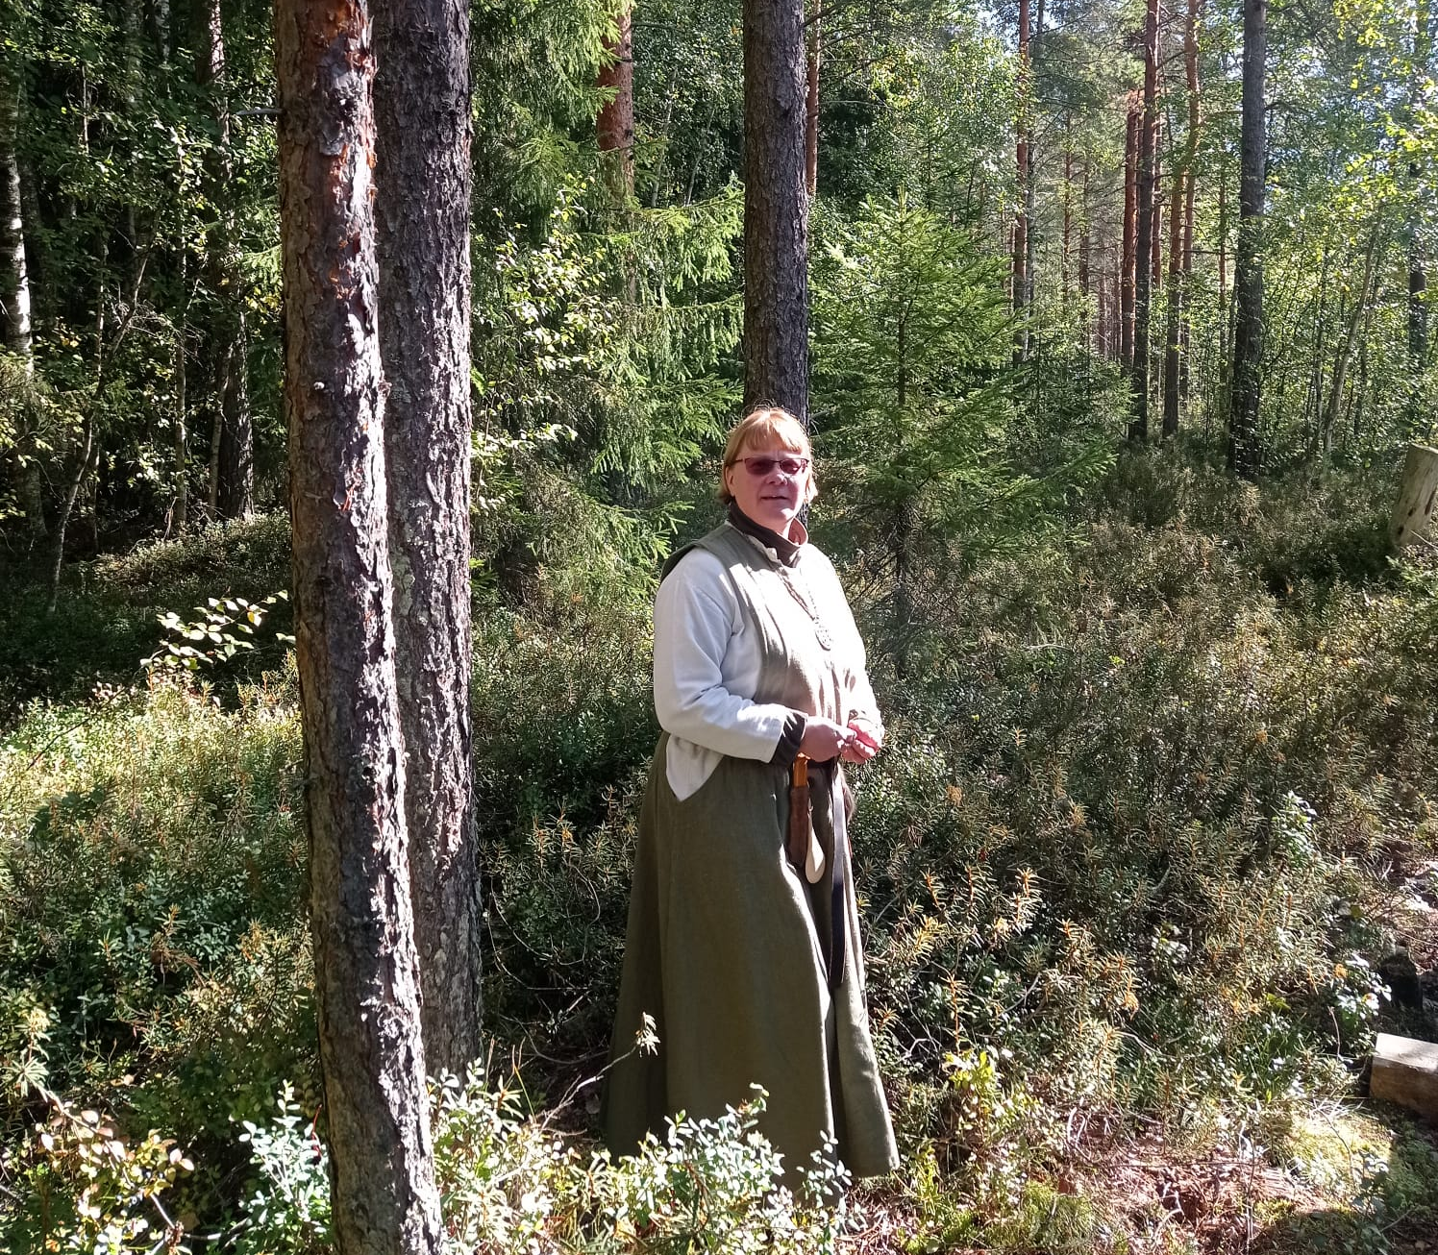
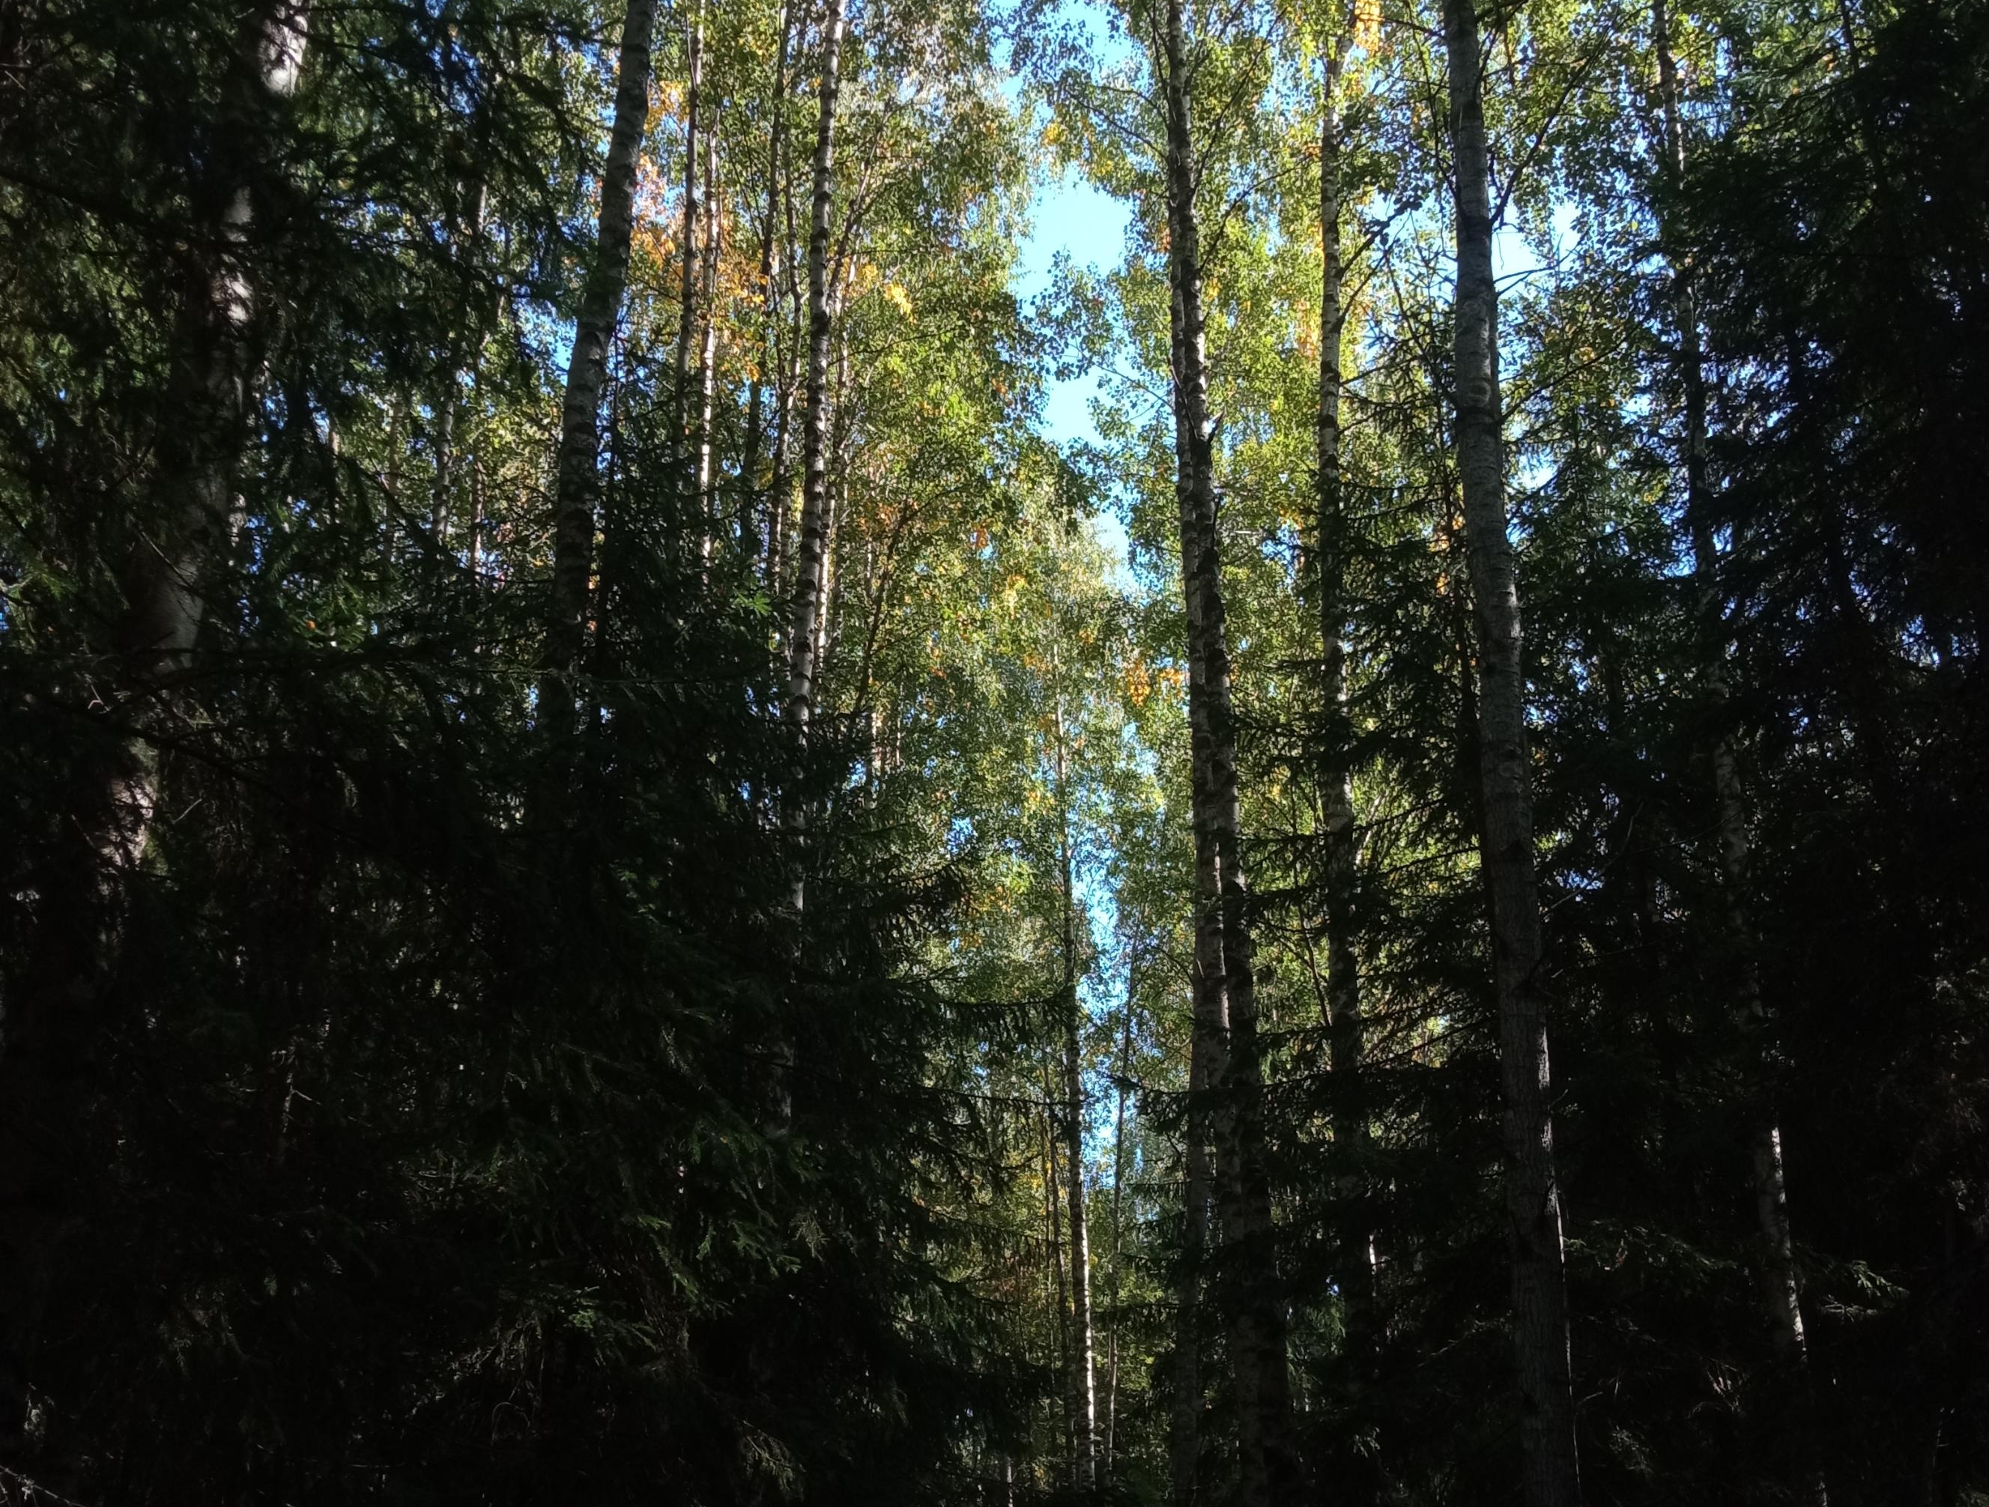
What is Torronsuo?

Slide 5
History and creation of Torronsuo

Slide 6
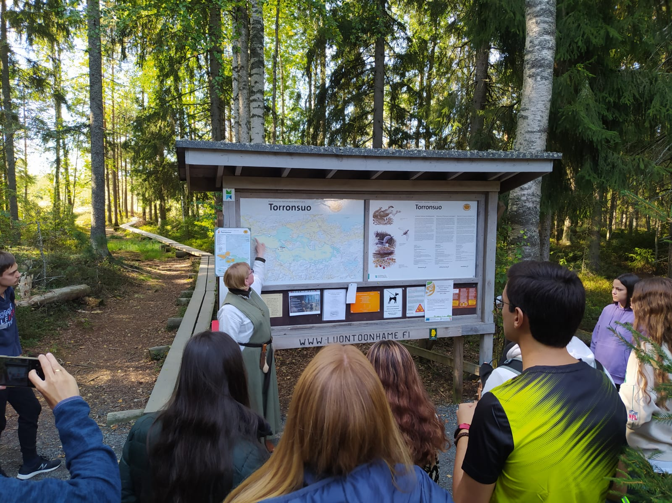
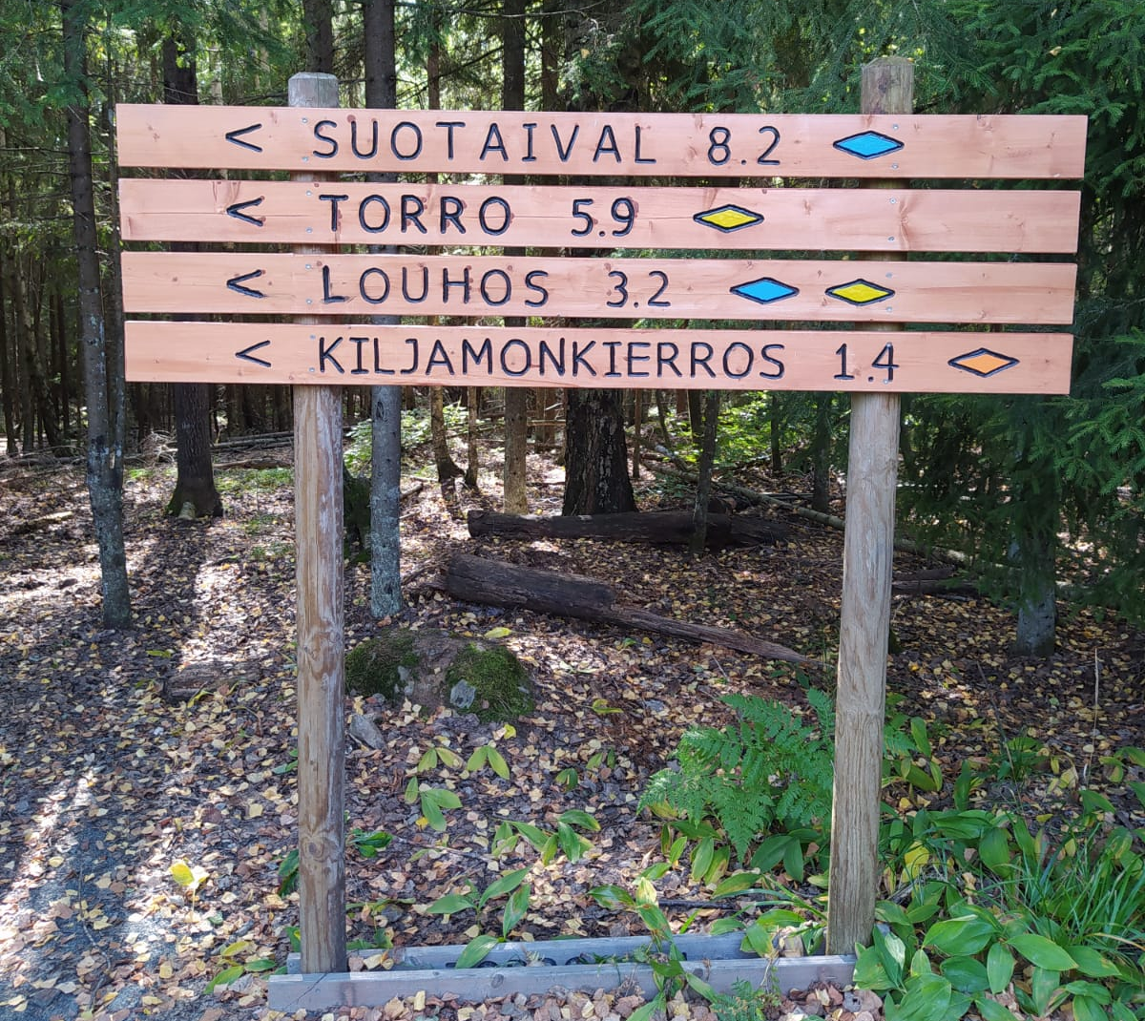
The routes to Torronsuo

Slide 7
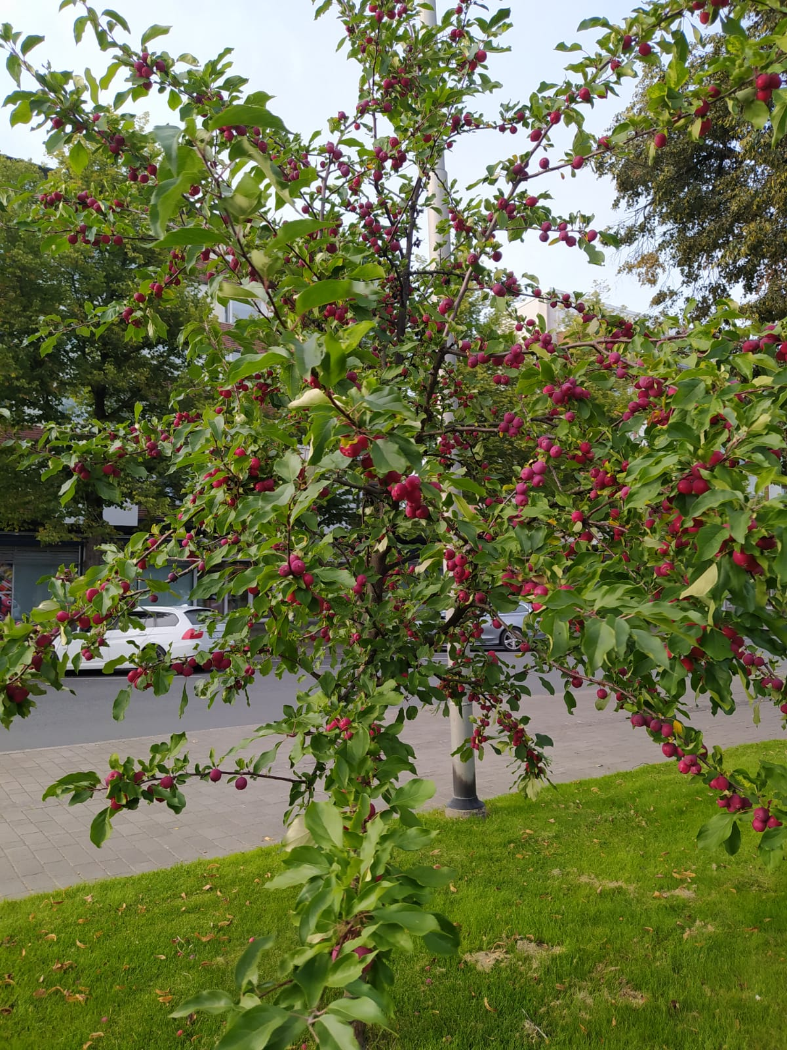
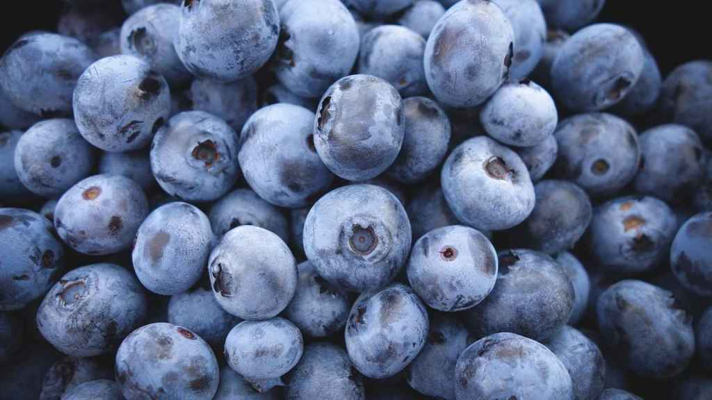
The flora in Torronsuo

Slide 8
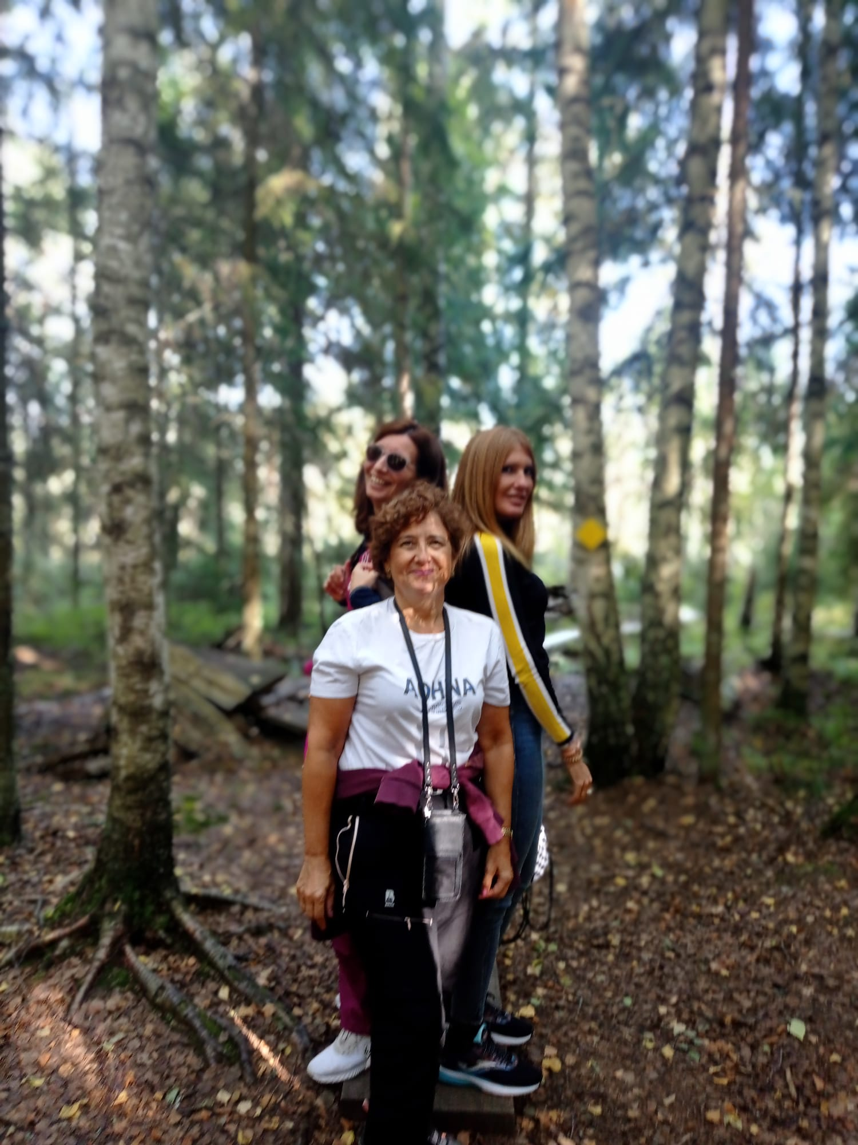
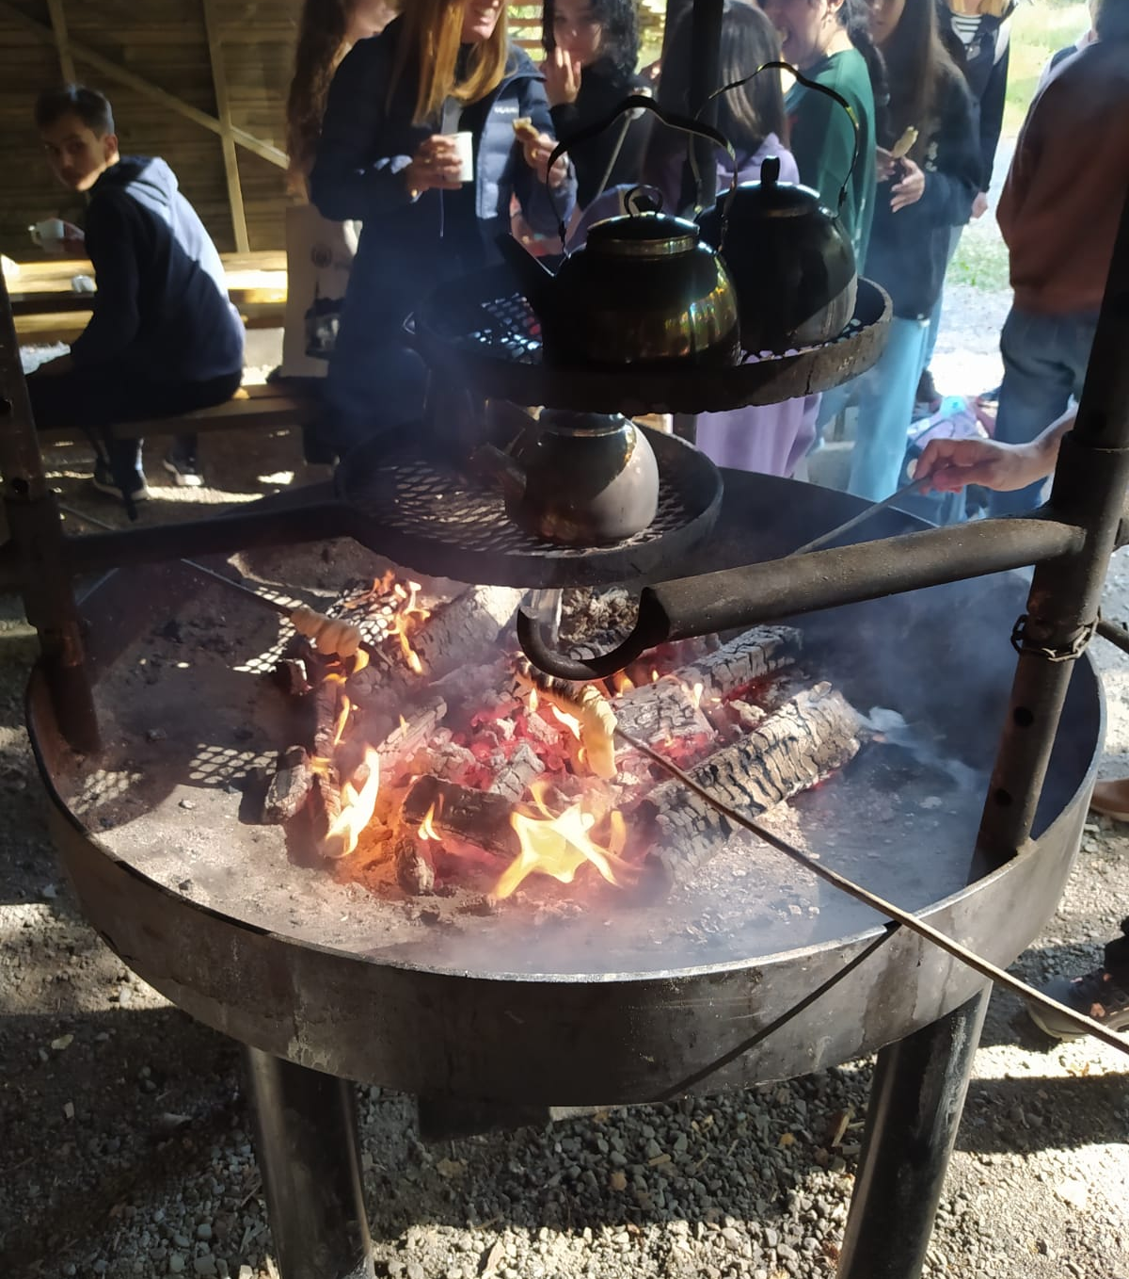
Final experience (welcoming and snack)

