Slide 1
Group 5: Torronsuo: experiences from the day Torronsuo day

Slide 3
General info: Torronsuo
A large swamp in the middle of nowhere
It has been made into a naturalpark to help preserve the kind of nature it contains
Torronsuo is the best place for people who don’t have a cabin but still want to experience nature as it is
The swamp is 12 meters deep and falling into a suonsilmä would be a really bad way to try and learn how to swim
Torronsuo has 31 square kilometers for you to get lost in if you start wandering off on your own

Slide 4
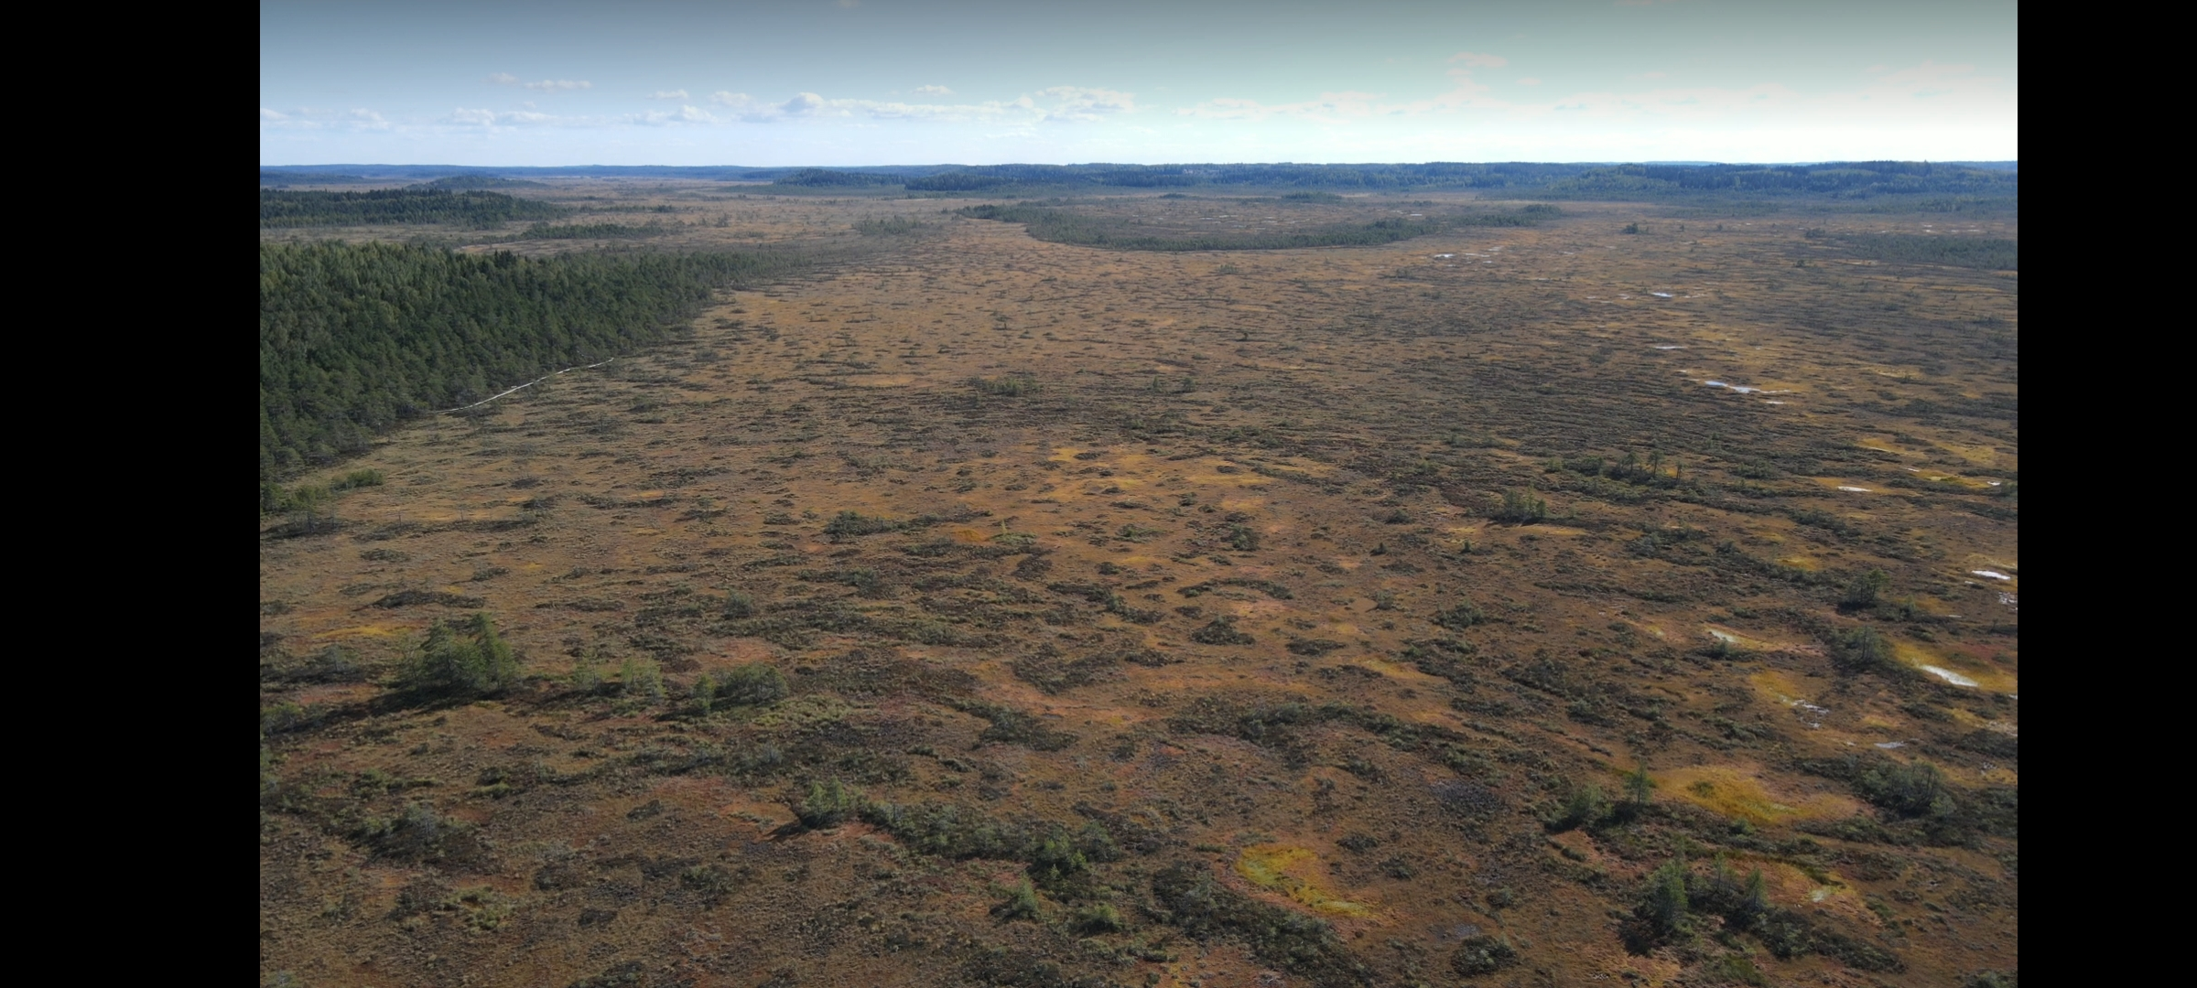

Slide 5
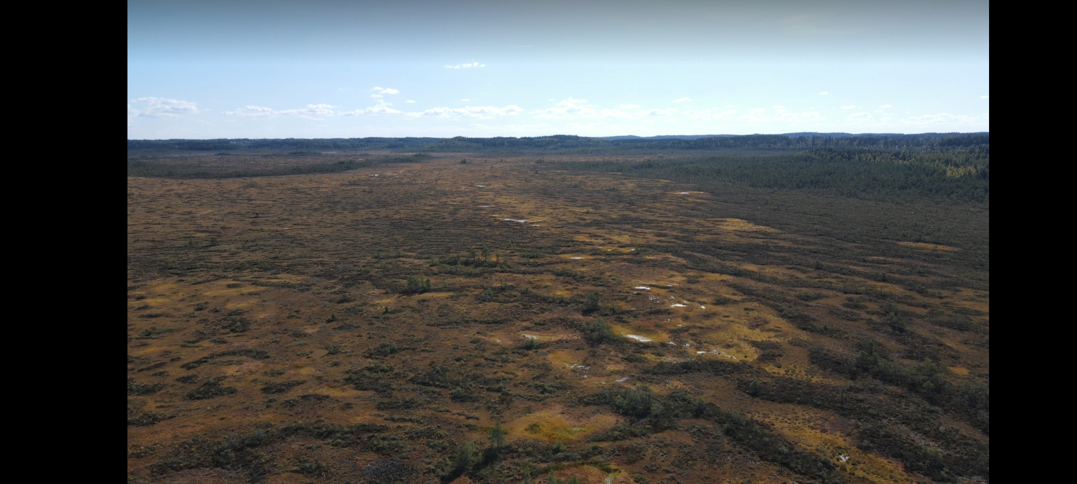

Slide 6
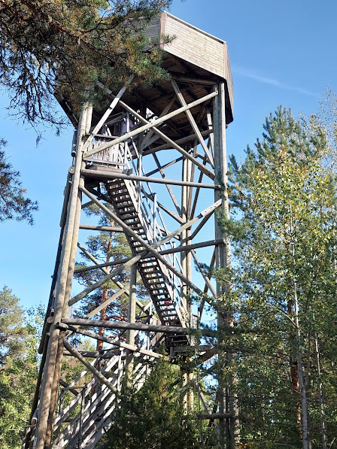

Slide 7
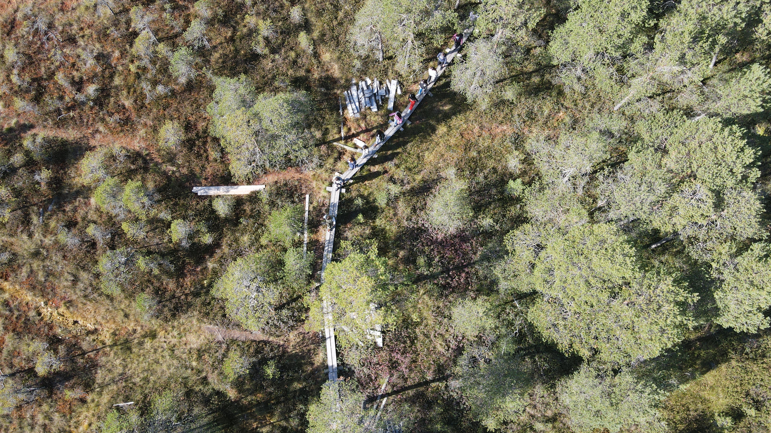

Slide 8
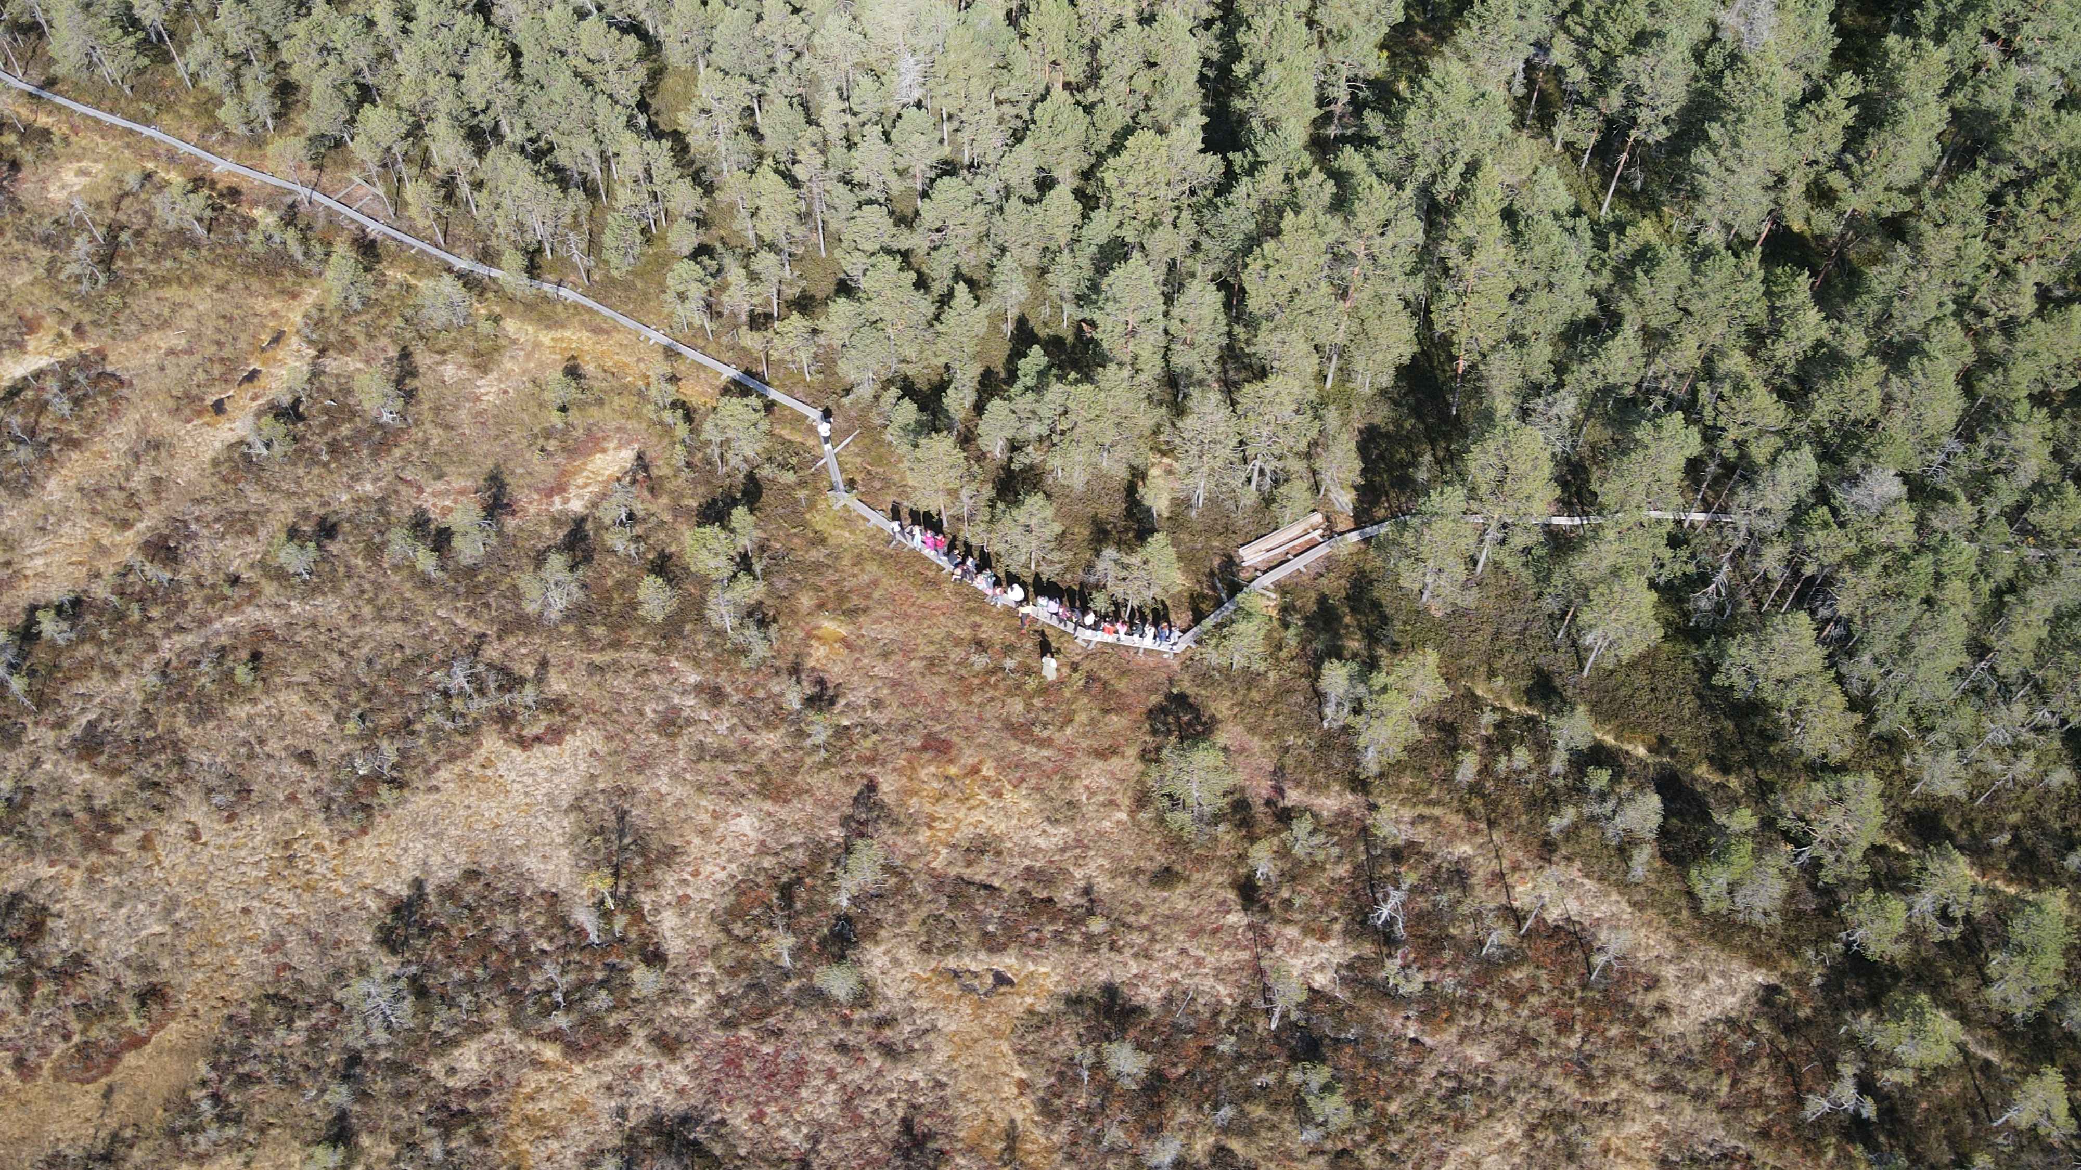

Slide 9
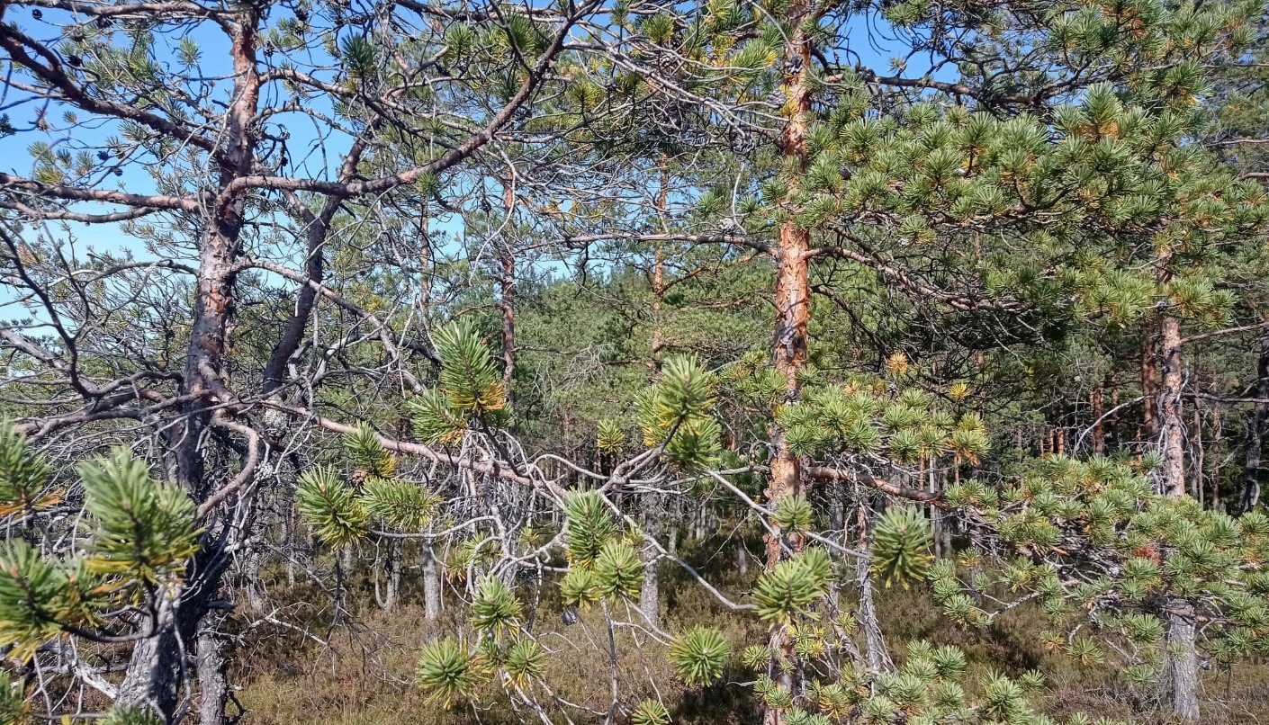
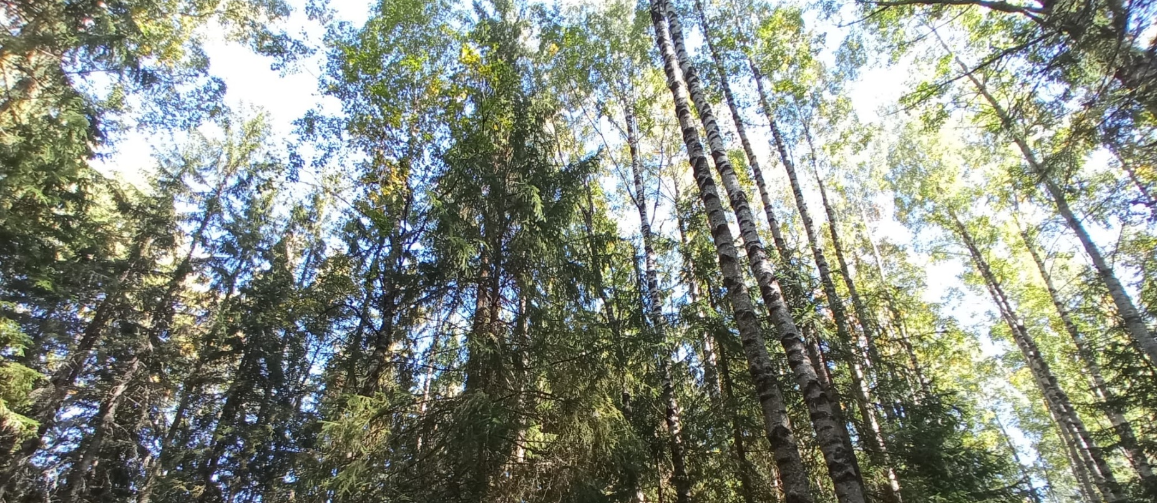

Slide 10
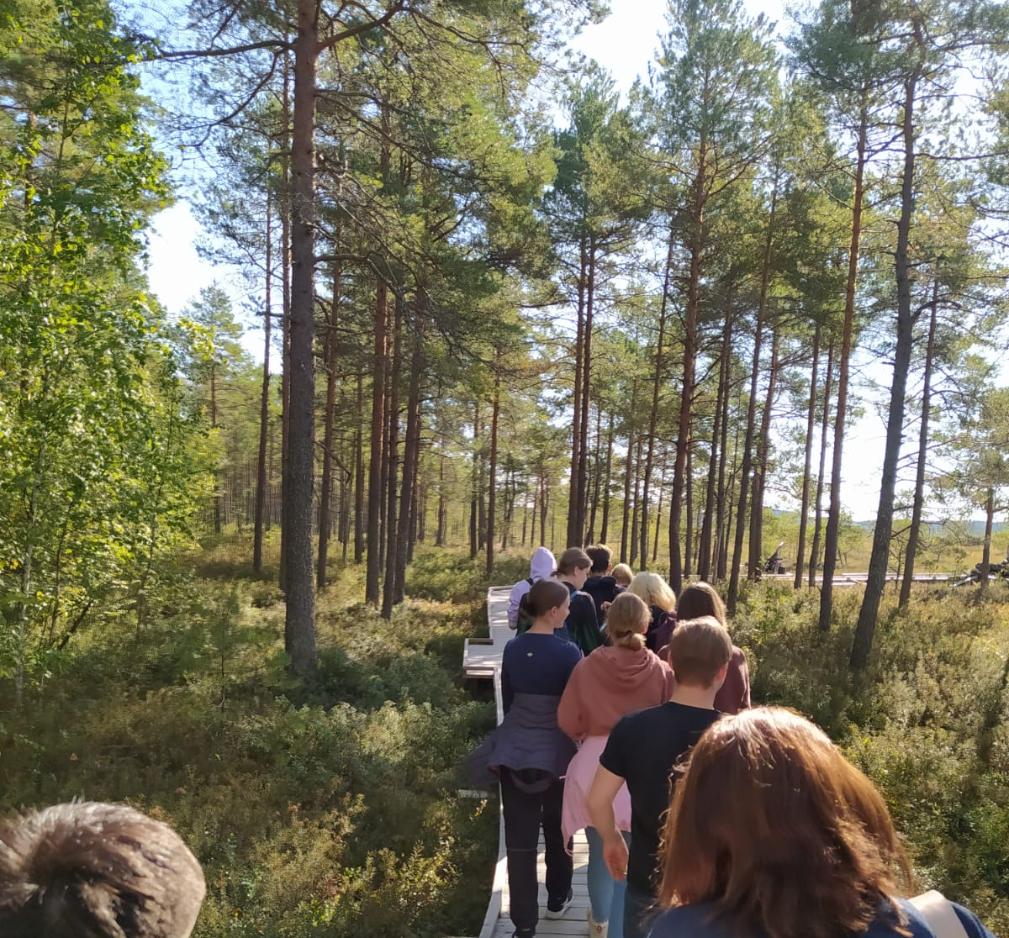
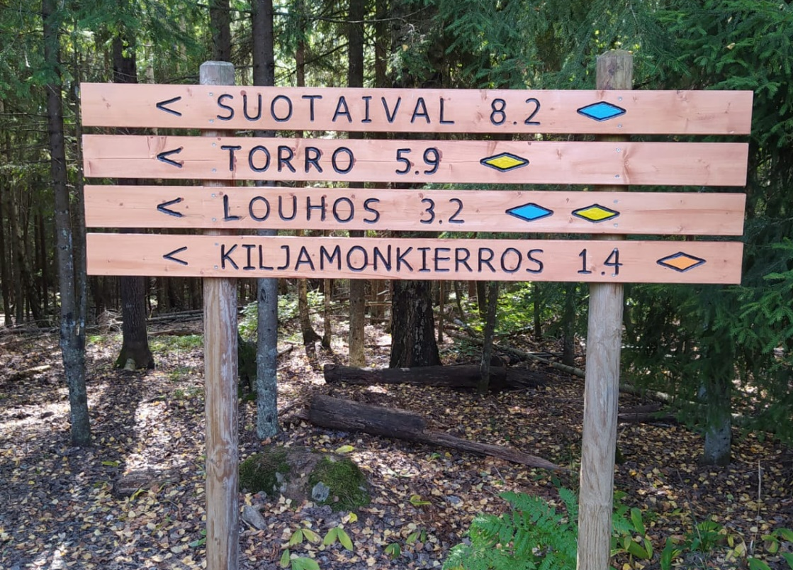
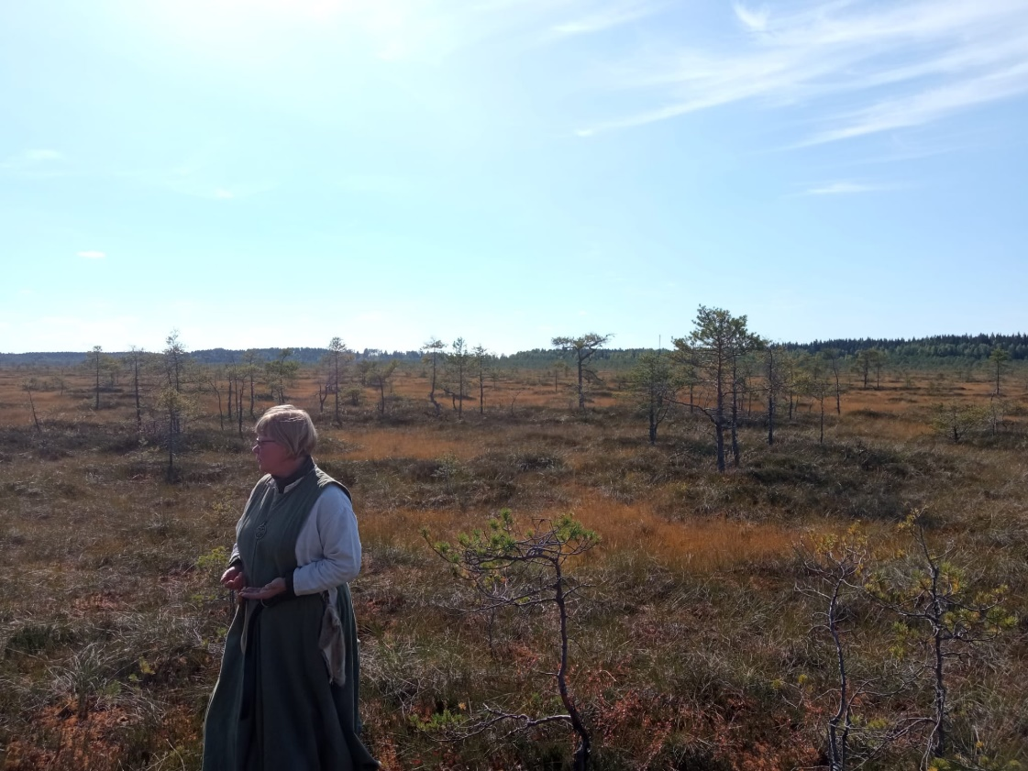

Slide 11
