Slide 1



Enhancing ICT skills
through exploring our
European Cultural Identity
ENCIRCLE
2019-2021

Slide 2

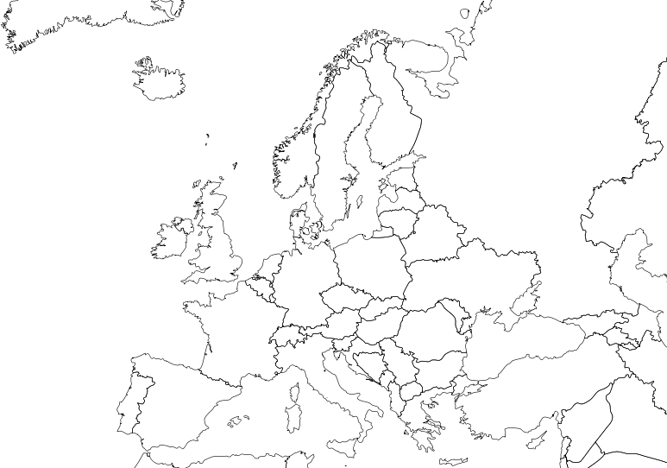







2019-2021
PROJECT REFERENCE No:
2019-1-CY01-KA229-058247_1

Slide 3
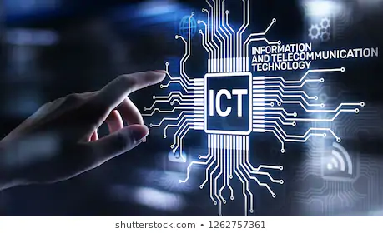
Enhancing ICT skills
through exploring our
European Cultural Identity
PROJECT DESCRIPTION
PARTICIPATING ORGANISATIONS
GENERAL OBJECTIVE
ACTIVITIES. MOBILITIES
BUDGET SUMMARY
2019-2021

Slide 4


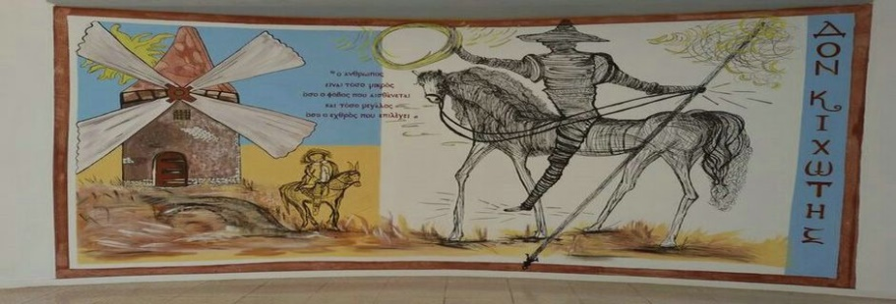
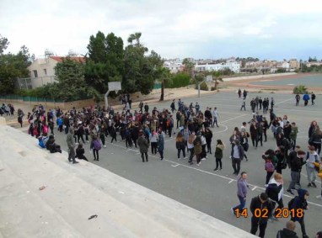
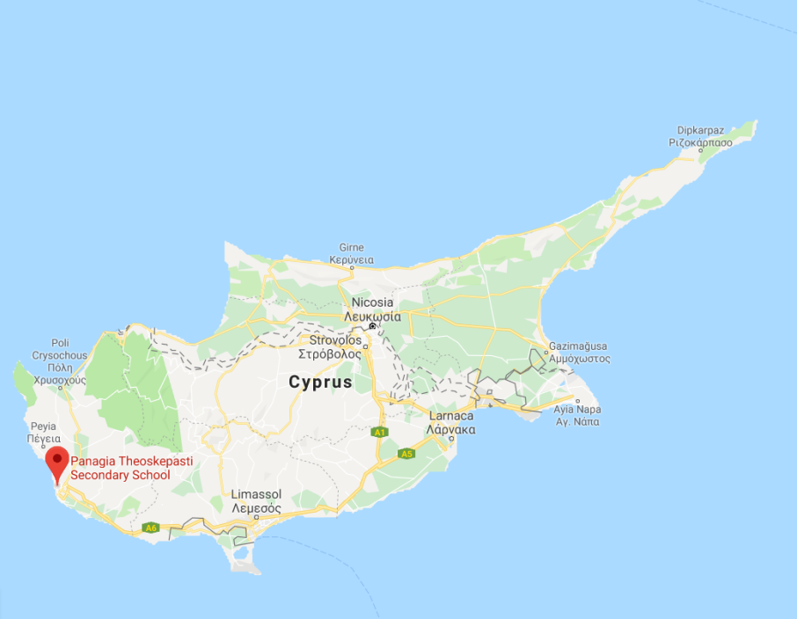
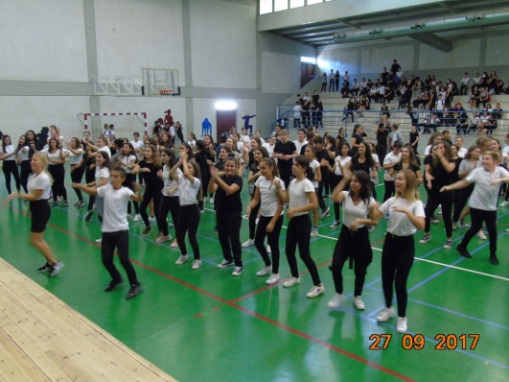
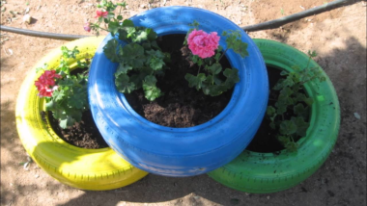

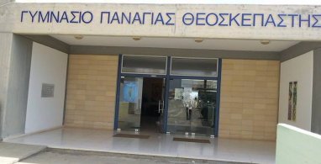
Enhancing ICT skills through exploring our European Cultural Identity
PARTNER SCHOOLS
Gymnasium Panagias Theoskepastis, Paphos, Cyprus.

Slide 5
Enhancing ICT skills through exploring our European Cultural Identity
PARTNER SCHOOLS
Gymnasium Panagias Theoskepastis, Paphos, Cyprus
Scoala Gimnaziala Magura, Buzau, Romania
Agrupamento Vertical de Escolas da Sé, Portugal
Pales pamatskola, Pāle, Latvia
Eurajoen yhteiskoulu, Eurajoki, Finland

Slide 6
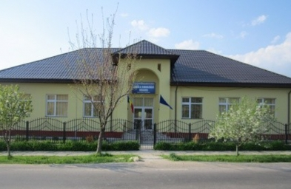
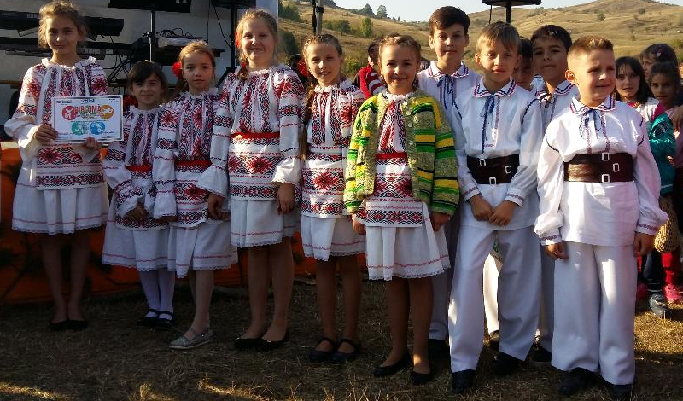
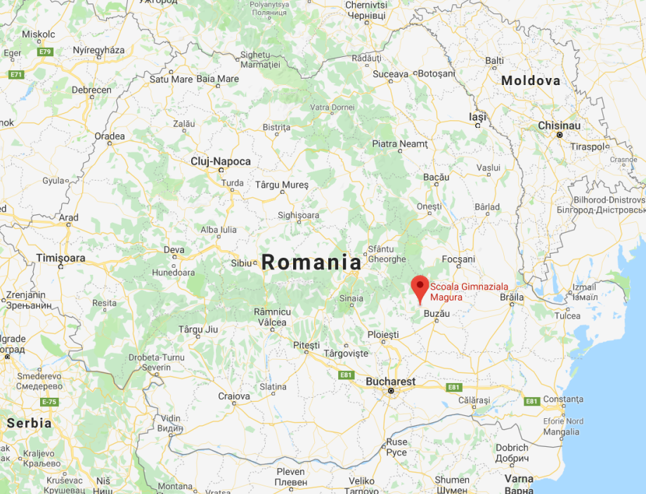
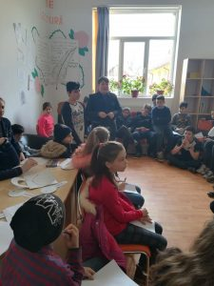
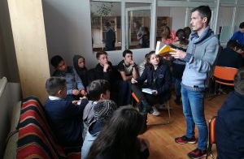

Enhancing ICT skills through exploring our European Cultural Identity
PARTNER SCHOOLS
Scoala Gimnaziala Magura, Buzau, Romania.

Slide 7
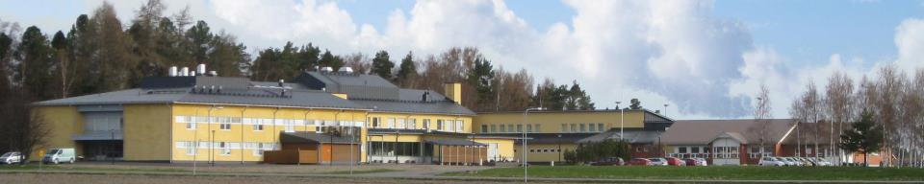
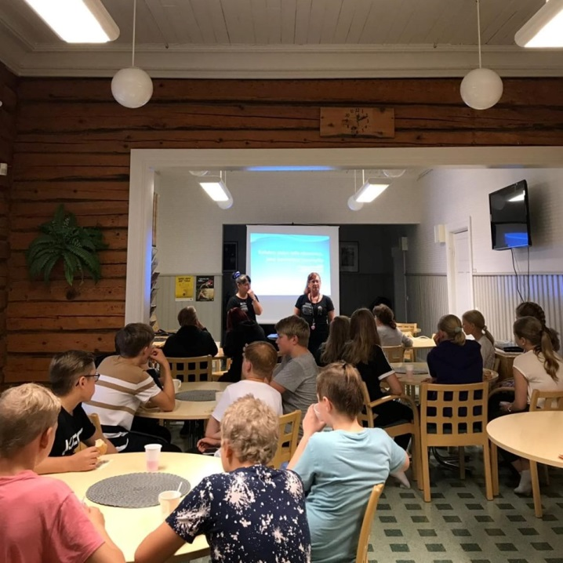
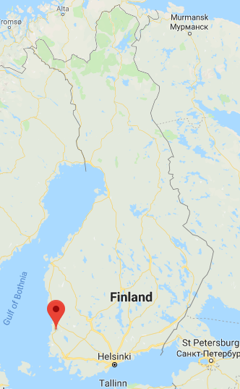
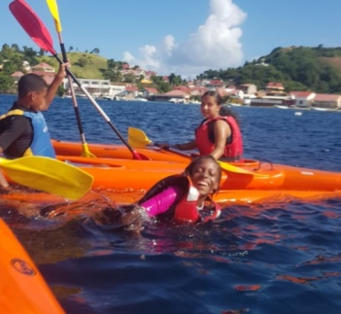
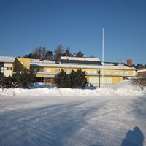
Enhancing ICT skills through exploring our European Cultural Identity
PARTNER SCHOOLS
Eurajoen yhteiskoulu, Eurajoki, Finland

Slide 8
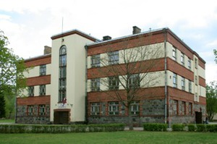
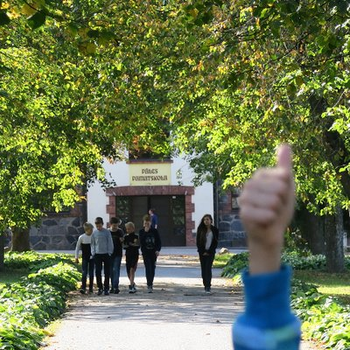
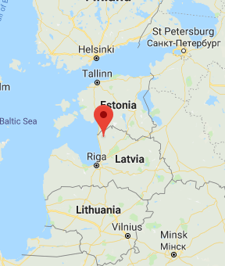
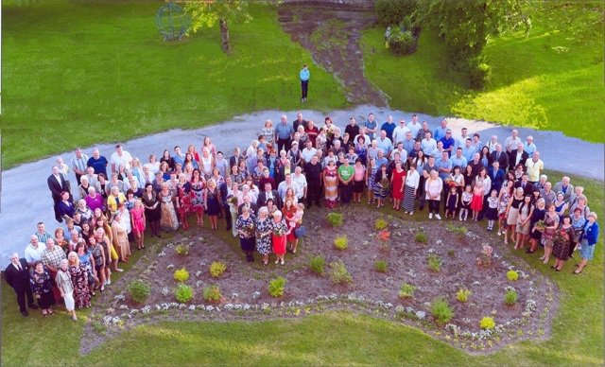
Enhancing ICT skills through exploring our European Cultural Identity
PARTNER SCHOOLS
Pales pamatskola, Pāle, Latvia

Slide 9
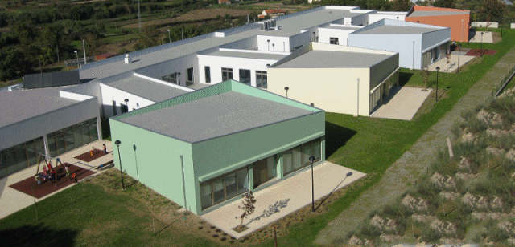
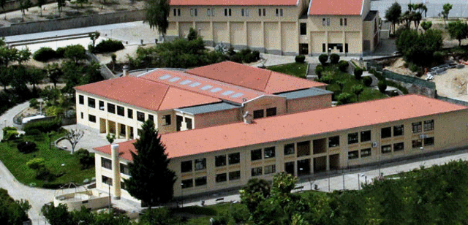
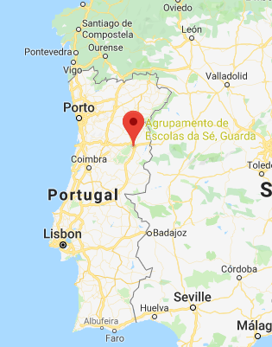
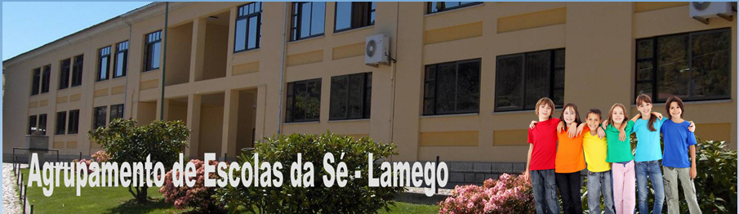
Enhancing ICT skills through exploring our European Cultural Identity
PARTNER SCHOOLS
Agrupamento Vertical de Escolas da Sé, Portugal

Slide 10

Enhancing ICT skills through exploring our European Cultural Identity
GENERAL OBJECTIVE
The need to successfully tackle the continuous progress of digital technology through the need to adapt the learning process to increasingly culturally heterogeneous groups of students, with an emphasis on enhancing European values such as tolerance, understanding of other cultures and respect for human rights.

Slide 11
Enhancing ICT skills through exploring our European Cultural Identity
SIDE OBJECTIVES
Keep up with the constant advances in digital technology
Introduction of new ICT-based teaching methods
Recognition and assimilation of the values ​​of national culture within the European family
Addressing the problems of culturally diverse people within the EU through education
Educating our students on issues such as flexibility, expanding their cultural horizons and knowledge, tolerance for different cultures and human rights
Identifying the similarities and differences of the cultures of the participating countries

Slide 12

Enhancing ICT skills through exploring our European Cultural Identity
ACTIVITIES
According to the objectives, we have designed four directions to define four stages of the project progress. They are:
1. SCHOOLS AND COMMUNITIES
2. OUR CULTURAL IDENTITY IN THE EUROPEAN FAMILY
3. ICT - THE BEST CULTURAL AMBASSADOR
4. LET'S SHARE OUR TREASURE (Final product)

Slide 13

Enhancing ICT skills through exploring our European Cultural Identity
MOBILITIES
C1 Short-term joint staff training events - 11-2019
    Leading Organisation: Gymnasium Panagias Theoskepastis
C2 Short-term exchanges of groups of pupils - 03-2020
  Leading Organisation: Agrupamento Vertical de Escolas da Sé
C3 Short-term exchanges of groups of pupils - 05-2020
  Leading Organisation: Eurajoen Yhteiskoulu
C4 Short-term exchanges of groups of pupils - 03-2021
    Leading Organisation: Pales pamatskola
C5 Short-term joint staff training events - 05-2021
    Leading Organisation: Scoala Gimnaziala Magura

Slide 14

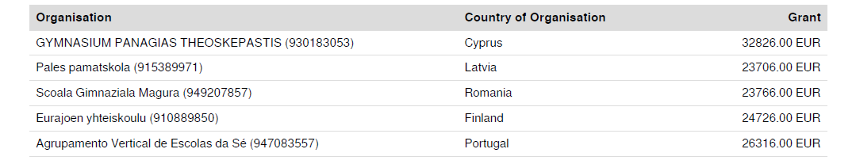
Enhancing ICT skills through exploring our European Cultural Identity
BUDGET

Slide 15
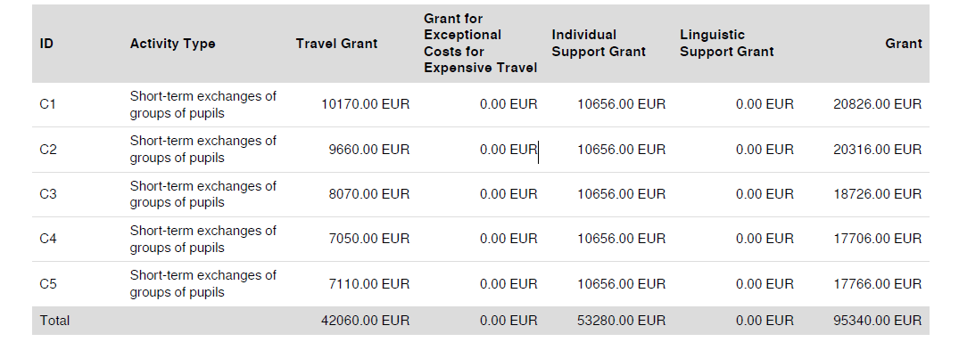
Enhancing ICT skills through exploring our European Cultural Identity
BUDGET

Slide 16
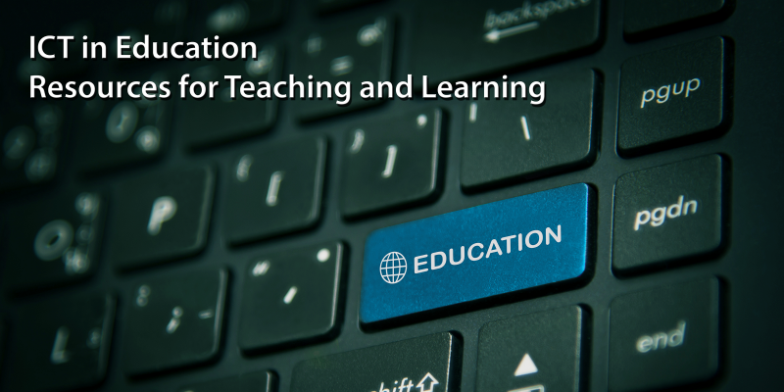

Enhancing ICT skills through exploring our European Cultural Identity

