Slide 1
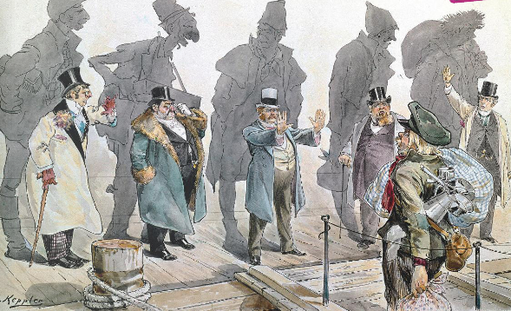
Caricature by Joseph Keppler in Puck, 11 January 1893

Slide 2
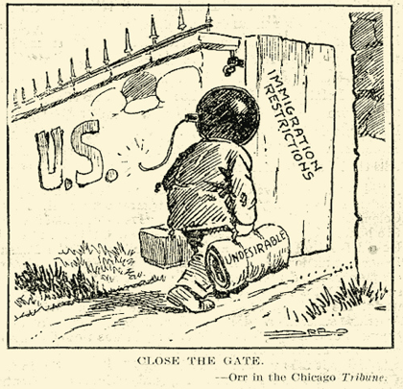
Some Responses (in the US) to Immigration
1) Quota Act of 1921 – limited immigration from each country to 3 % of total number who had immigrated in 1910 and set a yearly limit of 350,000
2) The 1924 quota reduced the quota to 2%, the base year changed from 1910 to 1890. This discriminated against eastern and southern Europeans because many had come to the US after 1890
3) National Origins Act of 1929 – the base year was moved to 1920, but total number was set at 150,000
Cartoon – Red Scare of 1919-1920

