Slide 1
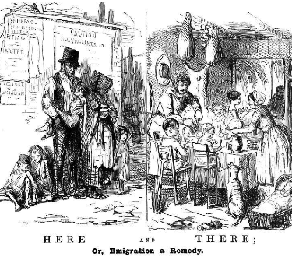
The Illustrated London News, 15th July 1848

