Slide 1
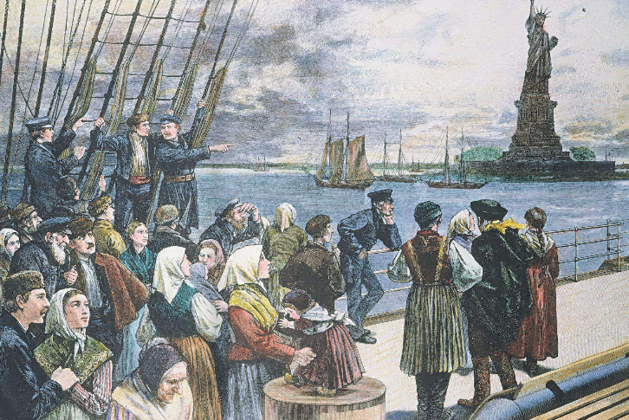
European Migration

Slide 2
Introduction
Between 1850 and 1914 more than 40 million people emigrated from Europe to the New World.
The USA took 2/3 of these emigrants with sizeable numbers also going to Canada, Australia and Latin America.
Broadly speaking, migrants left countries with a surplus of labour and low living standards and arrived in countries with a scarce supply of labour and higher living standards.

Slide 3
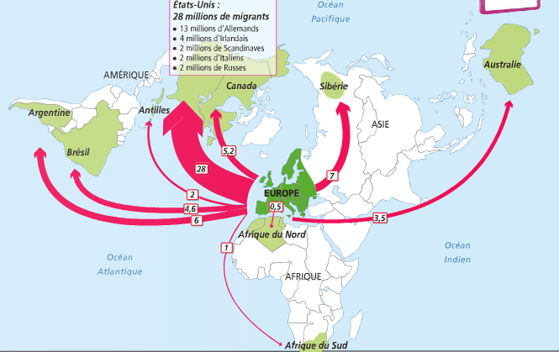
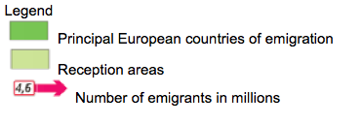
19th Century European Migration

