Slide 1
ROBO-course
In association with SeAMK

Slide 2
What is the ROBO-course?
It is a Course that teaches how to build and and program robot.
The courses idea is to program the robot to dance, and then have a competition against other robots.
The ROBO-course is a fun way to teach robotics and familiarize the students with the SeAMK University of Applied Sciences.
The course is sponsored by local technological companies

Slide 3
How was the robot built?
Robot arrived in pieces in a box
We read the instructions and connected all the electric motors
Next we assembled the frame of the robot and attached the motors to it
Step by step we built first the arms and then the legs and then we but the head in place
The last piece was the battery which was mounted on the back of the HUNO-robot

Slide 4
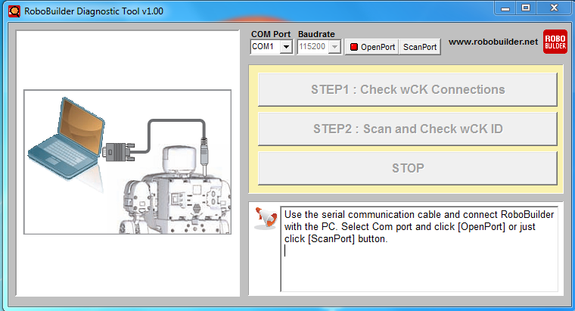
Programming the robot
The programming consists of a few steps
1. First you connect the robot to a computer with a usb wire
2. After thet you run the ROBO-builder diagnostics tool, which tests all of the motors in the robot

Slide 5
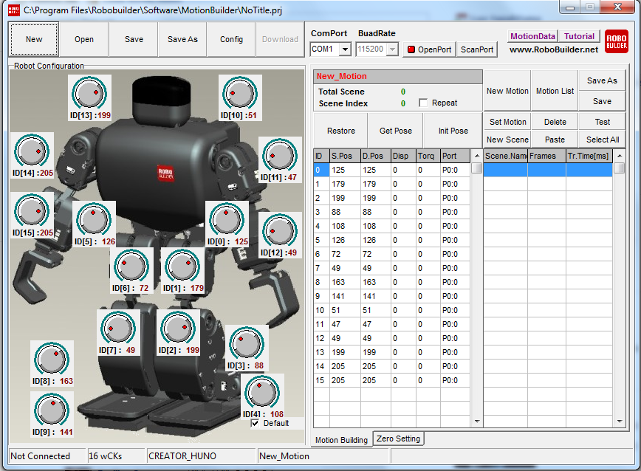
3. After all of the motors have been tested you move on to the Motionbuilder software, there you are able to program movements on to the robot

Slide 6
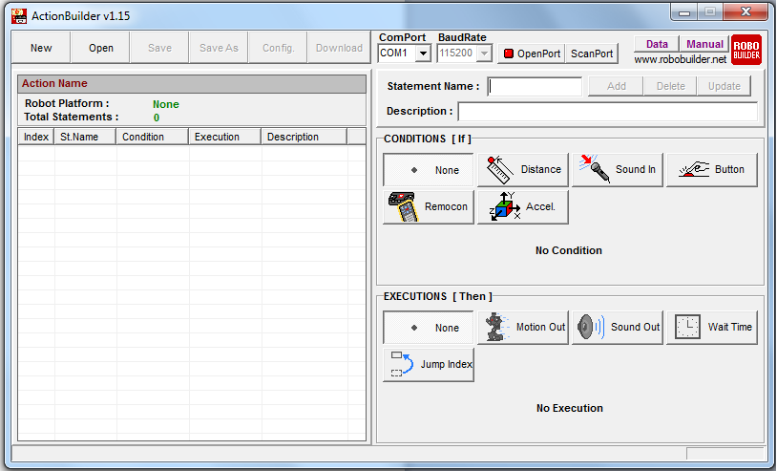
4. When you have programmed some movements you can make them into sequences with the Actionbuilder software

Slide 7
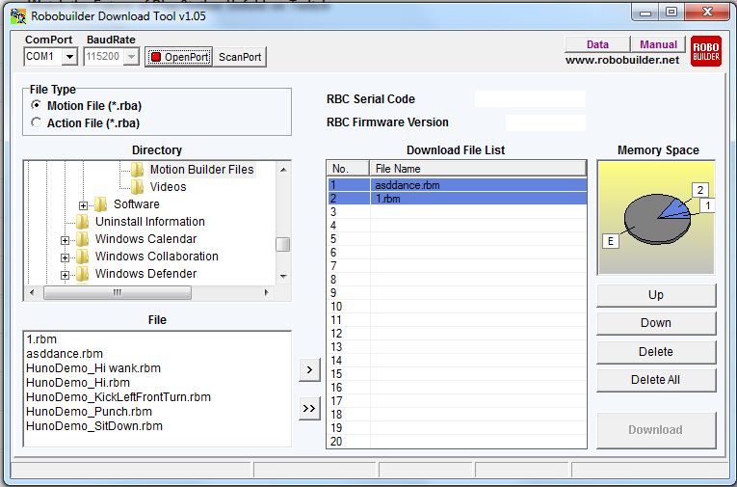
5. In the last step you move the movements and movement sequences on to the robot with the Robobuilder download tool

