Slide 1
Häjyt (knife-fighters)

Slide 2
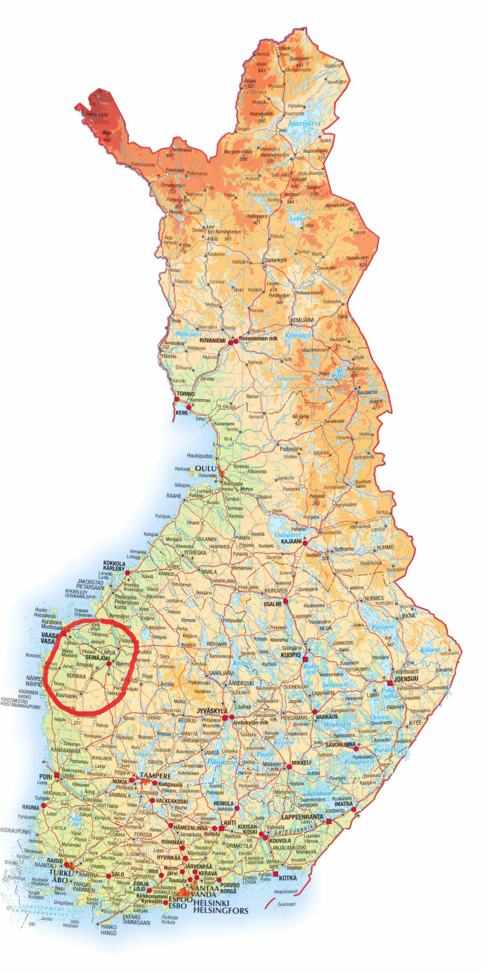
Who were they?
They were troublemakers and hellions from 19th century who fought a lot. For example they interrupted weddings and rode other peoples horses. Some of them also stole from people and murdered them.
The worst incident was near Lapuanjoki like in Kauhava, Ylihärmä, Alahärmä and in Laihia.

Slide 3
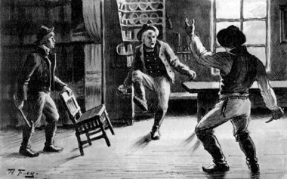
Why was ”Häjyt” created?
There is no main factor which would have explained the reason for this violent group, but maybe they wanted money and separate from people and fight against goverment.
Frustration was also one of the factors.

Slide 4
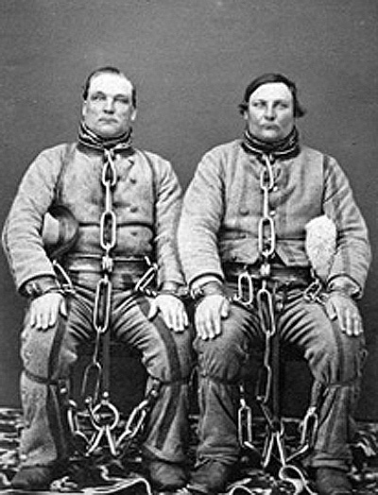
Antti Rannanjärvi and Antti Isotalo
These two guys were the leaders of this group. Rannanjärvi (left) was master and Isotalo (right) was second man.
Both of them were good at manipulating people.
There is a song about these two guys called ”Isontalon Antti ja Rannanjärvi”, many books and a movie.

Slide 5
A tale about ”Häjyt”
It is unclear, when Rannanjärvi and Isotalo found each other because häjyt were on the road all the time. A strong bond was created between those two guys and they felt sympathy. They marched together on roads and they were been afraid of outside their region also. Isotalo was more like a violent guy and Rannantalo wanted to gain more wealth. They moved like little kings with their subservients and they beat everyone who were against them. Even polismen could not resist them. Weddings were good places to knife-fighters because there was a lot of boose and fight places to raise their fame. If you had weddings, it would have been better to invite Rannanjärvi and Isotalo to party so they wouldn’t start revelling there.

Slide 6
The End of ”Häjyt”
This action came to end when Finnish senate forbid their organisation.
Rannanjärvi got whipped and he got a big fine. Isotalo was sentenced in prison for 12 years.

