Slide 1
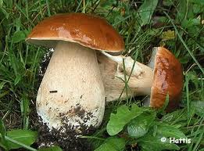
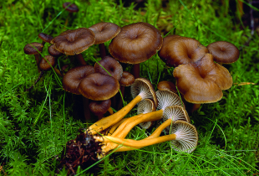
Edible mushrooms in Finland

Slide 2
General infromation of edible mushrooms
In Finland there are over 500 edible mushrooms
Mushroom picking is funny and useful hobby
It´s every mans right to pick up mushrooms
Season of mushroom picking is from late July to November
Mushrooms are classified delicious, excellent, good, passable and bad ones
There are about 14 delicious mushrooms in Finland
Excellent mushrooms are 77 sorts

Slide 3
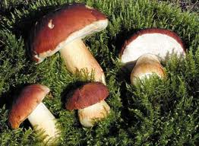
Boletus edulis
In Finland we call it Herkkutatti
Is one of the valued mushrooms
is sold a lot in Europe
is picked from summer to autumn
It´s colour is brown or light brown and it has a big hat

Slide 4
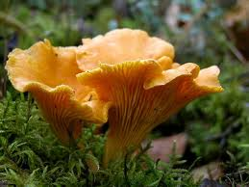
Cantharellus cibarius
It´s called Kanttarelli in Finland
Cantharellus cibarius is picked from summer to long way autumn
You can recognize it from the egg yellow color
It smells really nice too

Slide 5
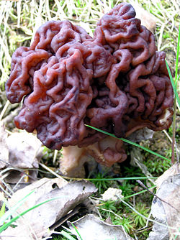
Gyromitra esculenta
We called it Korvasieni in finnish
It is really poisonous mushroom
You can eat it if you cook it first
It is picked up from April to June
It’s the only mushroom which
can be picked up in spring
It is recognized from chocolate
brown colour

Slide 6
Mushroom video
Very passionate mushroom picking
http://www.youtube.com/watch?v=sqrWtWAQ81o

