Slide 1
Mycorrhiza

Slide 2
Mycorrhiza in general
Together plants and mycelium form a mycorrhiza.
It helps the plant to get nutrients and water better from the ground, especially phosphorus.
About 95% of plants have mycorrhiza in their roots.

Slide 3
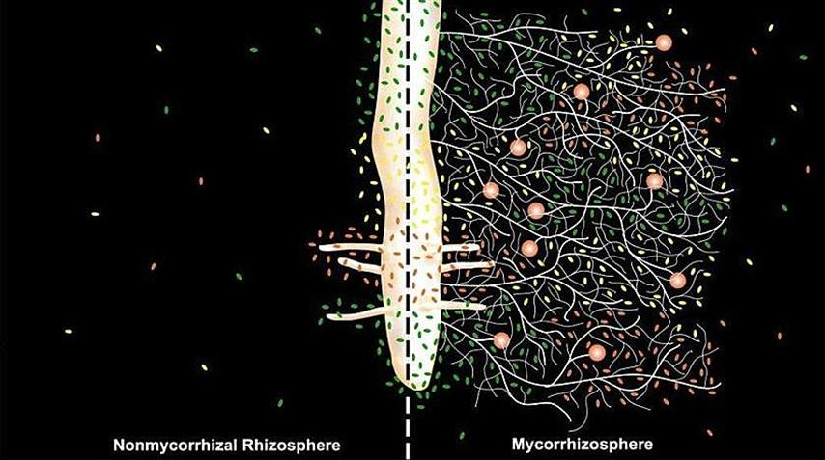
Nonmycorrhizal vs. Mycorrhizal

Slide 4
More about mycorrhiza
Typical example of mutualism. Fungus get glucosis and plant water and nutrients.
Mycorrhiza protects it’s plant from diseases and drought.
The plants with mycorrhiza are usually greener and healthier than the plants without it.
Mycorrhiza

